Slide 1
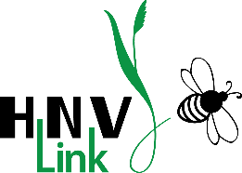
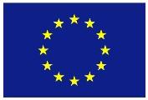
High Nature Value farmland
Examples across Europe: part 1 of 3
Irina Herzon, Traci Birge, Riina Koivuranta, Milka Keinänen
This presentation is an output of HNV-Link project - www.hnvlink-eu
THIS PROJECT HAS RECEIVED FUNDING FROM THE EUROPEAN UNION HORIZON 2020
RESEARCH AND INNOVATION PROGRAMME UNDER GRANT AGREEMENT NO. 696391

Slide 2
Notes for instructors and users
This presentation is part of the package of Education Materials on the topic of High Nature Farmland. It is an output of the Horizon 2020-funded project HNV-Link and is an Open Source material under CC BY-NC-SA. You may freely use, for non-commercial purposes only, any elements of it or as a whole, also modifying as fit, as long as you cite the project and its funding. Observe copyrights for images: all images are by HNV-Link unless otherwise specified.
The presentation contains minimum or no animation/special effects. Instructors may wish to add such effects according to their preferences.
Notes:
Attribution-NonCommercial-ShareAlike CC BY-NC-SA https://creativecommons.org/licenses/
"This license lets others remix, tweak, and build upon your work non-commercially, and although their new works must also acknowledge you and be non-commercial, they don’t have to license their derivative works on the same terms."
This presentation contains minimum or no animation/special effects. Instructors may wish to add such effects according to their audience and teaching style.

Slide 3
Learning objectives
To appreciate a diversity of High Nature Value farmland types across Europe and outside
To learn of the general characteristics of HNV farmland and farming systems
To familiarise oneself with various public values of HNV farmland

Slide 4
Content
Concept of High Nature Value (HNV) farmland
Examples from Europe
    Spain and Portugal
    Croatia
    Romania
    France
    Germany
    Ireland
    Finland
Examples outside Europe
Notes:
There are many more examples that can be accommodated in one lecture. The instructor can decide which ones to choose: contrasting parts of Europe or for representing a specific region.
IMPORTANT: High nature value farming is a European concept, but this does not mean that HNV-farming systems or farmlands are exclusive to Europe, as non-European HNV-farming examples show.

Slide 5
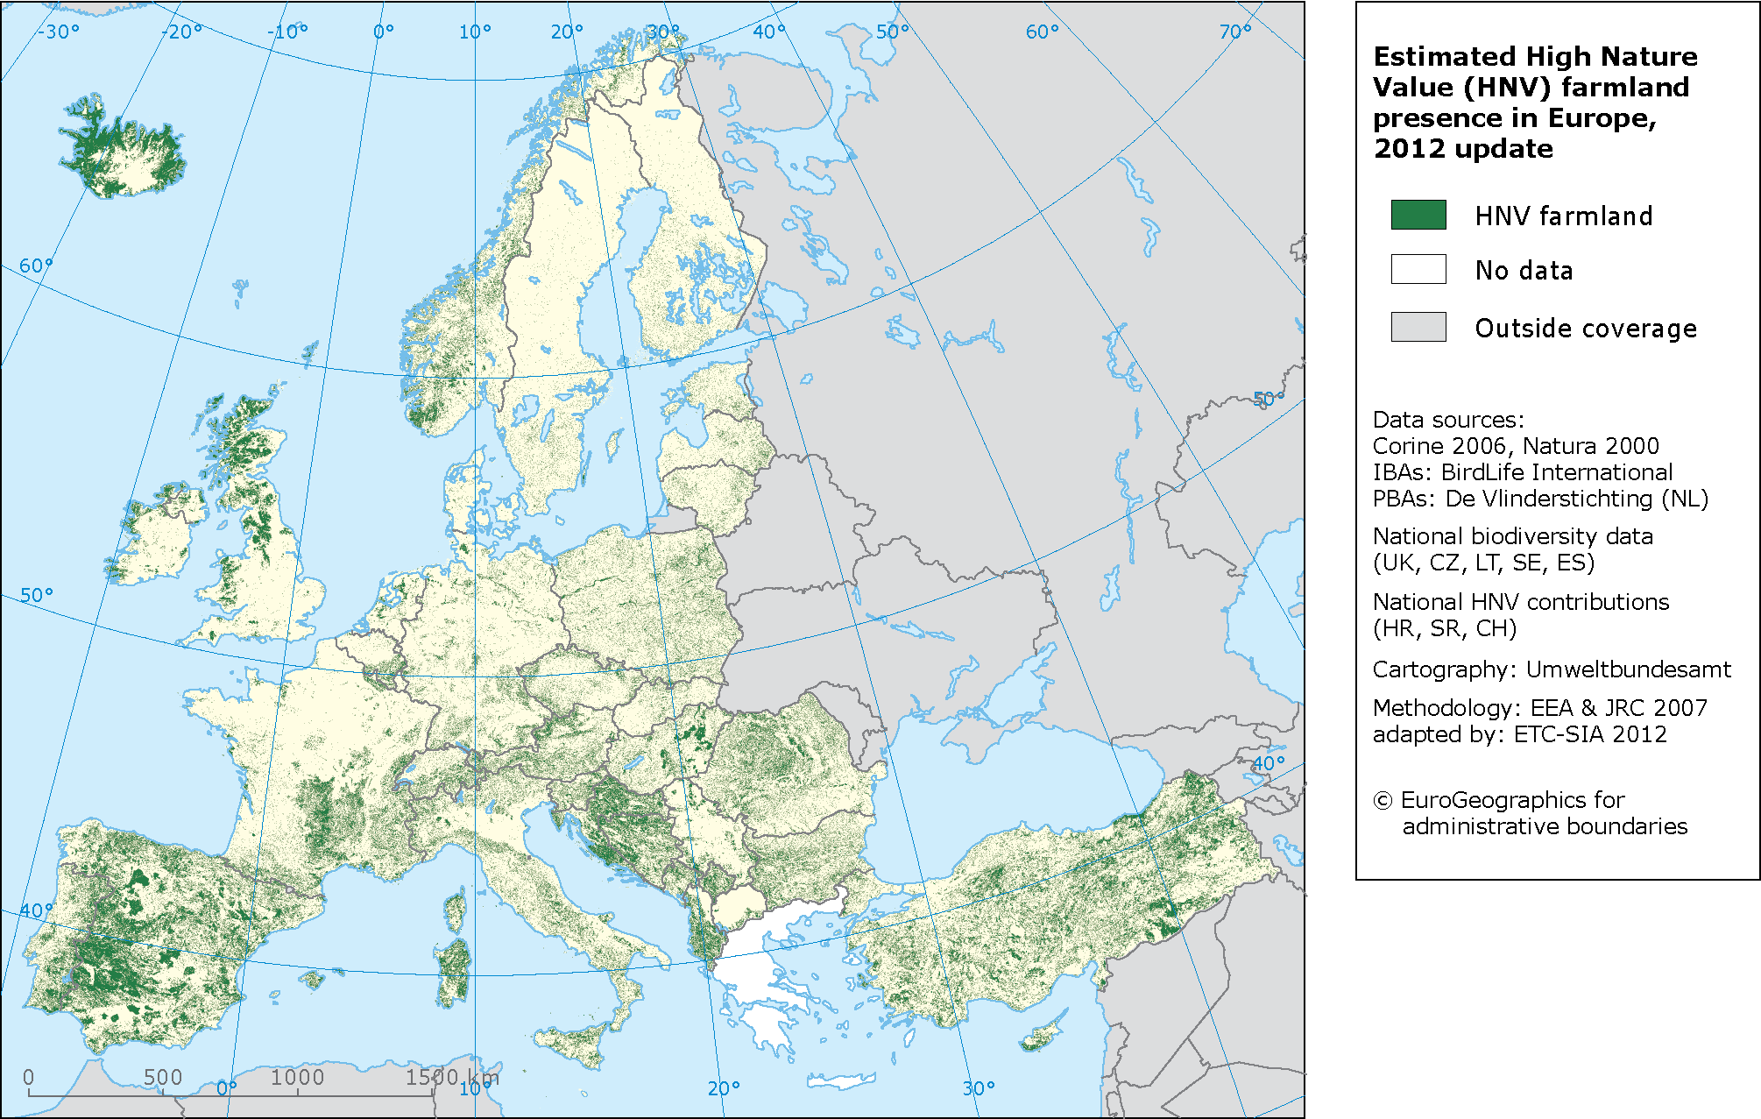
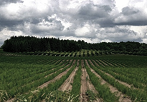
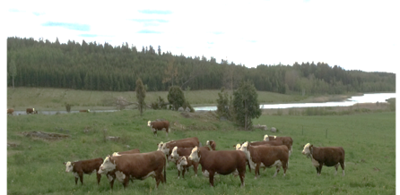
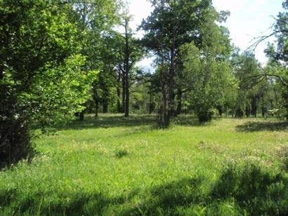
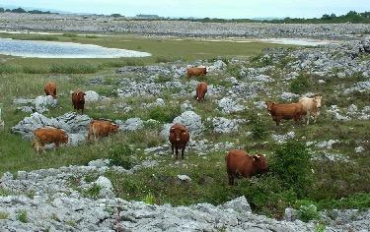
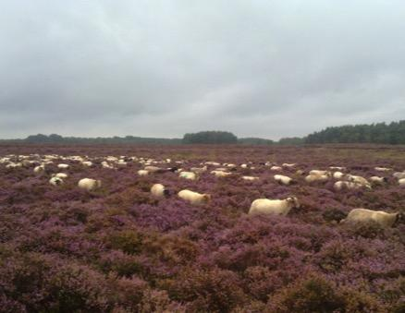
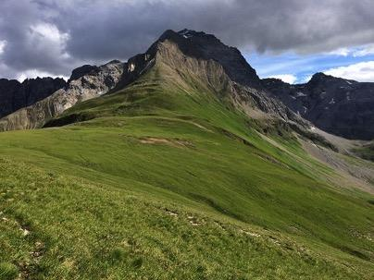
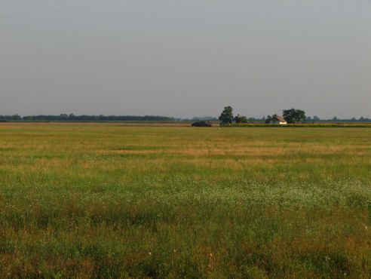
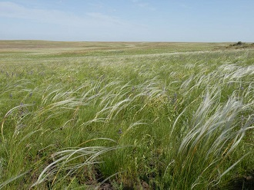
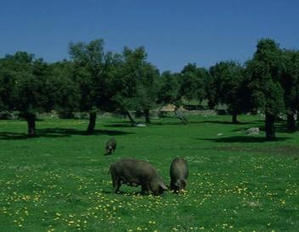
Intensive cropland
T. Birge
Morri362 CC BY-SA 3.0,
I. Herzon
Semi-natural vegetation & mosaic landscape
B.Dunford
T. Spek
A. Indermaur
C.Valdecantos/SEHEAM-MMA
A.Kovac
Natural
Ghilarovus -CC BY-SA 4.0
Notes:
‹#›
Note to presenter: start with the slide of monocrop on top right and let the other slides appear one after another, while you speak of diversity.
Agricultural landscape is not only about vast fields of monoculture. All across Europe, and indeed the world, there are areas used for production that lie somewhere along the continuum from intensively farmed crop fields to natural systems. Some unique habitats and whole communities have formed over the millennia of agricultural activities that are imbedded into varied natural environments: from pastures on calcareous bedrock of West Island to Pannonian steppe in Hungary called puszta, from wooded hay meadows and coastal grasslands of Northern Europe to Iberian agroforestry systems called dehesas, from heather moorlands along the Atlantic coast to Alpine meadows. There is a corresponding diversity of farming systems that evolved to function within these environments. They are rich in diversity, both agrobiodiversity and that of wildlife that is adapted to agriculture. In fact, in Europe many of the most species-rich habitats belong to such agricultural lands. Thus, the concept of High Nature Value (HNV) farmland was coined.

Slide 6
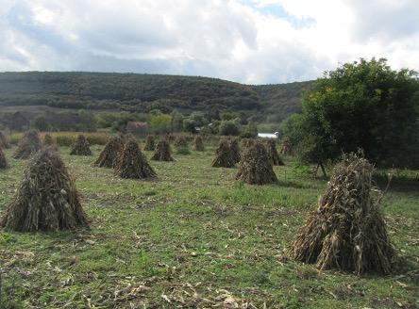
HIGH NATURE VALUE FARMLAND
T. Birge
Morri362 CC BY-SA 3.0,
”Areas in Europe where agriculture is a major (usually the dominant) land use and where agriculture sustains or is associated with either a high species and habitat diversity, or the presence of species of European conservation concern, or both”(Andersen et al. 2003)
I.Herzon
B.Dunford
HNV-Link
T. Spek
C.Valdecantos/SEHEAM-MMA
A.Kovac
Ghilarovus - CC BY-SA 4.0
Notes:
‹#›
It has been defined as…
Andersen, E., Baldock, D., Bennett, H., Beaufoy, G., Bignal, E., Bouwer, F., Elbersen, B.,
Eiden, G., Giodeschalk, F., Jones, G., McCracken, D., Nieuwenhuizen, W., Eupen, M.v., Hennekes, S., Zervas, G., 2003. Developing a High Nature Value Farming Area Indicator: Final Report, pp. 75.

Slide 7
HNV farmland concept
Developed in the early 1990s to encompass the rich diversity present on much of Europe's farmlands and ensure its conservation.
“The Nature of Farming” by Beaufoy et al. (1994) - benchmark for the identification and mapping of HNV farmland
Andersen et al. (2003) - report for the European Environmental Agency, 1st European assessment of farmlands with High Nature Value
Notes:
The the concept of HNVf was developed to encompass the diversity above and to ensure its conservation across Europe, by identifying its characteristics and distribution, assessing changes and threats, making predictions for the future and bringing this to the attention of decision-makers and researchers.
The Nature of Farming by Beaufoy et al. (1994), established an essential benchmark for the identification and mapping of HNVf, not only by compiling information regarding the main characteristics of low intensity farming systems, and identifying potential indicators, but also by presenting preliminary spatially-explicit mapping of such landscapes for selected countries.
Beaufoy, G., Baldock, D., Clarke, J., 1994. The Nature of Farming - Low Intensity Farming Systems in Nine European Countries. IEEP, London, pp. 68. AVAILABLE ONLINE FOR FREE
Andersen, E., Baldock, D., Bennett, H., Beaufoy, G., Bignal, E., Bouwer, F., Elbersen, B., Eiden, G., Giodeschalk, F., Jones, G., McCracken, D., Nieuwenhuizen, W., Eupen, M.v., Hennekes, S., Zervas, G., 2003. Developing a High Nature Value Farming Area Indicator: Final Report, pp. 75.

Slide 8
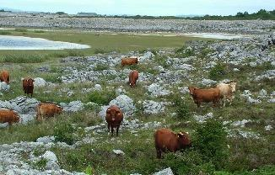
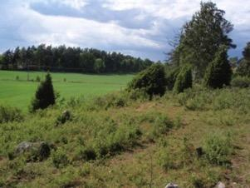
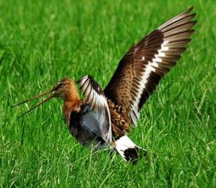
Types of High Nature Value Farmland:
Type 1:
100% semi-natural
100
Type 2:
Mix of semi-natural and crops
Semi-natural
vegetation (%)
Type 3:
More intensive crops and grass, used by certain species of conservation concern
Not HNV
0
Intensity of use (of land, livestock, nitrogen, biocides)
Images: HNV-Link (top and center) and Berend Jan Stijf CC BY-SA 3.0 (bottom)
Notes:
Type 1: Farmland with a high proportion of semi-natural vegetation.
Semi-natural refers to areas that are kept in an early successional state through human-managed activities like grazing and fodder collection, but where the land isn’t cultivated or sown. Many HNV-farming systems are based on grazing of semi-natural meadows and woodlands. Often, the semi-natural meadows become, over time, overgrown with tall grasses and herbaceous plants, shrubs, and trees if grazing or other management is discontinued.
Type 2: Farmland with a mosaic of low intensity agriculture and natural and structural elements, such as field margins, hedgerows, stone walls, patches of woodland or scrub, small rivers etc.
Mix of semi-natural and crops can also include some agro-forestry and permaculture practices.
Type 3: Farmland supporting rare species or a high proportion of European or world populations.
Type 1 and Type 2 support species of conservation concern, but Type 3 also includes more intensive production, for example non-permanent and improved pastures and grasslands, that provide habitat for species of conservation concern.

Slide 9
Examples from Europe
For each country:
Extent of HNV farmland
HNV farming systems
In focus: examples on important issues
Biodiversity
Other values
Notes:
Each example follows this format.

Slide 10
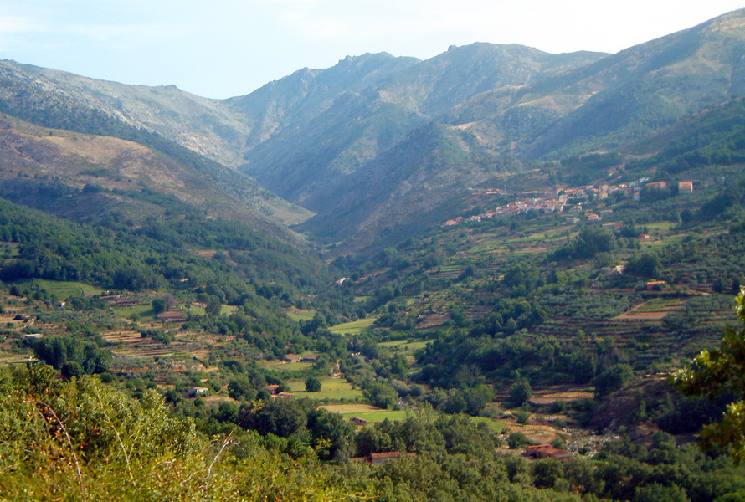
Spain & Portugal

Slide 11
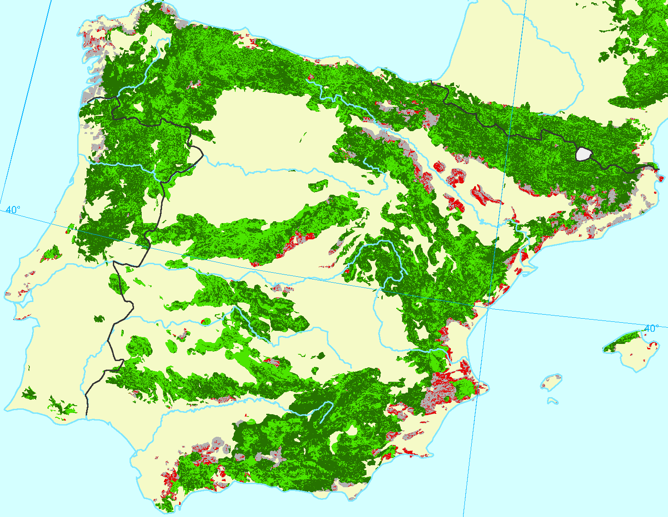
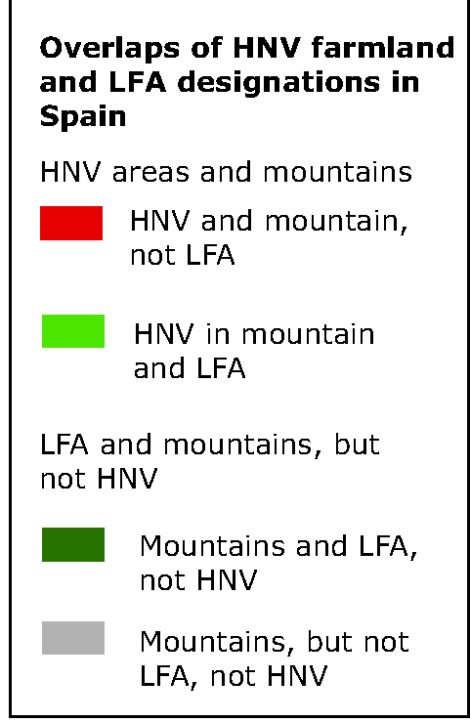
Extent of HNV farmland
Between 25,000,000 ha and 14,500,000 ha of HNV farmlands
The highest in Europe
EEA, Map 7.9_Mountains.eps.zoom.png
https://www.eea.europa.eu/search?sort_on=&b_start:int=230&Creator=alec
Notes:
Spain is one of the largest and most bio-geographically diverse countries in Europe. Most of the country has a Mediterranean climate. http://www.efncp.org/projects/projects-spain-navarra/
Agricultural statistics:
Spain: Land use: 47.4% agricultural area, 36.1% forest and scrub, 10.3% incidental poor grazing and unproductive land, 6% other. Utilized agricultural area: 24 million ha: arable crops & fallows 52%, permanent grassland and pasture 28%, permanent crops 20%, common lands 7.5 million ha. (Beaufoy et al. 2012 in Oppermann et al. 2012).
Spain’s land use is characterized by extremes, with large areas under very low-intensity use and other areas under very high pressure: A significant portion of the arable land area is recorded as fallow or out of use. This reflects the necessity of fallowing in the low-yielding arable farmland. Main permanent crops are olives, fruit and nut trees, and vines. Irrigated area covers about 20% of total arable and permanent crop area, but the economic value of this area is very significant. Over exploitation of water resources is a serious concern.
Portugal: The land area of slightly more than 9.2 million hectares was classified as follows (in thousands of hectares): 2,755 arable land and permanent crops (including 710 in permanent crops), 530 permanent pasture, 3,640 forest and woodland, and 2,270 other land. It's climatic and topographic conditions allow for an extremely large number of crops, including olives, figs, citrus, mushrooms, sunflower, tomatoes, cereals, at even bananas and pineapple (on islands). It is one of the world's largest producers of wine and cork
HNV Farming:
The map is from European Environment Agency and shows HNV farming and EU’s Least Favoured Area designations in mountainous areas in Spain and Portugal.
HNV farming in Spain consists of extensive dry-land pasturing, agroforestry, and arable systems with great proportion fallow periods and livestock diversity; seasonal transhumance.
Semi-natural pastures on limestone are found in the mountains. Dehesa / montado is an agro-sylvo-pastoral system in Spain and Portugal. Dryland arable farming includes extensive arable systems with long fallow periods and traditional orchards of olives, almonds and other fruit and nut trees. Pseudosteppes are farmed in the interior. Traditional low input olive production is found mainly on small holdings.
References:
Beaufoy, G., Caballero, R., Oñate, J.J. Spain. In: Oppermann, R., Beaufoy, G., Jones, G. (Eds) 2012. High Nature Value Farming in Europe: 35 European countries – experiences and perspectives. c. Verlag gegionalkultur, Germany. 544pp. ISBN: 978-89735-657-3
Semi-natural pastures http://www.high-nature-value-farming.eu/panorama/liebana/
Cereal steppes (Rio Jarama & Henares) http://www.high-nature-value-farming.eu/panorama/cereal-steppes-rio-jarama-henares/
Olive farming http://www.efncp.org/projects/olive-farming/
Example: Navarra http://www.efncp.org/projects/projects-spain-navarra/
Map: European Environment Agency (EEA) Map 7.9–Mountains.eps.zoom.png https://www.eea.europa.eu/data-and-maps/figures/overlaps-of-high-nature-value/overlaps-of-high-nature-value/Map%207.9_Mountains.eps.zoom.png

Slide 12
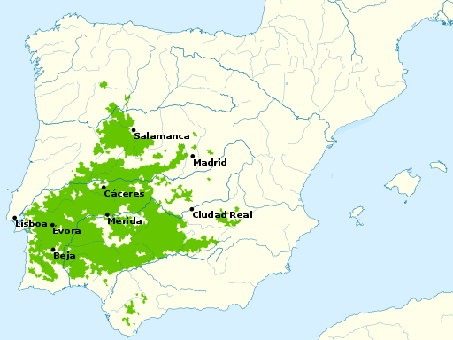
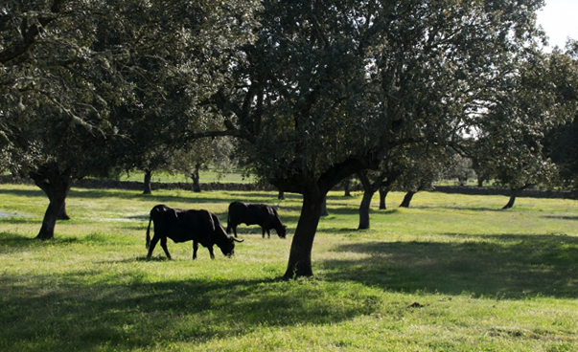
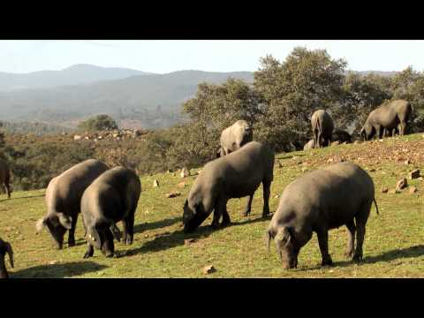
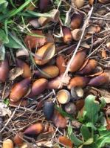
In Focus: Montados and Dehesas
Multifunctional agrosilvopastoral systems of Quercus forest with pasture or shrub found in Portugal (montado) and Spain (dehesa).
by El Mono Español [CC BY-SA 4.0]
HNV-Link
Tree production
Acorns
Cork
Fuel wood and biomass
Other
NON tree production
Grass (shrubs)
➔ pasture
Mushrooms
Crops
Others
https://www.youtube.com/watch?v=sFIF8kkexyQ
Notes:
The Spanish dehesa constitutes an open woodland forest agroecosystem created and maintained by humans and their livestock. The main products are cork and meat. Dehesas and montados produce a wide range of other individual minor private commercial products such as pine nuts and chestnuts, honey, wool, medicinal and edible herbs, mushrooms. New commercial initiatives in recent years include new acorn-derived products such as spirit drinks and beers, ice-creams, heart-healthy oils, gluten-free flavours, and natural tannins (Domingo Santos & Reyes: Dehesas presentation, see http://hnvlink.eu ).
Dehesas and montados are traditional Mediterranean silvopastoral systems linking production and nature conservation. the are a result of long adaptation and co-evolution to the specific weather and fertility conditions, including hot, dry summers and shallow soil of low fertility and low low water retention capability.
Dehesa farming uses a strategy of efficiency and diversification of structures and products with the aim of taking advantage of every natural resource with a minimum input of energy and materials.
“Dehesa” in Spain and a similar agroforestry system called “montado” in Portugal cover up to 3.5 million hectares of the south-western Iberian Peninsula, where they are the main land use systems (Opermmann et al. 2012) and form one of the largest agroforestry system in Europe (Eichhorn et al. 2006).
References:
Eichhorn, M.P. et al. 2006. Silvoarable systems in Europe- past, present and future prospects. Agroforestry Systems 67:29-50.
HNV-Link hosts a slide presentation by Domingo Santos & Reyes on Dehesas. Please see http://hnvlink.eu
Embedded video https://youtu.be/sFIF8kkexyQ

Slide 13
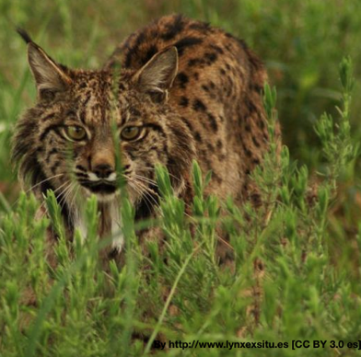
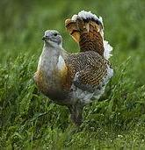
Biodiversity
Many dry grassland types - Included in Habitat Directive
Dehesa & montado
30% of Iberian peninsula vascular plant species
More diverse communities of butterflies and passerine birds than neighboring denser woodland, grassland, or arable land
Important habitat for many red-listed species
Pseudo-steppes
Highly diverse steppeland bird community
© Francesco Veronesi from Italy (Great Bustard - Hortobagy - Hungary_CS4E3968) [CC BY-SA 2.0], via Wikimedia Commons
Great Bustard
Otis tarda
Iberian lynx
Lynx pardinus
Notes:
Spanish farmland has high associations with species that have disappeared from the more intensively farmed regions of Europe. Such species include: marsh fritillary butterfly, birds such as the great and little bustards, wolf and brown bear. Further, the Iberian lynx, the world's most endangered feline, is dependent dehesas for hunting territory.
Dehesa farming system is in the EU Habitat Directive. About 30% of the vascular plant species of the Iberian peninsula are found in cork oak and holm oak stands that also support more diverse communities of butterflies and passerine birds than neighboring denser woodland, grassland, or arable land (Oppermann et al 2012, p. 74).
The Agforward Project (Agforward 2016) summarises some of the biodivesrity values of dehesas based on national surveys. For example, with vascular plants, research has described 135 species in 0.1 ha in holm oak dehesas or 60–100 species per 0.1 ha in cork oak stands (Marañón 1986). Values of species richness of this and other taxa are much higher than those of other European man-made habitats. Also, diversity values of plants, birds and butterflies have been shown to be similar, or even higher, to those found in natural or semi-natural habitats located nearby (Díaz et al. 2003). As the only example available of a comprehensive biodiversity survey is from a 220 ha montado (portuguese word for dehesa) farm where, 264 fungi, 75 bryophytes, 304 vascular plants and 121 vertebrate species were recorded (Santos-Reis and Correia 1999). (Source: Alejano Reyes and Juan M. Domingo-Santos (University of Huelva, Spain; juan.domingo@uhu.es, see http://hnvlink.eu for slide presentation)
Dehesa is the habitat of endangered or protected species such as Mediterranean animals, such as the Iberian lynx (Lynx pardinus) (formerly inhabiting the whole dehesa area and nowadays reduced to much smaller sites, and regarded among the most endangered mammals globally), the wolf, the black stork (Ciconia nigra), the otter (Lutra lutra), the genet (Genetta genetta) and the dormouse (Muscardinus avellanarius). This area also shelters numerous species of birds of prey, such as the Cinereous vulture (Aegypius monachus), the Spanish imperial eagle (Aquila adalberti), the short-toed eagle (Circaetus gallicus), the sparrowhawk (Accipiter nisus), the peregrine falcon (Falco peregrinus). Many bird species, notably common cranes (Grus grus L.), use dehesas as their preferred winter habitat (Source: Alejano Reyes and Juan M. Domingo-Santos (University of Huelva, Spain; juan.domingo@uhu.es, see http://HNVlink.eu for slide presentation)
Dry steppes are characterized by high species richness and many are are designated in the Habitat Directive as a major habitat for biodiversity conservation within the EU. Iberian Peninsula hosts by far the largest area of these in the EU.
Pseudo-steppe resembles true steppes still in existence in Russia and Asia. They mimic conditions needed for species of steppic origin. Since natural steppes are all gone from Europe, many of species have no other habitat left that such man-maintained production areas. Among flagship species is Great Bustard Otis tarda. (More on pseudo steppes in Spain: http://www.high-nature-value-farming.eu/panorama/cereal-steppes-rio-jarama-henares/ )
European Commission. 2008. Management of Natura 2000 habitats: Pseudo-steppe with grasses and annuals (Thero-Brachypodietea). Technical Report 2008 13/24. http://ec.europa.eu/environment/nature/natura2000/management/habitats/pdf/6220_Pseudo_steppe.pdf
Nature in Spain is threatened by the decline of low-intensity farming, with a parallel process of abandonment on poorer land and intensification on better land. Protection of the biodiversity "hotspots" has progressed to some extent, but steady loss of HNV farming continues. EU legislation has had positive effect on nature conservation in farmlands, but more could be done by national and regional governments to use agri-environment incentives to support HNV farming systems http://www.efncp.org/projects/projects-spain-navarra/ . Abandonment is accelerating and afforestation has added to the losses in some regions. Major infrastructure projects (roads, dams, building development) have destroyed and fragmented some highly valued landscapes. Due to high fuel load in ungrazed and afforested areas, wildfires are a major environmental issue.
References: Beaufoy, G., Caballero, R., Oñate, J.J. Spain. In: Oppermann, R., Beaufoy, G., Jones, G. (Eds) 2012. High Nature Value Farming in Europe: 35 European countries – experiences and perspectives. c. Verlag gegionalkultur, Germany. 544pp. ISBN: 978-89735-657-3
Oppermann, R., Beaufoy, G., Jones, G. (Eds) 2012. High Nature Value Farming in Europe: 35 European countries – experiences and perspectives. c. Verlag gegionalkultur, Germany. 544pp. ISBN: 978-89735-657-3
European Commission. 2008. Management of Natura 2000 habitats: Pseudo-steppe with grasses and annuals (Thero-Brachypodietea). Technical Report 2008 13/24. http://ec.europa.eu/environment/nature/natura2000/management/habitats/pdf/6220_Pseudo_steppe.pdf
European Forum on Nature Conservation and Pastoralism http://www.efncp.org/projects/projects-spain-navarra/
Domingo Santos & Reyes. slide presentation on Dehesas: http://hnvlink.eu
Photo: Iberian lynx https://upload.wikimedia.org/wikipedia/commons/9/94/Iberian_Lynx_fandango01.jpg By http://www.lynxexsitu.es [CC BY 3.0 es (https://creativecommons.org/licenses/by/3.0/es/deed.en)], via Wikimedia Commons

Slide 14
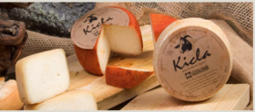
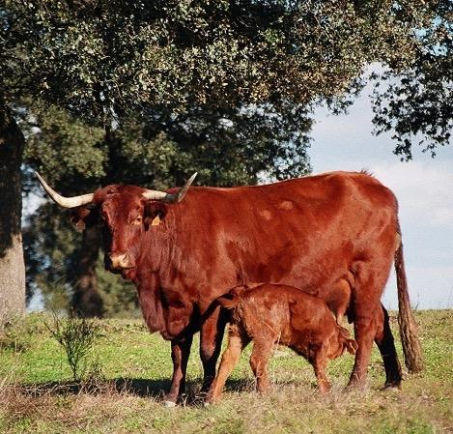
Other values
Photo: HNV-Link Baseline assesment for La Vera, Spain
Multifunctional landscapes
High quality HNV farmland livestock products
Conservation of native breeds
Production well adapted to natural conditions and resource-efficient
Wildfire risk reduction
          fire break grazing programmes pay farmers to concentrate grazing on fire break areas.
Photo: Indigenous cattle, Spain.
Alejano Reyes/ Juan M. Domingo Santos,
Notes:
High quality HNV livestock products: e.g. goat and sheep cheese, ham, beef
Picture top: Cheese from HNV-Link learning area La Vera, Extremadura, Spain http://www.hnvlink.eu/download/SpainBaselineAssessment.pdf
Conservation of native breeds
Picture cows: Indigenous breed by Alejano Reyes and Juan M. Domingo-Santos
Wildfire risk reduction: an important service provided by extensive grazing
Wildfire prevention (http://www.efncp.org/projects/projects-spain-navarra/wildfire-prevention/)
Traditional systems, such as dehesa, are centuries-old, economic solutions adapted for the restrictive environment. The dehesa historically exhibits a successful integration of a rural economy with nature conservation and biodiversity preservation. The sustainability and efficiency of the agrosilvopastoral system has been demonstrated by its ecological stability for centuries.

Slide 15
Sources & experts
http://www.hnvlink.eu/learning-areas/la-vera-extremadura-spain/
http://www.efncp.org/projects/projects-spain-navarra/
https://www.agforward.eu/index.php/en/dehesa-farms-in-spain.html
Agforward. 2016. System report: Dehesa Iberian, Spain. Available et https://www.agforward.eu
Angueita, G. The dehesas and cork production today, and its alliance with FSC. http://ga2014.fsc.org/opinion-analysis-74.the-dehesas-and-cork-production-today-and-its-alliance-with-fsc
Eichhorn, M. P., Paris, P. Herzog, F., Incoll, L. D., Liagre F., Mantzanas, K., Mayus, M., Moreno, G., Papanastasis, V. P., Pilbeam, D. J., Pisanelli, A., Dupraz, C. 2006. Silvoarable Systems in Europe – Past, Present and Future Prospects. Agroforestry Systems 67, 29–50.

Slide 16
Sources & experts
Alejano, R., Vázquez-Piqué, et al. 2013. Dehesas: Open woodland forests of Quercus in Southwestern Spain. In Chuteira, C.A. y Grao, A.B. (Eds.), Oak: Ecology, types and management. Nova Science Publishers; Hauppauge, New York. pp.87-117.
Ferraz de Oliveira, M.I. & Pinto Correia, T. 2016. Management of Montados and Dehesas for High Nature Value: An interdisciplinary pathway. Agroforestry Systems Special Issue 90(1)
https://link.springer.com/journal/10457/90/1/page/1
Rodríguez-Estévez, V. et al. Consumption of Acorns by Finishing Iberian Pigs and Their Function in the Conservation of the Dehesa Agroecosystem. Available from www.intechopen.come/books

Slide 17
Sources & experts
The Iberian pig in the dehesa: https://www.youtube.com/watch?v=sFIF8kkexyQ
Dehesa de Extremadura - https://www.youtube.com/watch?v=C5B1gaXv_FE (in Spanish)
La dehesa indómita - https://www.youtube.com/watch?v=OftykBCgZfo (in Spanish)
Domingo Santos, J.M. & Reyes, A. A presentation on Dehesas:
www.hnvlink.eu/education
Experts:
Guy Beaufoy, EFNCP & Pedro M. Herrera, Entretantos, Spain; Maria Isabel Ferraz de Oliveira, University of Evora, Portugal

Slide 18
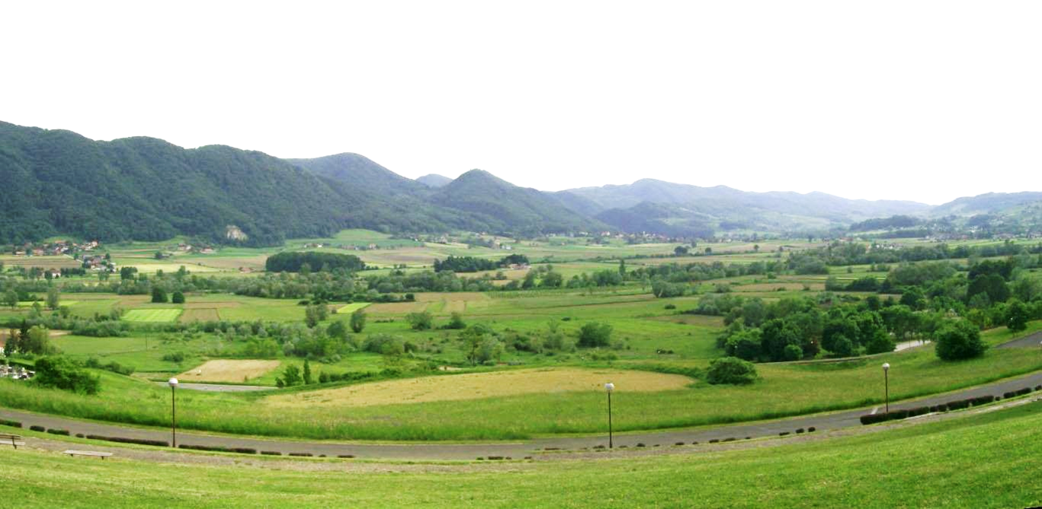
Croatia
By Suradnik13 [CC BY-SA 4.0]
Notes:
Photo: By Suradnik13 [CC BY-SA 4.0 (https://creativecommons.org/licenses/by-sa/4.0)], from Wikimedia Commons https://commons.wikimedia.org/wiki/File:Kumrovec_pogled_dolina_Sutle.jpg

Slide 19
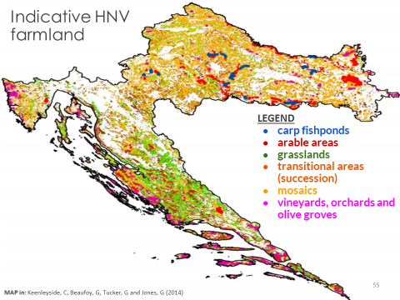
Indicative HNV farmland
MAP in: Keenleyside, C, Beaufoy, G, Tucker, G and Jones, G (2014)
Notes:
Croatia is located at the meeting point of the Mediterranean, the Alps and the Pannonian plain and has great geographic, natural, and agricultural diversity. The country has two distinct climatic regions: continental and Mediterranean. The geography ranges from the Danube floodplain and rolling hills around the capital to the rocky mountains of the Dinaric Alps stretching along the Adriatic coast. The coastline includes more than 1,200 islands, islets and reefs.
Agricultural statistics: 22.9% of the country land area is agricultural area. UAA is 1.3 million ha, of which 863,023 ha are arable. Family farming is the heart of agricultural production in Croatia, especially for HNV farming. It covers 80% of utilised agricultural area, and accounts for 95% of the total workforce in agriculture.
(SOURCE Todorović, S.K., 2012 Croatia. In: Oppermann, R., Beaufoy, G., Jones, G. (Eds) 2012. High Nature Value Farming in Europe: 35 European countries – experiences and perspectives. c. Verlag gegionalkultur, Germany. 544pp. ISBN: 978-89735-657-3)
MAP Keenleyside, C, Beaufoy, G, Tucker, G and Jones, G (2014) High Nature Value farming throughout EU-27 and its financial support under the CAP. Report prepared for DG Environment, contract ENV B.1/ETU/2012/0035. Institute for European Environmental Policy: London. Annex 1 (maps) available here: http://www.efncp.org/download/HNV_and_CAP_Annex_1_maps_.pdf

Slide 20
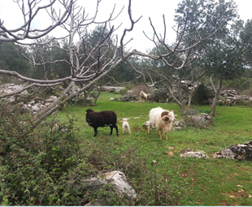
HNV farmland
Limited data - mapping is in early stages
Estimated 690,000 ha HNVf in Natura 2000 areas. Of this:
  c. 39% Permanent pasture and common grazing
  c. 57% Mosaic landscapes with arable, traditional orchards, vineyards and gardens; also agroforestry
HNVf relates to contiguous small holdings
  Low-input, traditional practices are widespread
  4 out of 5 farms in Croatia have some livestock (average 5.3 LU)
HNV-Link
Abandonment: Over half of grasslands in mountainous and coastal areas (likely HNVf) are were abandoned due to resettlement and landmine contamination.
Notes:
HNV farming is widely distributed throughout the country, although mapping of HNV areas in Croatia is in early stages still.
Existing data suggests that there are large areas of HNV farmland falling into all three HNV category types:
Type 1: Extensive grassland – permanent pasture and common grazing cover approximately 39% of the agricultural area of the proposed Natura 2000 network.
Type 2: Mosaic landscapes of arable plots, vegetable garden, traditional orchards and vineyards are the most common HNVf type (57% of the agricultural land in the proposed Natura 2000 network). In 2010, 4 out of 5 farms had livestock
Type 3: Croatian arable land hosts species of conservation concern. (SOURCE: Todorović 2012 in Oppermann 2012)
Family farming
The average farm size in 2010: 5.6ha, and ⅔ arable farm area is in cereals; A high proportion ⅘ of all farms have some livestock- this is a much higher proportion than in the EU generally. The number of animals is small- on average 5 livestock animal units - and 25% of the ‘national herd’ is found on farms with up to 5 LSU. (SOURCE: http://ec.europa.eu/eurostat/statistics-explained/index.php/Structure_of_agriculture_in_Croatia).
Family farming, much of which is low-input and labour intensive HNV farming: the majority of agricultural households in the country are smaller than 3 ha and are not registered in the Farm Register. Survey prior to 2012 suggests that the average size of a commercially viable family farm is 11.5 ha. The significance of the family farm structure to HNVf is that large areas of the farmed landscape are managed by individuals with contiguous smallholdings (see Keenleyside et al. 2014 p. 141 https://ieep.eu/uploads/articles/attachments/2e7adcbd-ba75-44db-89e6-0e1669076607/HNV_and_CAP_Full_Report.pdf?v=63664509849)
Challenges: Croatia shares many challenges for continuation of extensive agriculture with other countries with predominantly small scale agriculture. Additionally, recent war and displacement has had a strong impact on the farming and caused permanent population shifts and barriers to farming: During the 1991-1995 war, 30% of agricultural land was rendered inaccessible due to landmines, 200,000 farmers were displaced and a third of livestock and a quarter of agricultural machinery destroyed. Coastal and mountain grassland – thought to have been HNV farmland – has been abandoned due to resettlement and landmine contamination.
Threats to HNV farming are primarily declining number of farmers and loss of traditional land management practices. Also: limited work done for HNV conservation and aging and poorly educated agrarian population. Further, up to ⅔ of the farms are subsistence farms outside of any formal registers or structures, and many are last-resort subsistence strategies for people without sufficient pensions or other income.
Tourism is an economic driver for the country. Tourism provides potential income for HNV farmers, but so far this area is largely underdeveloped. (SOURCE: Todorović 2012 in Oppermann 2012)
Main resources:
http://see.efncp.org/countries/croatia/general-info/
Todorović, S.K., 2012 Croatia. In: Oppermann, R., Beaufoy, G., Jones, G. (Eds) 2012. High Nature Value Farming in Europe: 35 European countries – experiences and perspectives. c. Verlag gegionalkultur, Germany. 544pp. ISBN: 978-89735-657-3
http://ec.europa.eu/eurostat/statistics-explained/index.php/Structure_of_agriculture_in_Croatia
Photo: Agroforestry is common in smallholdings in Croatia. Here: olives, pasture, figs and lavender. HNV-Link Attribution-NonCommercial-ShareAlike CC BY-NC-SA.

Slide 21
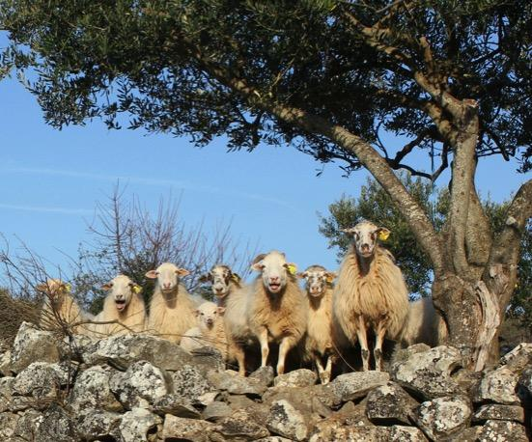
Examples of HNV farming systems
Small scale mosaic cropping in western hilly areas
Traditional hay making by family members
Mediterranean grasslands historically used for sheep grazing
Traditional low input olive groves on the Croatian coast
HNV-Link
Notes:
Small scale mosaic cropping in western hilly areas:
Mosaic landscapes with arable plots, vegetable gardens, traditional orchards and vineyards
Characterized by smallholdings, mixed farming and generally low yields
Traditional hay making by family members: Without external support, practices such as hand mowing and traditional hay making are gradually disappearing
Mediterranean grasslands historically used for sheep grazing: Many of these areas are already being abandoned and typical man-made features such as stone walls are degrading
Traditional low input olive groves on the Croatian coast: Almost half of families living on the Croatian coast and 93% of families living on islands cultivate olives. Top quality olive oil is a specific product output. Olives are often the main crop but the system can include also pistachio, pomegranite, almond, figs as well as sheep pasture. Herbs and (wild) vegetables may also be found in these orchards.
Also honey production and tourism contribute to HNV maintenance and economy.
SOURCES: Todorović, S.K., 2012 Croatia. In: Oppermann, R., Beaufoy, G., Jones, G. (Eds) 2012. High Nature Value Farming in Europe: 35 European countries – experiences and perspectives. c. Verlag gegionalkultur, Germany. 544pp. ISBN: 978-89735-657-3
HNV-Link Baseline Assessment for Croatia http://www.hnvlink.eu/download/CroatiaBaselineAssessment.pdf
Photo: Sheep on a stone wall with an olive tree. HNV-Link Attribution-NonCommercial-ShareAlike CC BY-NC-SA

Slide 22
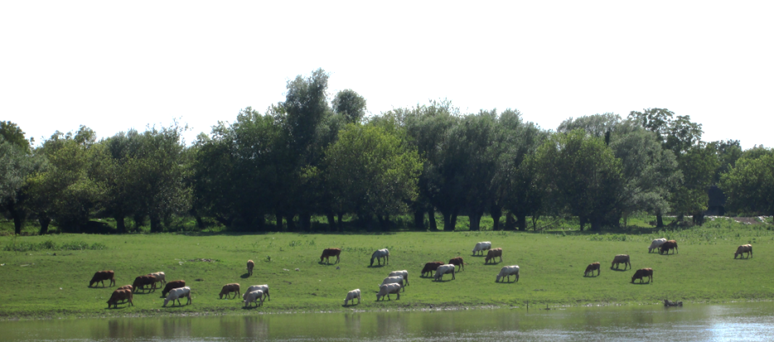
In Focus: Common grazing in flood plains
Common grazing: complex legal context & competing visions
Threats: population decrease & isolation, social stigma, poverty, loss of traditional knowledge, developmental pressures.
Challenge: finding common ground about the future for these lands and traditions
Fraxinus [CC BY-SA 4.0]
*http://see.efncp.org/download/sofia2013/Croatia.pdf
Notes:
Permanent pasture and common grazing: from http://see.efncp.org/download/sofia2013/Croatia.pdf - an excellent presentation on common grazing in Croatia.
There are varying estimates of the amount of permanent pasture and of common grazing in Croatia. Data is not consistent!
Legal framework: In 1953 an act transferred communities’ common property to State ownership. The Agricultural Land Act (OG 152/08) – amended 21/10, 124/10 and 63/11: Municipalities given the right to decide on the lease of the formerly common and now State owned land. Amendment 63/11 introduction of so called Pasturing Communities. PCs - a cooperative – only with people with residence of that or neighbouring municipalities. The Ordinance on Conditions for Submitting Requirements and Criteria for the Lease of Communal Pastures (OG 135/11). Newest Agricultural Land Act 39/13 - References to Pasturing Communities removed between two readings in Parliament– subacts to follow – future of Pasturing Communities uncertain. Articles 46 and 47 - biggest differences – any private or legal person instead of PC’s ; 5 years instead of 20; proportionally to number of cattle, Agency for agricultural Land taking over the tenders and all procedures from municipalities
Most important threats for common grazing in Croatia Disappearance of the last generation of pastoralists, population decrease and isolation in the rural areas , social stigma. Economic and the the social conditions in areas where common grazing still exist are very unfavourable, most of them being in the so called Areas of special state concern. These areas are in most cases also affected by the war in the 1990s and have suffered additional war related depopulation. The traditional knowledge of extensive grazing regimes and conditions is disappearing since there is no transfer of knowledge to the younger generations. Shepherding carries a social stigma, being linked to the poorest members of society.
Gajna common grazing https://www.iccaconsortium.org/wp-content/uploads/2015/07/event-inter-2011-gerace-03-benes.pdf (presentation)
Photo: https://upload.wikimedia.org/wikipedia/commons/a/ad/Lonjsko_Polje_Cows.jpg By Fraxinus [CC BY-SA 4.0 (https://creativecommons.org/licenses/by-sa/4.0)], from Wikimedia Commons

Slide 23
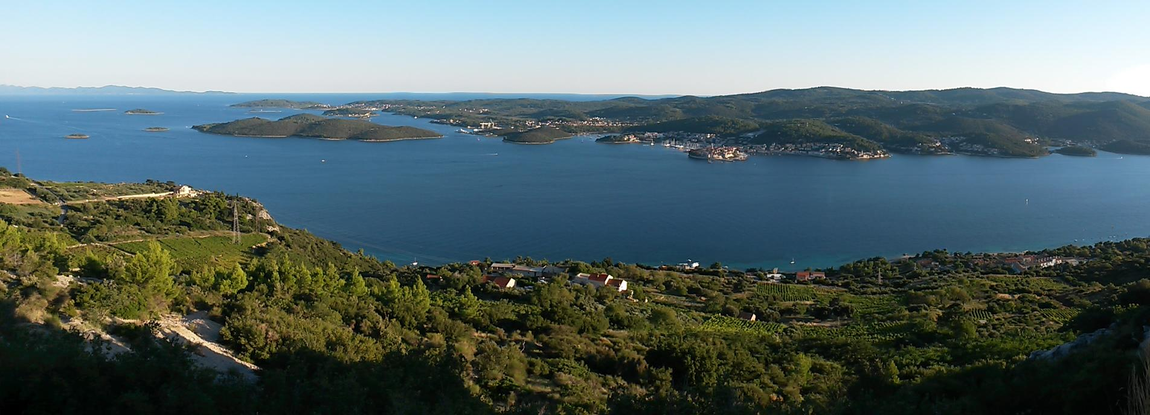
In Focus: Dalmatian Islands
Karstic fields, terraces on slopes, karstic pastures
Vineyards, olives, agroforestry, subsistence farming
Challenges: isolation, limited fresh water, market challenges, seasonal tourism
Abandonment exacerbates erosion, biodiversity loss, fire risk
Business as Usual: mass seasonal tourism, farmland abandonment
OR
HNV scenario: Agrotourism, revitalisation of traditions, self-sustaining islands
Notes:
The 3 zones of the Dalmation Islands are coastline, mountain and central plateau. Tourism has lead to over-urbanisation along the coast. Traditional settlements are usually located between field and hill.
Important HNV elements include: stone walls with olives, central plateau vineyards, coastal landscapes with vineyards, pastoralism and pastoral-agroforestry.
The background photo of Pelješac peninsula shows high levels of cultivation of terraces and shows farming between the woodlands and from the mountains to the sea. It is a very mosaic landscape. (photos used with permission of LAG 5).
Highly variable landscapes and ecology across the islands.
Open islands such as the archipelagos belong to the semi-arid or ‘’olive’’ climate covers that are characterised by pronounced heat and dryness, while precipitation comes only in the coldest parts of the year. True Mediterranean climate is found on the closer islands and the Pelješac peninsula. It is similar to the semi arid but has much more rainfall (Ozimec et al, 2015:33).
In line with climate conditions, dominant agriculture consists of citrus fruits, olive trees and vineyards. Animals graze in agroforestry systems.
Three types of landscapes in the Dalmatian Islands:
a) karstic fields (flooded due to eroded surrounding hills)
b) terraces on slopes (typical man-made landscape; erosion prevention measure which was a result of the labour surplus and cultivable land shortage)
c) karstic pastures (extensive pasture; scarce xerophyte vegetation)
EROSION: Due to the shortage of natural arable land in this karstic area, very sensitive landscape in Dalmatian Islands is a result of a long lasting efforts to create additional arable land and prevent erosion by cleaning stones and building stonewalls. Erosion prevention is very important aspect of water management in a karstic area.
Three types of vegetation (Defilippis, 1997:28): “makija” – impassable dense holm communities; garigue – evergreen shrubs, low trees, aromatic herbs, and bunchgrasses found in poor or dry soil; pinus halepensis.
Dalmatian islands are a very important area of biodiversity. Land use abandonment is recognized as the major threat for biodiversity due to succession caused by lack of mowing and pasture (Nikolić et al. 2009:23)
Challenges for living on the islands include isolation/difficult access, lack of fresh water, lack of economic opportunities.
Business as usual is based on mass tourism and results in loss of the farming and other traditions of the island. Seasonal workers replace families and the places are emptied in the winter.
An alternative HNV vision focuses on agrotourism, repopulation and restoration and having self-sustaining islands.
(SOURCE: http://www.hnvlink.eu/download/CroatiaBaselineAssessment.pdf )
Defilippis, J. (1997): Dalmatinsko selo u promjenama, Avium, Split
Nikolić, T., Topić, J. and Buković, N. (Eds.)(2009): Područja Hrvatske značajna za floru, Important Plant Area - Croatia, Working version 3.0, Zagreb

Slide 24
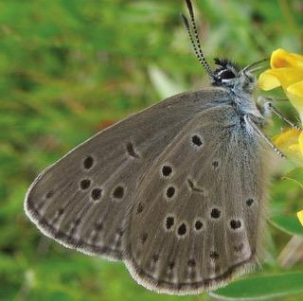
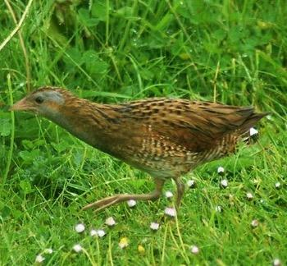
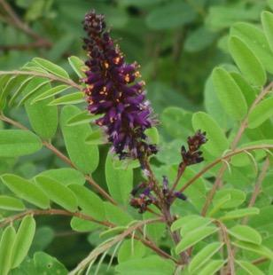
Biodiversity
Alcon blue
Maculinea alcon
Tartally A, Koschuh A, Varga Z [CC BY 3.0]
3rd in Europe for plant species/area
187 species of butterflies in meadow habitats
Directive species: e.g., corncockle (Agrostemma githago), corncrake (Crex crex), stone-curlew (Burhinus oedicnemus), Calandra lark (Melanocorypha calandra)
Rachel Davies [CC BY 2.0]
Corn crake Crex Crex
Invasive plant species a major threat for meadows, esp. Amorpha fruticosa
→ Best controlled by grazing
Amorpha fruticosa
Dalgial [CC BY-SA 3.09]
Notes:
Croatia is among the most biologically rich countries in Europe – it ranks third for the number of plant species per area
Farmland, especially grassland and meadow orchards are very biodiversity rich habitats, hosting numerous of valuable species
corncockle (Agrostemma githago), corncrake (Crex crex), stone-curlew (Burrhinus oedicnemus) and Calandra lark (Melanocorypha calandra)
The majority of 187 species of butterflies can be found in meadow habitats including the ant-dependent genus, Maculinea
Invasive plant species pose a major threat, particulary Amorpha fruticosa – which can only be effectively controlled by grazing.
The best caretakers of the pasture are Indigenous and protected breeds such as the Tsigai sheep, Black Slavonian Pig, Posavina Horse because they are low input and high stamina and specifically adapted to these habitats. They are also are part of the natural and cultural heritage and are important for conservation of genetic diversity.
Source: http://see.efncp.org/countries/croatia/general-info/
Photos
Amorpha fruticosa https://upload.wikimedia.org/wikipedia/commons/f/f1/Amorpha_fruticosa_04.JPG By Dalgial [CC BY-SA 3.0 (https://creativecommons.org/licenses/by-sa/3.0)], from Wikimedia Commons
Crex crex: By Rachel Davies (Flickr: CORNCRAKE!!!) [CC BY 2.0 (https://creativecommons.org/licenses/by/2.0)], via Wikimedia Commons https://upload.wikimedia.org/wikipedia/commons/c/c2/Corncrake2.jpg
Butterfly Maulinea alcon: https://upload.wikimedia.org/wikipedia/commons/d/d9/Maculinea_alcon.jpg By Tartally A, Koschuh A, Varga Z [CC BY 3.0 (https://creativecommons.org/licenses/by/3.0)], via Wikimedia Commons

Slide 25
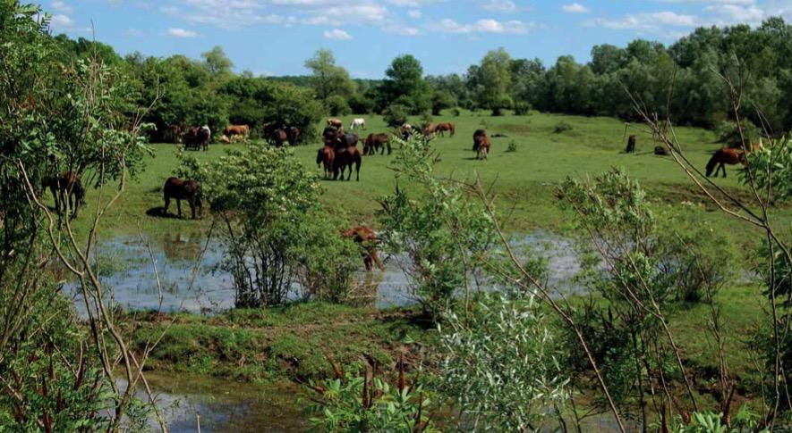
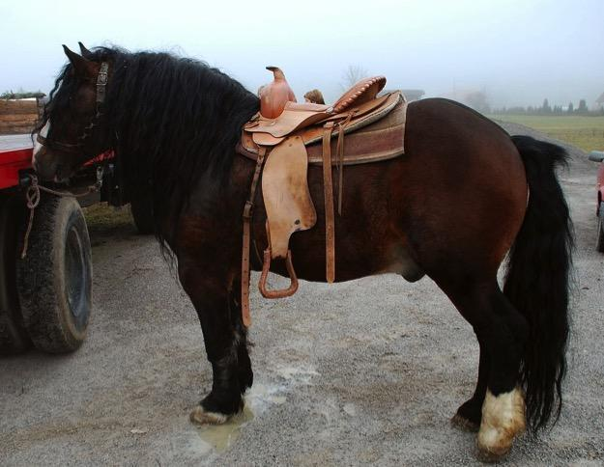
Other values
Large grazed floodplains, e.g. in Lonjsko Polje Nature Park, retain water & prevent floods.
Indigenous species
Sustainable tourism
  HNV farming and wine tours (e.g. Dingač wine in Dalmatian Islands)
Photo: www.pp-lonjsko-polje.hr permission granted for this use only
Ines Zgonc[ CC BY-SA 2.5 si
Posavina horse
Notes:
Lowland alluvial areas along the Sava, Mura, Drava and Danube rivers are managed largely through traditional agricultural practices. the main production is extensive grazing, and they are highly important retention areas for flood waters for the Sava and its tributaries.
Many High Nature Value farmlands have characteristics that facilitate agricultural production free of pesticides and herbicides. For example, the steep and sunny slopes of Dingač on Pelješac island, Croatia, enable fast runoff and create dry microclimate that prevents grape illnesses. Weed growth is also limited. The result is a high quality red wine of plavac type called Dingač. Steep slopes also mean most of work is done by hand. Due to difficult access of the slopes, safety ropes are an essential tool for wine farmers of Dingač. Unique, high quality products and practices like these enhance the rural tourist experience and could be better integrated into sustainable agri-tourism.
Grazing of the karstic and other areas reduces fire risk.
Steep, sunny slopes of Dingač on Pelješac Island create a dry microclimate that prevents grape illnesses and limits weed growth.
Indigenous and protected breeds – best caretakers of the pasture –Indigenous and protected breeds, such as the Tsigai sheep, Black Slavonian Pig, Posavina Horse are the best caretakers of pastures: low input, high stamina, natural and cultural heritage, gene pool, best for extermination of invasive plant species, adaptation qualities
Posavina horse photo: By Ines Zgonc (Amazone7) [GFDL (http://www.gnu.org/copyleft/fdl.html) or CC BY-SA 2.5 si (https://creativecommons.org/licenses/by-sa/2.5/si/deed.en)], from Wikimedia Commons https://upload.wikimedia.org/wikipedia/commons/e/e0/Posavec_horse_Sentrupert_dec_26_2009.jpg

Slide 26
Sources & experts
http://see.efncp.org/countries/croatia/hnv-farming/
http://www.hnvlink.eu/download/CroatiaBaselineAssessment.pdf
Beneš, I. 2013. Common grazing in Croatia http://see.efncp.org/download/sofia2013/Croatia.pdf
Todorović, S.K., 2012 Croatia. In: Oppermann, R., Beaufoy, G., Jones, G. (Eds) 2012. High Nature Value Farming in Europe: 35 European countries – experiences and perspectives. c. Verlag gegionalkultur, Germany. 544pp. ISBN: 978-89735-657-3
Expert: Marija Roglić, Local action group LAG 5
Notes:
There is limited information about Croatia HNV farming in English. Here are some main sources.

Slide 27
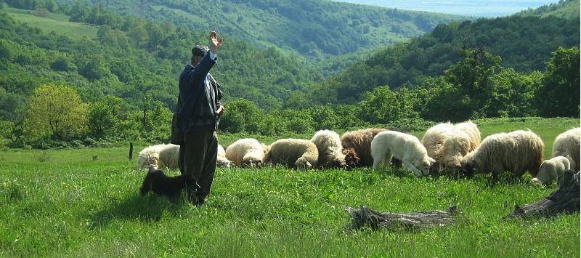
Romania
paraohiapojejena CC 3-0
Notes:
Photo: by paraohiapojejena Creative Commons Attribution-Share Alike 3.0 Unported https://commons.wikimedia.org/wiki/File:Pojejena,_Romania_-_panoramio.jpg

Slide 28
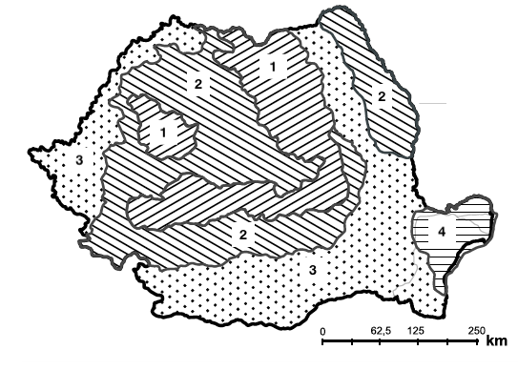
Simplified distribution of HNV farming in Romania
adapted from Keenleyside et al. 2014. High Nature Value farming throughout EU-27: Annex 1 (maps)
Mountain areas with forest and extensive grassland systems (HNVf type 1)
Mosaic mixed farming: hay meadow, pastures, traditional orchards (HNVf type 2)
More intense farming with scattered HNV areas (limited HNVf)
Danube Delta. Extensive reed-bed systems (HNVf type 3)
Notes:
Romania is evenly divided between lowland, hill and mountain areas: there are low-lying areas along the Danube plain, and the Carpathian Mountains curve through the centre of the country. Annual rainfall varies according to altitude. Due to the geographic variation in the country, Romania has, uniquely to the EU countries, 5 biogeographical regions: Continental, Pannonic, Steppic, Pontic and Alpine.
Agricultural statistics: 64% of the country’s land is agricultural area, 28% forest, and 11% other. Utilized agricultural area is 14,716,000 ha, used as follows: arable land = 64%, permanent pasture = 23%, hay meadows = 10%, vineyards and vine nurseries = 2%, orchards and tree nurseries = 1%.
Land use patterns vary across the country: arable and more intensively farmed areas predominate in the south, east and extreme west.
Livestock farming and permanent grasslands are concentrated in northern and central regions. Generally, agriculture has been in decline in Romania due to rural depopulation, development and afforestation.
Romanian farmland was affected by collectivisation during 1947-1989, when 90% of agricultural areas came under the authority of state and collective farms. The other 10% of lands in the mountains remained primarily as smallholdings. Continuation of smallholdings in the mountains has been beneficial for biodiversity. Further, fertilization of permanent grasslands ceased in 1989, and the grasslands have made a strong comeback in terms of improved biodiversity since cessation of fertilization. (SOURCE: Page, N., Bӑan, A, Huband, S., Popa, R., Rákosy, L., Sutcliffe, L. 2012. Romania. In: Oppermann, R., Beaufoy, G., Jones, G. (Eds) 2012. High Nature Value Farming in Europe: 35 European countries – experiences and perspectives. c. Verlag gegionalkultur, Germany. 544pp. ISBN: 978-89735-657-3)
HNV farmland occurs at landscape scales and is characterised by a rich variety of Natura habitats and species. HNV farmland provides part of the living of up to 3 million small farmers whose future provides one of the biggest challenges to rural policy. (SOURCE: http://www.efncp.org/projects/projects-in-romania/ )
Some of Europe’s most important HNV farmed landscapes are found in Romania. They occupy at least 30% of the total agricultural area, amounting to about 5 million hectares. They are mostly found in smaller holding sizes in hilly areas within the Carpathian arc, especially in Transylvania, Maramures and in the southern Carpathian slopes of Oltenia. (SOURCE: https://www.agridea.ch/fileadmin/thematic/Projet_HNV_Layman_report.pdf )
MAP Keenleyside, C, Beaufoy, G, Tucker, G and Jones, G (2014) High Nature Value farming throughout EU-27 and its financial support under the CAP. Report prepared for DG Environment, contract ENV B.1/ETU/2012/0035. Institute for European Environmental Policy: London. Annex 1 (maps) available here: http://www.efncp.org/download/HNV_and_CAP_Annex_1_maps_.pdf

Slide 29
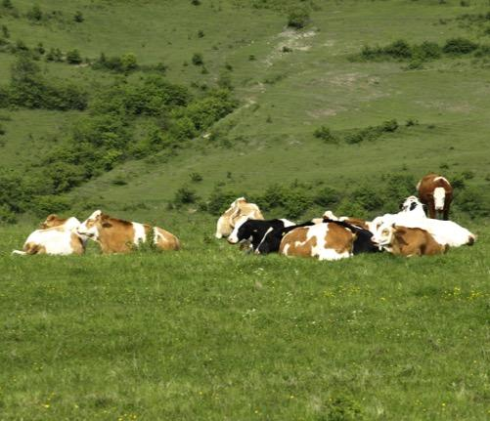
HNV farming systems
Based on small-holdings and common unimproved pastures
Extensive dairy sheep breeding
    use of upland semi-natural pastures
    shepherding
Small farms and mixed land use
    permanent grassland, leys, rotational arable, wood pasture, traditional orchards
HNV-Link
Broad flat pastoral expanses on Danube Plain and Delta
Notes:
HNV farming in Romania is largely defined by two chief characteristics of Romanian farming: the high number of smallholdings (89% of farms under 5 ha in area) and the presence of common grazing (50% of all permanent grassland in Romania). Common grazing is an essential element for the viability of small farms in Romania. Municipalities rent grazing land to grazing associations and to individual shepherds. Commonly grazed pastures are generally unimproved, large ( up to several hundred ha) farmlands often located on steeper and less productive lands.
The typical agricultural system in upland type 1 areas is extensive dairy sheep, where flocks remain up in the hills for 6 months out of the year. The sheep are hand milked 3 times a day, and milk or cheese is sold in the markets. Grazing intensity is c. 4-6 sheep/ha.
Small-scale mosaic farmed landscapes have mixtures of permanent pastures and meadows, including the damp meadows that are under severe threat throughout Europe. The also contain grass leys, rotational arable patches, wood pasture and scrub, and traditional orchards.
The typical agricultural system in upland type 2 is small farms. Ownership and management is fragmented. They contain habitat types that have largely disappeared in much of Europe. The most important HNV orchards are found in the hilly type 2 areas, where every house has its own small orchard of apples, plums, pears, walnuts, and sometimes quince. The orchards have a grassy understory that is usually hand-mown for hay. Many hill villages also have communal fruit orchards, which are larger and have local varieties but are also mostly abandoned. They are quite different from former State orchards of the lowlands, which do not have the grass understory and are sprayed with pesticides.
Type 3 HNV– arable areas hosting species of conservation concern: Broad, flat expanses along the Danube plain and near the Danube Delta in the southern and eastern parts of the country. These areas are important for migrating bird species.
HNV in a nutshell:
Small-holdings : 89% of farms under 5 ha in area
Common grazing : 50% of all permanent grassland in Romania
Upland semi-natural pastures : mainly sheep (milk products and meat), 6 months in the mountains (transhumance)
Mosaic farmed landscapes : mall farms, rotational farming and agroforestry
Danube Plain and Delta are Broad flat expanses
(Reference: Page, N., Bӑan, A, Huband, S., Popa, R., Rákosy, L., Sutcliffe, L. 2012. Romania. In: Oppermann, R., Beaufoy, G., Jones, G. (Eds) 2012. High Nature Value Farming in Europe: 35 European countries – experiences and perspectives. c. Verlag gegionalkultur, Germany. 544pp. ISBN: 978-89735-657-3)

Slide 30
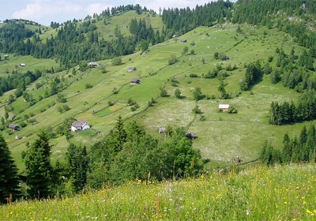
In Focus: Eastern Hills of Cluj
Valleys:
    Villages surrounded by arable land
Middle elevation:
    Mixed arable, grazing, meadows
High elevation:
    Meadows, forests
    Wheat, maize, fodder, other
    Sheep highly important - do not require winter stabling as cows do
Photo: HNV-Link
Notes:
Eastern Hills of Cluj (Dealurile Clujului Est) is located in Transylvania in the Northwestern Romanian Development region.
The area is recognised for its rich biodiversity: 18,889 ha of the territory forms a Natura 2000 site with the name Dealurile Clujului Est. The Natura 2000 site covers around one third of the territory and population of the communes.
The area also includes two natural reserves for botanical, fauna, landscape and geomorphology conservation. Steppe flora conservation and butterfly conservation (Maculinea nausithous) are explicit aims.
Agriculture is central to nature and livelihoods in the region. Land use is stratified by altitude and include areas between 500-700m above sea level. The landscape is shaped by geography and farming techniques. There is a network of rivers that flows from northwest to southeast. The villages are located at the bottom of the valleys and usually surrounded by arable land situated between 300 to 500 m altitude. The next layer (between 500 to 600 m altitude) is a mixture of arable land with permanent natural pastures and meadows. Above 600 m altitude is the area covered with meadows and, in some areas, with forests.
The specific landscape of the permanent meadows and pastures is probably unique nowadays in Europe. It is a mosaic of parcels that are farmed using different agricultural techniques for different times of the year. Some parcels are still manually mowed and others are used only for summer grazing.
Cluj is a diverse area with varied economic and demographic conditions across the municipalities. Challenges are aging rural population and that the areas with the highest HNVf have poor economies compared to peri-urban areas with industry. There is little innovation in the agriculture and markets, and the quantity of both crop and animal household production sold on the market is very small. the cost of getting products to market in the urban areas or, alternatively, producing enough for wholesale (for which the farmers get very low prices) are barriers for farmers selling their products.
SOURCE: http://www.hnvlink.eu/download/RomaniaBaselineAssessment.pdf

Slide 31
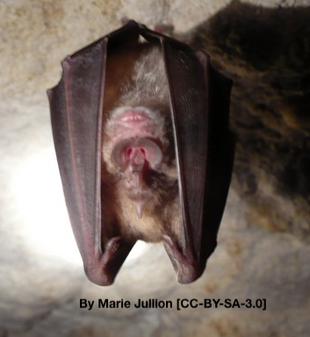
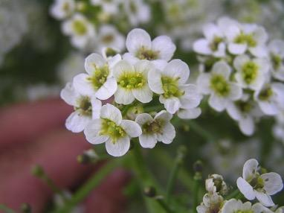
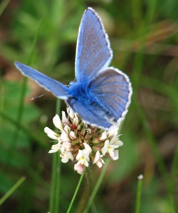
Biodiversity
Extremely high species richness
Quantity & connectivity key to high level of biodiversity
e.g. Tȃrnava Mare area of Transylvania:
    1100 vascular plant species – 87 priority species
    1300 lepidoptera species
Birds Directive species
Wolves, brown bear
Tatarican Colewort (Crambe tataria)
Photo by: Petr Filippov
Eget arbete, CC BY-SA 3.0
by HNV-Link
Notes:
Quantity and connectivity of the HNV farmlands in Romania, as well as proximity to natural habitats, is key to their high level of biodiversity.
The rich biodiversity of Romanian HNV farmlands is primarily due to generations of farmers who have used low intensity farming techniques.
In Eastern Cluj, the absence of chemical inputs and management within ecological capacity have resulted in a landscape with 282 recorded vascular plants. SOURCE: http://www.hnvlink.eu/download/RomaniaBaselineAssessment.pdf
Small-scale upland orchards are important for several taxa, including: rare birds, reptiles, butterfly and beetle species.
Village fruit trees are often heirloom cultivars- important sources of agricultural species diversity.
60 native plants are related to crop plants, a potential resource for plant breeding. This is particularly notable for distinctive varients of forage legumes like red clover and sainfoin.
(Reference: Page, N., Bӑan, A, Huband, S., Popa, R., Rákosy, L., Sutcliffe, L. 2012. Romania. In: Oppermann, R., Beaufoy, G., Jones, G. (Eds) 2012. High Nature Value Farming in Europe: 35 European countries – experiences and perspectives. c. Verlag gegionalkultur, Germany. 544pp. ISBN: 978-89735-657-3)
In Cluj, Two mammals (Sicista subtilis; Rhinolophus ferrumequinum) and 6 amphibians and reptiles (Vipera ursinii rakosiensis - priority species; Bombina variegata; Triturus vulgaris ampelensis; Triturus cristatus; Bombina bombina; Emys orbicularis) are also among the protected species listed in the Habitat Directive. (SOURCE: http://www.hnvlink.eu/download/RomaniaBaselineAssessment.pdf )
Crambe tataria is protected by law in Czech Republic, Slovakia, Hungary, Serbia and Romania. The leaves are eaten as a vegetable and the root has a taste similar to horseradish (Hoskovec, 2014) (SOURCE: http://www.hnvlink.eu/download/RomaniaBaselineAssessment.pdf)
Photo attributions
Tatarican Colewort: Photo by: Petr Filippov Eget arbete, CC BY-SA 3.0, https://commons.wikimedia.org/w/index.php?curid=681955
Butterfly: HNV-Link Bavius Mavisi (Pseudophilotes bavius)
Horseshoe bat: By Marie Jullion [GFDL (http://www.gnu.org/copyleft/fdl.html) or CC-BY-SA-3.0 (http://creativecommons.org/licenses/by-sa/3.0/)], from Wikimedia Commons https://upload.wikimedia.org/wikipedia/commons/f/f3/Grand_Rhinolophe_2.jpg

Slide 32
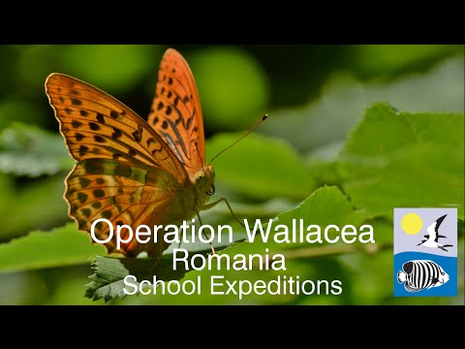
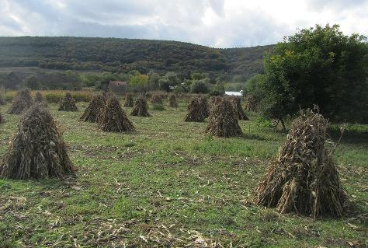
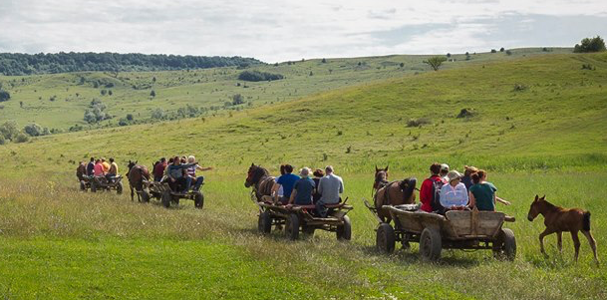
Other values
European heritage: traditional farming still exists on a scale much larger than most EU countries
Rural tourism and high quality local products
Agro-biodiversity: genetic resources for crops and breeds
https://www.youtube.com/watch?v=n0t_qcrzJac
Tourism ©by HNV-Link C
Hay meadow by HNV-Link
Notes:
European heritage: traditional farming still exists on a scale much larger than most EU countries, making the country an appealing destination for rural tourism. Linked to this, markets for high quality local products would help HNV farmers and small-scale agriculture.
Agrobiodiversity is an important resource. Romania’s HNV farmed areas contain many wild crop relatives, especially fodder plants, and important reserve of germplasm for future plant breeding. 60 native plants are related to crop plants (SOURCE: Page, N., Bӑan, A, Huband, S., Popa, R., Rákosy, L., Sutcliffe, L. 2012. Romania. In: Oppermann, R., Beaufoy, G., Jones, G. (Eds) 2012. High Nature Value Farming in Europe: 35 European countries – experiences and perspectives. c. Verlag gegionalkultur, Germany. 544pp. ISBN: 978-89735-657-3)
Video: Operation Wallacea 3:45 minutes https://www.youtube.com/watch?v=n0t_qcrzJac
Also collection of videos by Fundatia Adept: https://fundatia-adept.org/videos/
Photos: HNV-Link Attribution-NonCommercial-ShareAlike CC BY-NC-SA https://creativecommons.org/licenses/ "This license lets others remix, tweak, and build upon your work non-commercially, and although their new works must also acknowledge you and be non-commercial, they don’t have to license their derivative works on the same terms."

Slide 33
Sources & experts
http://www.efncp.org/projects/projects-in-romania/
http://www.efncp.org/projects/projects-in-romania/hnv-bulgaria-romania/
http://www.hnvlink.eu/learning-areas/eastern-hills-of-cluj/
https://fundatia-adept.org/high-nature-value-landscapes/
https://fundatia-adept.org/videos/
https://www.agridea.ch/fileadmin/thematic/Projet_HNV_Layman_report.pdf
Romania: Why and how CAP should support HNV farming in Transylvania?
http://www.efncp.org/download/demeter.pdf (presentation)
https://ec.europa.eu/agriculture/sites/agriculture/files/consultations/family-farming/contributions/adept_en.pdf

Slide 34
Sources & experts
Sutcliffe, L. & Larkham, K. 2011. Monitoring high nature value grassland in Transylvania, Romania. In: Knowles, B. Mountain hay meadows: hotspots of biodiversity and traditional culture, http://www.mountainhaymeadows.eu/online_publication/09-monitoring-high-nature-value-grassland-in-transylvania-romania.html
Page, N. & Popa, R. 2013 Family farming in Romnia https://ec.europa.eu/agriculture/sites/agriculture/files/consultations/family-farming/contributions/adept_en.pdf
Tanczos, B. The imporance of HNV farming – views from Romania https://www.yumpu.com/en/document/view/28491423/the-importance-of-high-nature-value-farming-a-barna-efncp
Expert: Mugurel Jitea, University of Agricultural Sciences and Veterinary Medicine

Slide 35
High Nature Value Farming: Learning, Innovation and Knowledge HNV-Link
Disclaimer: This presentation reflects the author's view and the Research Executive Agency is not responsible for any use that may be made of the information it contains.
Working together for a sustainable future
www.hnvlink.eu

