Slide 1
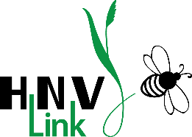
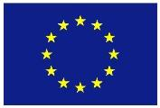
High Nature Value farmland
Examples across Europe: part 2 of 3
Irina Herzon, Traci Birge, Riina Koivuranta, Milka Keinänen
This presentation is an output of HNV-Link project - www.hnvlink-eu
THIS PROJECT HAS RECEIVED FUNDING FROM THE EUROPEAN UNION HORIZON 2020
RESEARCH AND INNOVATION PROGRAMME UNDER GRANT AGREEMENT NO. 696391

Slide 2
Notes for instructors and users
This presentation is part of the package of Education Materials on the topic of High Nature Farmland. It is an output of the Horizon 2020-funded project HNV-Link and is an Open Source material under CC BY-NC-SA. You may freely use, for non-commercial purposes only, any elements of it or as a whole, also modifying as fit, as long as you cite the project and its funding. Observe copyrights for images: all images are by HNV-Link unless otherwise specified.
The presentation contains minimum or no animation/special effects. Instructors may wish to add such effects according to their preferences.
Notes:
Attribution-NonCommercial-ShareAlike CC BY-NC-SA https://creativecommons.org/licenses/
"This license lets others remix, tweak, and build upon your work non-commercially, and although their new works must also acknowledge you and be non-commercial, they don’t have to license their derivative works on the same terms."
This presentation contains minimum or no animation/special effects. Instructors may wish to add such effects according to their audience and teaching style.

Slide 3
Learning objectives
To appreciate a diversity of High Nature Value farmland types across Europe and outside
To learn of the general characteristics of HNV farmland and farming systems
To familiarise oneself with various public values of HNV farmland

Slide 4
Content
Concept of High Nature Value (HNV) farmland
Examples from Europe
    Spain and Portugal
    Croatia
    Romania
    France
    Germany
    Ireland
    Finland
Examples outside Europe
Notes:
There are many more examples that can be accommodated in one lecture. The instructor can decide which ones to choose: contrasting parts of Europe or for representing a specific region.
IMPORTANT: High nature value farming is a European concept, but this does not mean that HNV-farming systems or farmlands are exclusive to Europe, as non-European HNV-farming examples show.

Slide 5
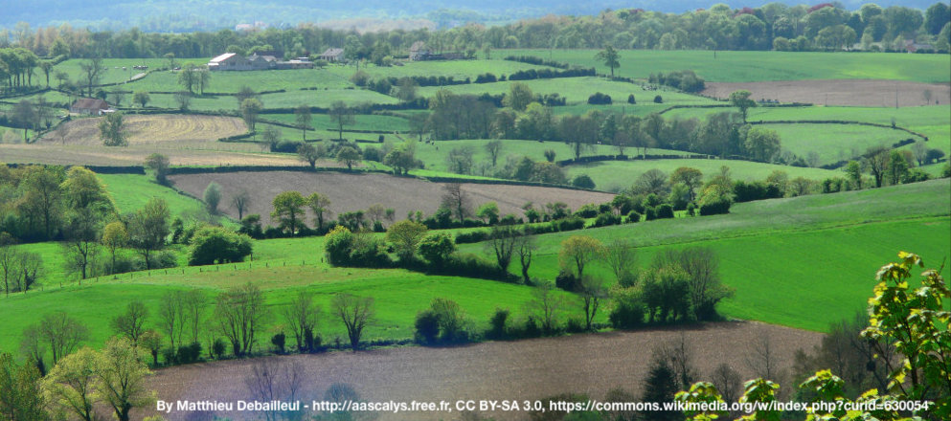
France
Bocage landscape

Slide 6
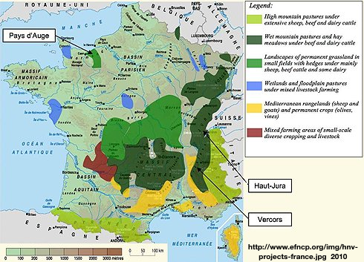
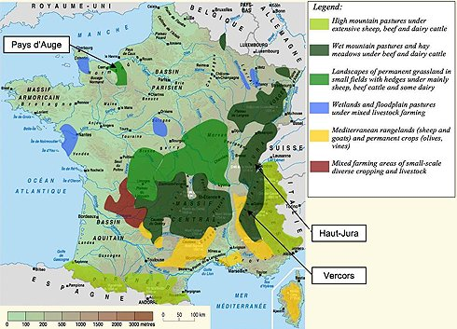
Legend
High mountain pastures under extensive sheep, beef and dairy cattle
Wet mountain pastures and hay meadows under beef and dairy cattle
Landscapes of permanent grassland in small fields with hedges under mainly sheep, beef cattle and some dairy
Wetlands and floodplain pastures under mixed livestock farming
Mediterranean rangelands (sheep and goats) and permanent crops (olives, vines)
Mixed farming areas of small-scale diverse cropping and livestock
Notes:
Extent:
Agricultural statistics: 53% of land area is in agriculture, 28% in forest, 9% as settlements and infrastructure, 10% other. Of the agricultural land: 62% is arable land, 33% permanent grassland, 3% permanent crops. Organic farming covers 2% of all agricultural lands. (Poux & Ramain in Oppermann et al. 2012).
France has a tremendous variety of landscapes. These are northern and Atlantic plains plateaus, medium altitude mountains, high mountains with peaks about 2000 m, and the Mediterranean zone. France’s geography is generally favourable for agriculture. France is a major exporter of agricultural products.
This figure shows the main HNV agrarian systems. HNV farming also may occur locally or in areas not dominated by a special type of farming or farmland.
The areas indicated are high mountain pastures (light green), wet mountain pastures (dark green), landscapes of permanent grassland in small fields (bright green), mixed livestock farming in wetlands and floodplains (blue), Mediterranean rangelands (yellow), and mixed small-scale farming areas (red).
Type 1 semi-natural pastures and meadows is the dominant HNVf in France.
Estimate of land under semi-natural use
Groves/copses: 854, 295 ha – Mainly, but not exclusively, found in open agricultural landscapes
Hedges: 1,000,774 ha – Associated to linear infrastructures (roads)
Moorland/herbaceous land with bushes 2,526,302 ha – Typical pastoral rangeland
Unused natural grassland: 354,310 ha – Occasional grazing
Alpages- high altitude permanent grassland: 713,463 ha – Recognized as semi-natural grassland
non-Alpage low productivity permanent grassland: 1,295,787 ha – likely to be semi-natural grassland
Total: 6,784,931 ha c. 12% of French territory (SOURCE: Teruti, 2008 as reproduced in Fig. 3 p. 210 in Oppermann et. al. (Eds) 2012.)
Both quantity and quality of HNV farmlands in France are in decline due to intensification of land use practices in semi-natural areas and destruction of landscape features (Poux & Ramain in Oppermann et al. 2012).
SOURCE: Oppermann, R., Beaufoy, G., Jones, G. (Eds) 2012. High Nature Value Farming in Europe: 35 European countries – experiences and perspectives. c. Verlag gegionalkultur, Germany. 544pp. ISBN: 978-89735-657-3
Teruti data (land use) https://agreste.maapar.lbn.fr/ReportFolders/ReportFolders.aspx?CS_referer=&CS_ChosenLang=fr
http://agreste.agriculture.gouv.fr/IMG/pdf_primeur246-2.pdf
see also http://agreste.agriculture.gouv.fr/enquetes/territoire-prix-des-terres/enquete-teruti-lucas-resultats/

Slide 7
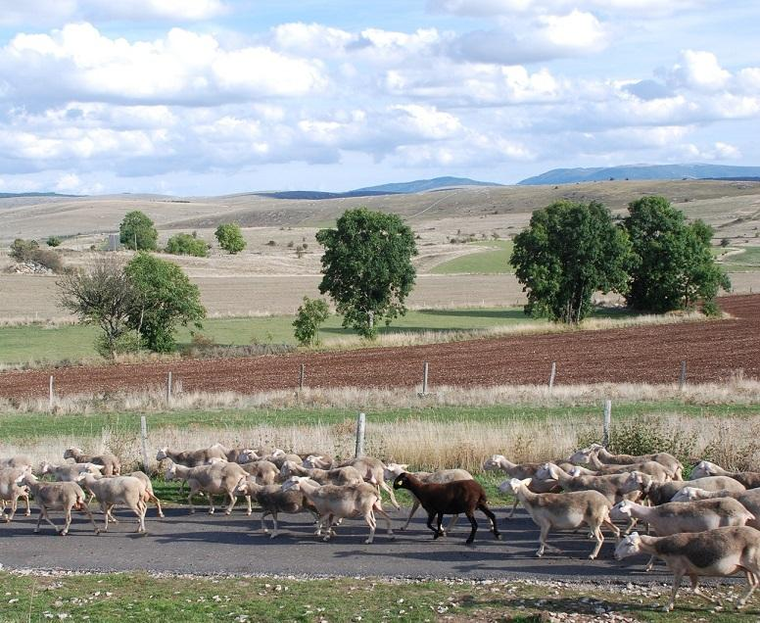
HNV farming systems
Mainly extensive grazing-based HNVf
Mixed farming to a lesser extent
Agroforestry
Use of landraces
Protected Designation of Origin labelled products
Transhumance = moving livestock from one grazing ground to another following a seasonal cycle https://vimeo.com/231845586
In focus:
In Causses & Cevennes, herds are moved on foot along the ancient drovers’ roads (drailles).
These nowadays are at the center of popular summer festivities.
Notes:
HNV farming in France is mainly based on livestock grazing but also includes some mixed farming and agroforestry.
HNV farming systems are mostly located in mountain areas.
The HNV farming systems are mainly low input, including permanent pastures, which are often common lands.
Transhumance, which consists in this context of moving of herds to mountain pastures for the summer and back to the valleys for winter – a type of vertical transhumance– is a significant HNV system. Such agropastoral systems have enabled people to live in difficult regions for millennia (since about 6,000 CE).
In Causses & Cevennes, herds are moved on foot along the ancient routes – drailles – which nowadays are at the center of popular summer festivities. There is a 302,319 ha area in the southern part of central France designated as a UNESCO World Heritage Site exemplifying Mediterranean agro-pastoral Cultural Landscape in the The Causses and the Cévennes.
“The Causses and Cévennes demonstrate almost every type of pastoral organisation to be found around the Mediterranean (agro-pastoralism, silvi-pastoralism, transhumance and sedentary pastoralism)”. More: http://whc.unesco.org/en/list/1153 and in the Baseline Assessment at www.hnvlink.eu Video of transhumance in Cevennes https://vimeo.com/231845586

Slide 8
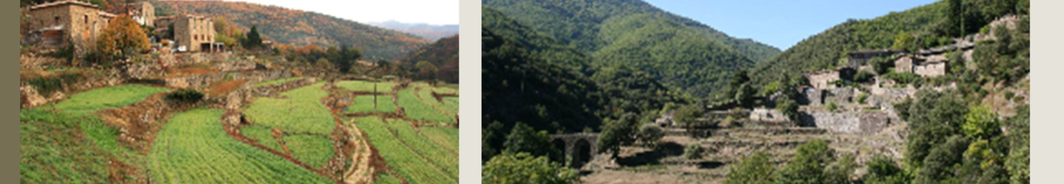
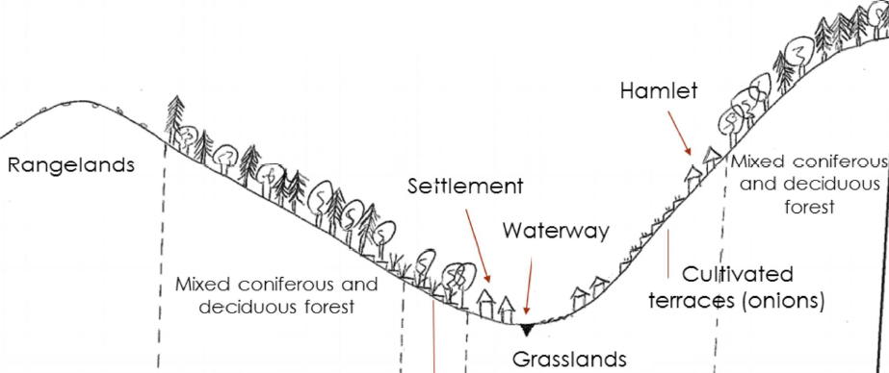
In Focus: Cevennes crests and valleys 2017
Old chestnut grove
Images: HNV-Link
Notes:
The Cevennes (photos, schematic and text from France Baseline Assessment p. 25). This schematic shows a cross section of Cevennes area. The landscapes of the crests and valleys are covered with mixed forest (conifers, beech trees). Settlements are villages in the valley bottoms and hamlets on the hillside. Terraces are used to grow onions and as pastures. Some grasslands in the valley are also used for pasture and to mow the grass for hay. There are also some relic chestnut groves. Depending on the valleys, open heathlands or holm oak wood are found on the crest. Conifers were planted on the hillsides and are gaining ground.

Slide 9
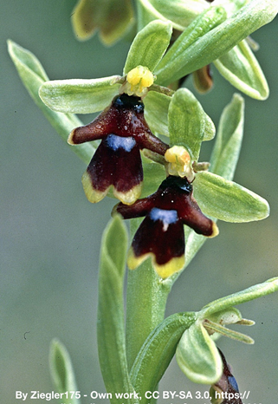
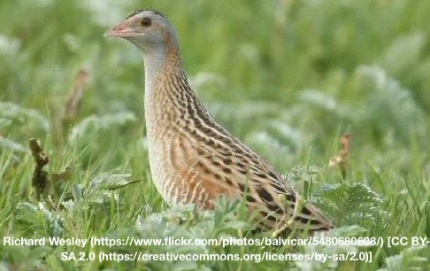
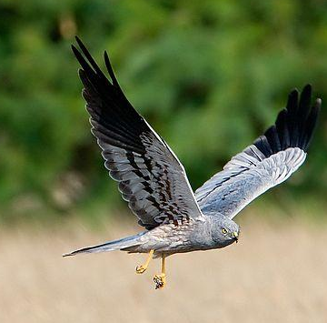
Biodiversity on HNV farmland
High vascular plant species diversity
Important for birds:
    ~ 37% national population of farmland bird species in only 25% of the national farmland area
    73% of the corncrake (Crex crex) population
Ophrys aymoninii
Crex crex
Bocage landscape
Circus pygargus
By Cks3976 - Own work, CC BY-SA 3.0, https://commons.wikimedia.org/w/index.php?curid=17854595
Notes:
Because France has several types of HNVf areas, from salt marshes to high mountain pastures, there is a high range of farmland and semi-natural habitat associated with HNVf practices. A large element of France’s biodiversity is linked to the maintenance of certain farming practices. 41% of the Nature 2000 area is farmland (Poux & Ramain in Oppermann et al. 2012), and 63.3% of farmed Natura 2000 is located in HNV areas (Pointereau et al. 2010).
HNV farmland & Birds: Birds have been used for understanding biodiversity in HNVf in France: “HNV Farmland sustains about 37% of the national population of farmland bird species in only 25% of the national farmland area. Particularly contrasting responses have been found for species with unfavourable conservation status, with 39% of them well represented in HNVf (over 40% of national population) and 12% strongly underrepresented (under 12% of national population).” Underrepresented species are either crop specialists (ex: Perdix perdix) and/or have low altitude preferences (ex: Vanellus vanellus). – Pointereau et al. 2007
There is high vascular plant species diversity. Example shown, ophrys aymoninii (an orchid with a very limited range that is endemic to the Causse region).
Hedges and common lands provide connectivity in the grazed and cultivated landscapes, which is important for biodiversity. Bocage areas (pictured) are mixed woodlands and pastures with networks of hedges. The farming mostly revolves around permanent grassland-based livestock systems. The hedges, when extensively managed, are important habitats for insects and birds and also provide habitat connectivity. Bocage areas are found in e.g. Normandy, Morva Charolais, Bourbonnais. (Poux & Ramain in Oppermann et al. 2012).
References:
Oppermann, R., Beaufoy, G., Jones, G. (Eds) 2012. High Nature Value Farming in Europe: 35 European countries – experiences and perspectives. c. Verlag gegionalkultur, Germany. 544pp. ISBN: 978-89735-657-3
Pointereau, Philippe, Aggeliki Doxa, Frédéric Coulon, Frédéric Jiguet, Maria Luisa
Paracchini. 2010. Analysis of spatial and temporal variations of High Nature Value farmland and links with
changes in bird populations: a study on France. EUR 24299 EN – Joint Research Centre – Institute for Environment and Sustainability
Publications Office of the European Union. Scientific and Technical Research series – 79 pp.
ISSN 1018-5593 ISBN 978-92-79-15312-9 doi:10.2788/79127
agrienv.jrc.ec.europa.eu/publications/pdfs/EUR_24299.pdf
Pointereau, Philippe, Maria Luisa Paracchini, Jean-Michel Terres, Frédéric Jiguet, Yves Bas, Katarzyna
Biala. 2007. Identification of High Nature Value Farmland in France through Statistical Information and Farm Practices
Surveys. EUR 22786 EN – Joint Research Centre – Institute for Environment and Sustainability
Luxembourg: Office for Official Publications of the European Communities. Scientific and Technical Research series – 65 pp. ISSN 1018-5593 ISBN 978-92-79-06475-3 agrienv.jrc.ec.europa.eu/publications/pdfs/JRC_HNV_France.pdf

Slide 10
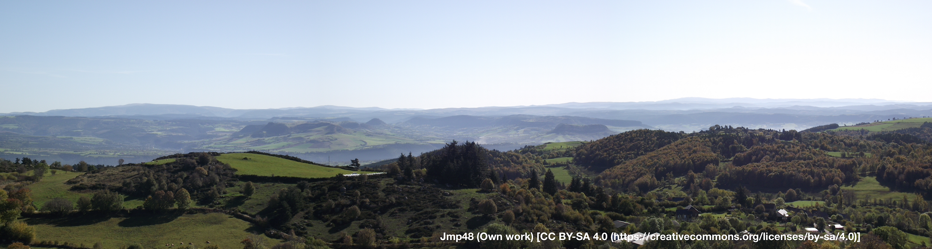
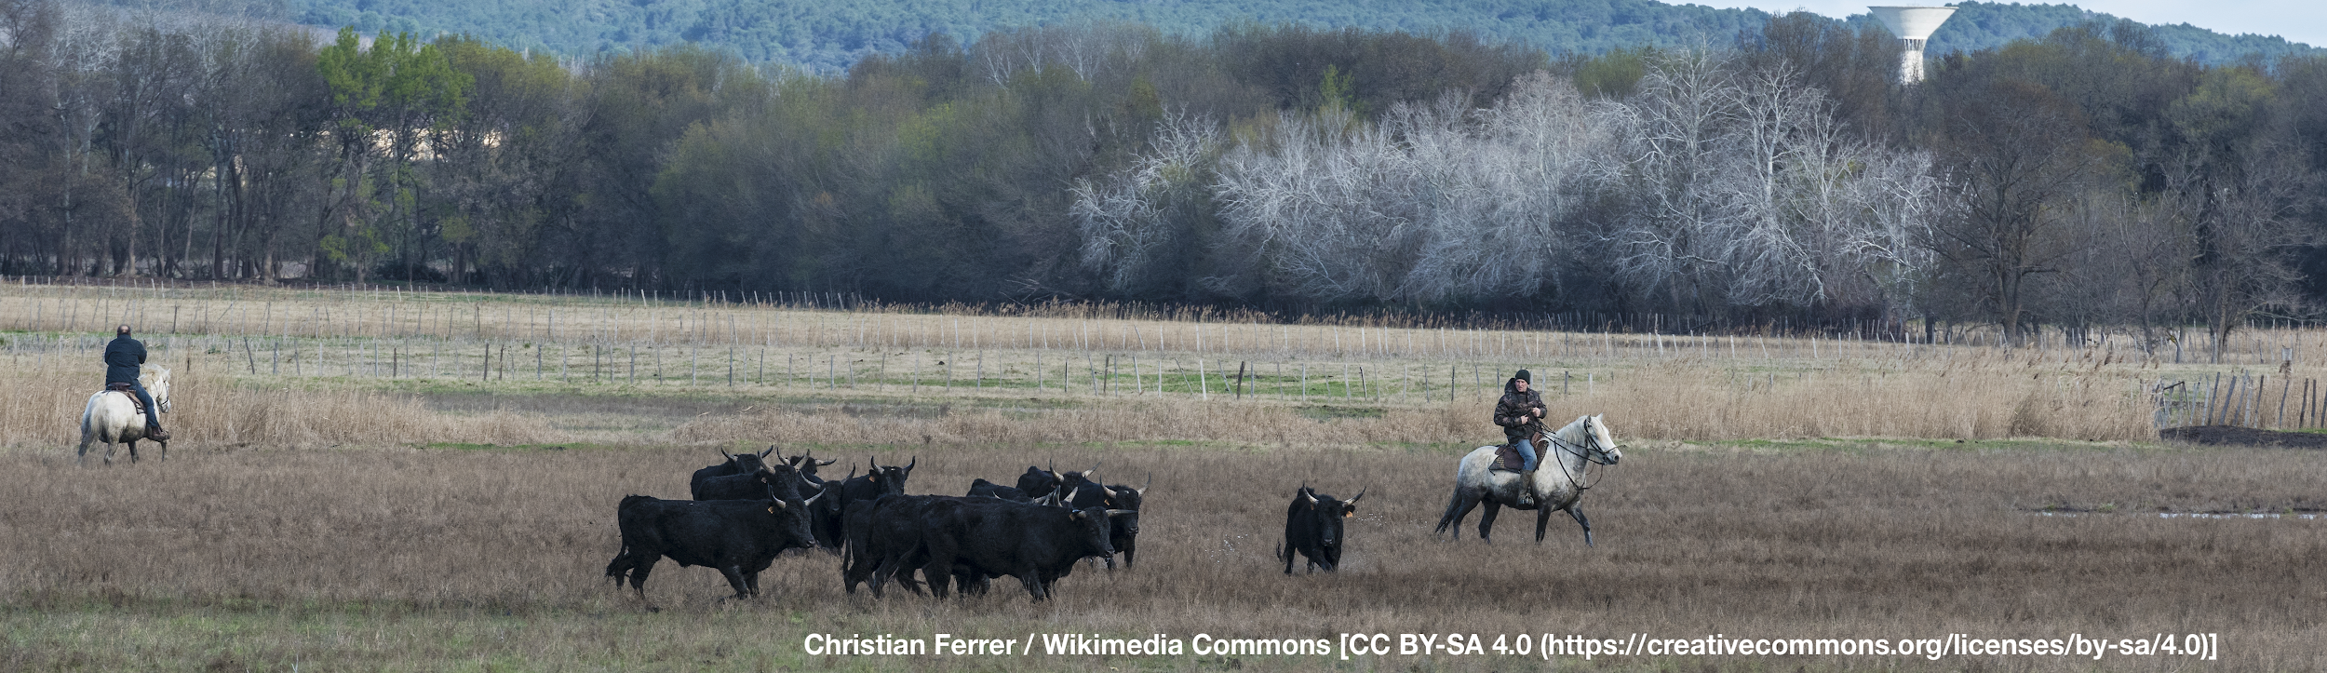
Other values: Culture (heritage)
Cevennes UNESCO Heritage Site
HNV farmland & traditional practices are part of the identity of many famous regions
Camargue
Notes:
Many HNV farmland regions are highly associated with cultural practices and specific products in France. The landscape itself has cultural meaning. Here are two examples.
Camargue, southern France: famous for its white horses and black bulls: Pictured are gardians- aka “cowboys of the Riveira”. They are riding camargue horses and herding camargue cattle. Meat from the cattle has the status of Protected Designation of Origin Appellation d’Origine Contrôlée status as "Taureau de Camargue". The cattle maintain large areas of Camargue wetland and also add to local tourism https://en.wikipedia.org/wiki/Camargue_cattle Bullfighting is allowed to continue here as a local tradition but meat from animals used in bullfighting is excluded from the "Taureau de Camargue" certification (http://www.esdaw.eu/bullfighting---france.html)
Camargue has a biosphere reserve and is a wetland of international importance under the Ramsar Convention. Birdwatching and tourism related to it is significant. About 110 000 people live permanently within the biosphere reserve. However, the number rises up to 220 000 in the summer (1997) making tourism one of the main management issues. People in the region are mainly engaged in the tourism industry and services, agriculture, salt extraction and fisheries. http://www.unesco.org/new/en/natural-sciences/environment/ecological-sciences/biosphere-reserves/europe-north-america/france/camargue/
Causses and Cévennes UNESCO designation: The area “manifests an outstanding example of a Mediterranean agro-pastoralism type”. This is a magnificent recognition of the many values of HNV farming. The upland landscapes have been shaped by agro-pastoralism over three millennia and people from around the world flock to experience its rich nature and culture.
The territories within the Causses and Cevennes UNESCO perimeter are the most significant examples of agropastoralist landscapes (geological and morphological criteria, landscape unity, cultural elements, rangelands and summer pastures). The area has a strong historical identity and benefits from a complete set of protective and management measures. The reasons for enrolling in UNESCO: The permanence of the cultural landscapes (transhumance trails, rangelands, sheepfolds) even though some (terraces, the hydraulic system) are already relics. Agropastoralism, the combination of extensive livestock breeding and cultivation of forage crops has always succeeded in keeping the land open. The cultural traditions are based on social structures and breeding that are adapted to the environmental constraints. www.hnvlink.eu/download/France_BaselineAssessment.pdf

Slide 11
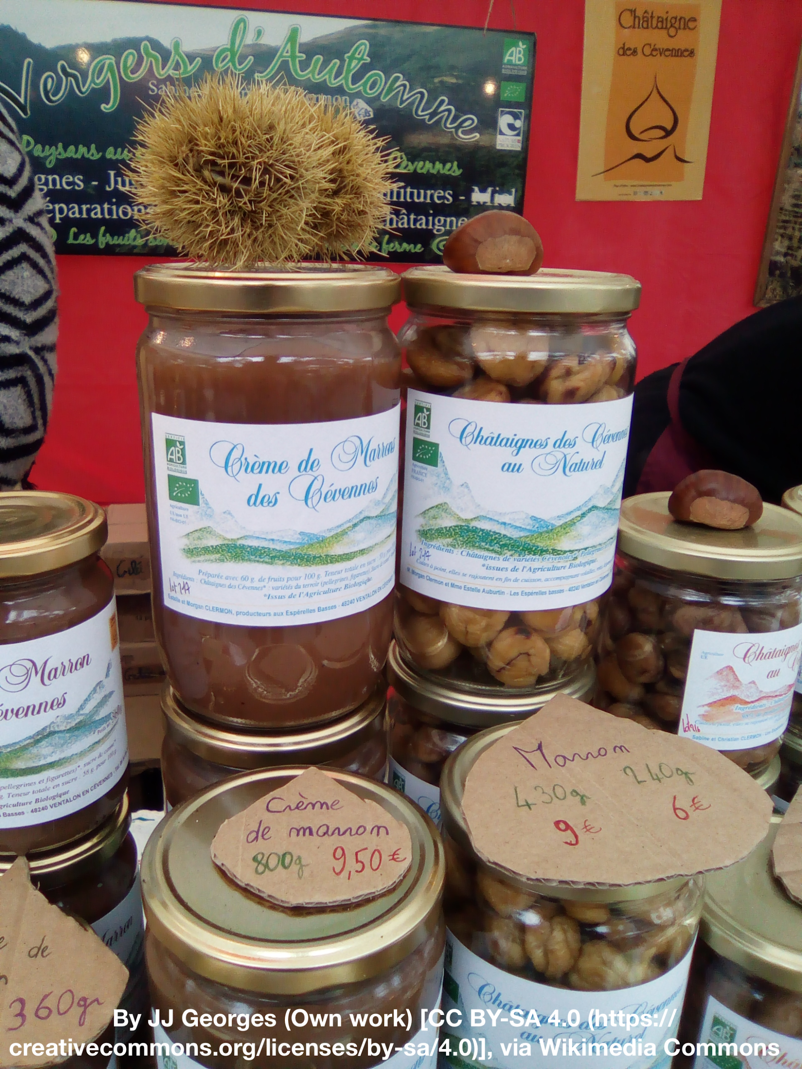
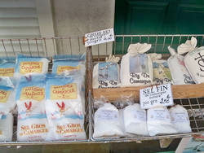
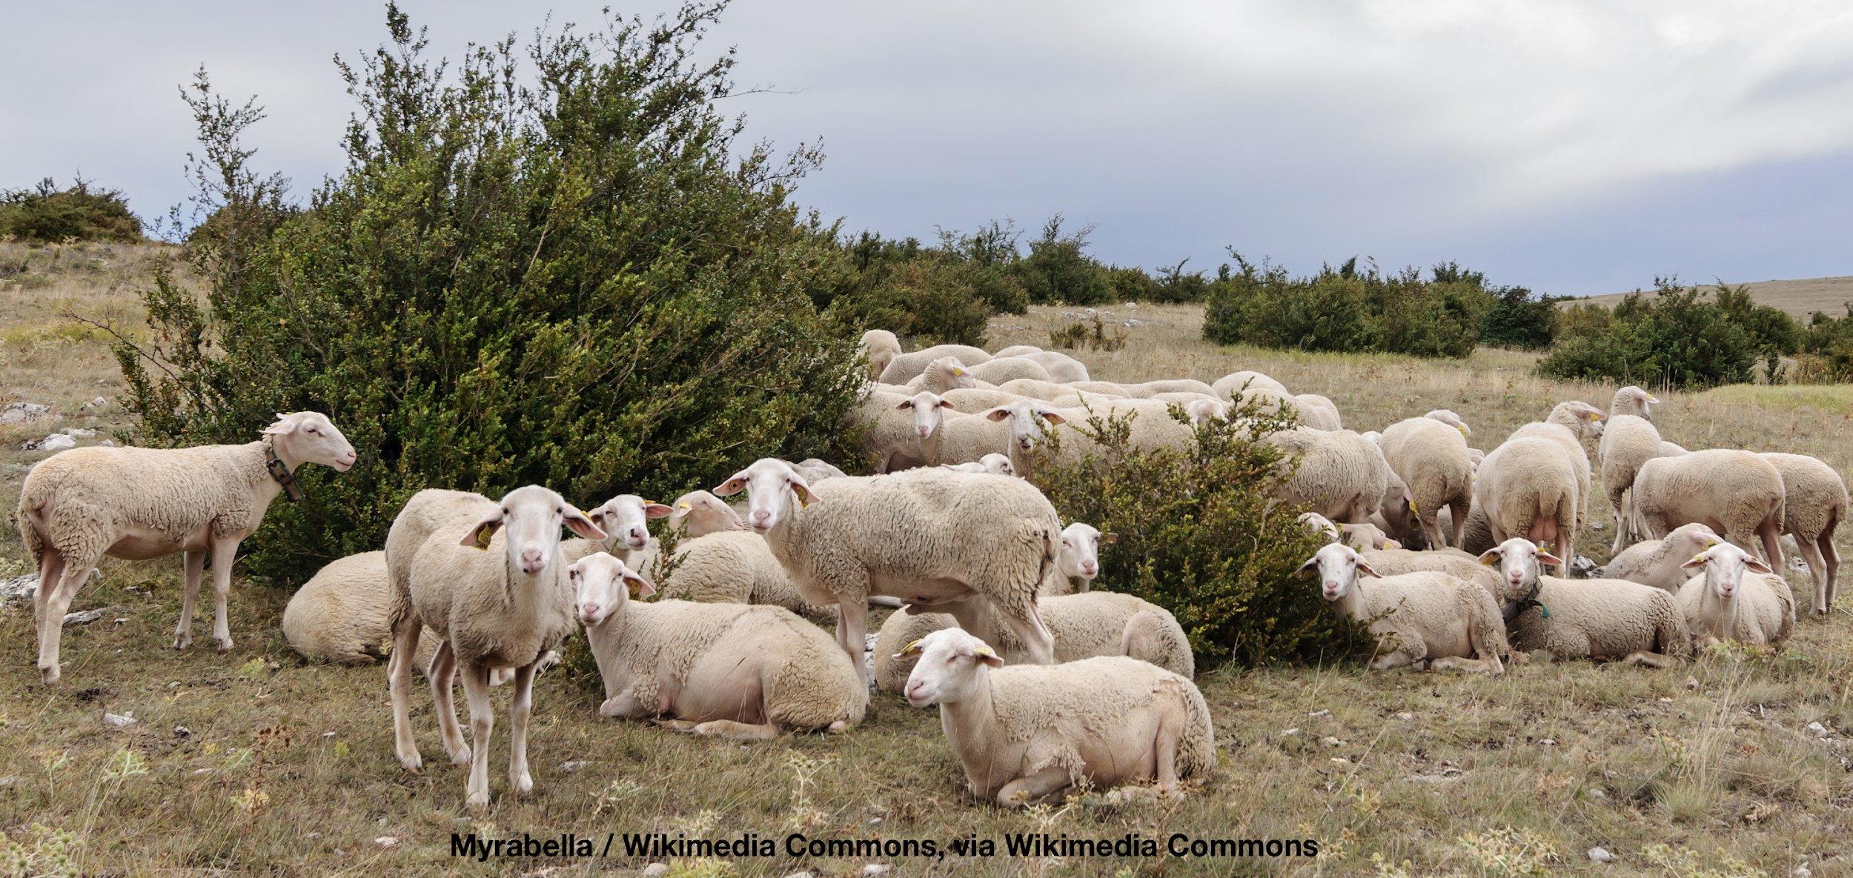
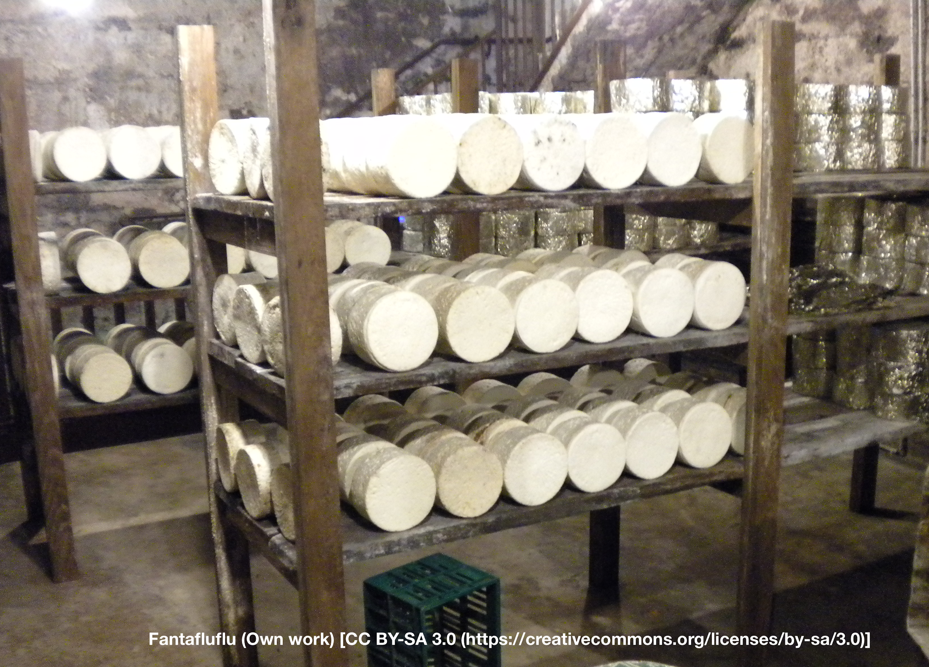
Other values: Production
72% of HNV farms produce products of Protected designation of origin
(PDO; Apellation d’origne protégée)
Véronique PAGNIER [CC BY-SA 3.0 (https://creativecommons.org/licenses/by-sa/3.0)],Wikimedia Commons
In focus: Lacaune dairy sheep
well adapted to uncultivated species-rich summer pastures
milk used for a famous Roquefort cheese
Notes:
Within the HNV farmland: 65% of the endangered breeds of sheep and 42% of cattle. Many unique breeds: Raïole mutton sheep, Caussenarde Garrigues mutton sheep, Rouge of Roussillon mutton sheep and Aubrac cattle, to name but a few.
Pictured: upper: preserved chestnut items from Cevennes, salt and rice from Camargue
Lacaune sheep & Roquefort cheese: HNV, Heritage, and Breeding: Due to government-driven breeding programme, Lacaune sheep are the most prevalent sheep breed in France. The breeding programme of the 20th century resulted in development of separate meat and dairy Lacaune. However, the sheep are still adapted to pasture management (http://en.france-genetique-elevage.org/Lacaune-dairy-line.html). Roquefort is made entirely from the milk of the Lacaune breed of sheep. Roquefort cheese was the first cheese to receive the label of origin quality of guarantee in 1951, at the International Convention of Stresa. Roquefort is confirmed as an Appellation d’Origine on an international level (http://www.roquefort.fr/en/news/discovering/the-cheese/origins/).
More: http://www.roquefort.fr/en/news/discovering/the-lacaune-ewe/ and http://www.roquefort-vernieres.fr/sheep-milk/?lang=en

Slide 12
Sources & experts
http://www.efncp.org/projects/hnv-farming-france/
http://www.hnvlink.eu/learning-areas/causses-cevennes/
https://ec.europa.eu/jrc/en/publication/eur-scientific-and-technical-research-reports/identification-high-nature-value-farmland-france-through-statistical-information-and-farm
https://www.youtube.com/watch?v=ZZAwnUpDIVs&feature=youtu.be
Notes:
Many materials for HNV farmland in France are on the website of European Forum on Nature Conservation and Pastoralism.
Other sources: the HNV-Link Baseline Assessment for Causses and Cévennes, the EU reports by Pointereau et al. 2007 Identification of High Nature Value farmland in France through statistical information and farm practice surveys and Pointereau et al. 2010 Analysis of spatial and temporal variations of High Nature Value farmland and links with changes in bird populations: a study on France.

Slide 13
Sources & experts
Oppermann, R., Beaufoy, G., Jones, G. (Eds) 2012. High Nature Value Farming in Europe: 35 European countries – experiences and perspectives. ISBN: 978-89735-657-3
Pointereau, Philippe, P. et al. 2010. Analysis of spatial and temporal variations of High Nature Value farmland and links with changes in bird populations: a study on France. agrienv.jrc.ec.europa.eu/publications/pdfs/EUR_24299.pdf
Pointereau, P. et al. 2007. Identification of High Nature Value Farmland in France through Statistical Information and Farm Practices Surveys. agrienv.jrc.ec.europa.eu/publications/pdfs/JRC_HNV_France.pdf
Experts: Xavier Poux, AScA http://www.asca-net.com/
See also a case on Angers Flood Meadows, France (www.hnvlink.eu )

Slide 14
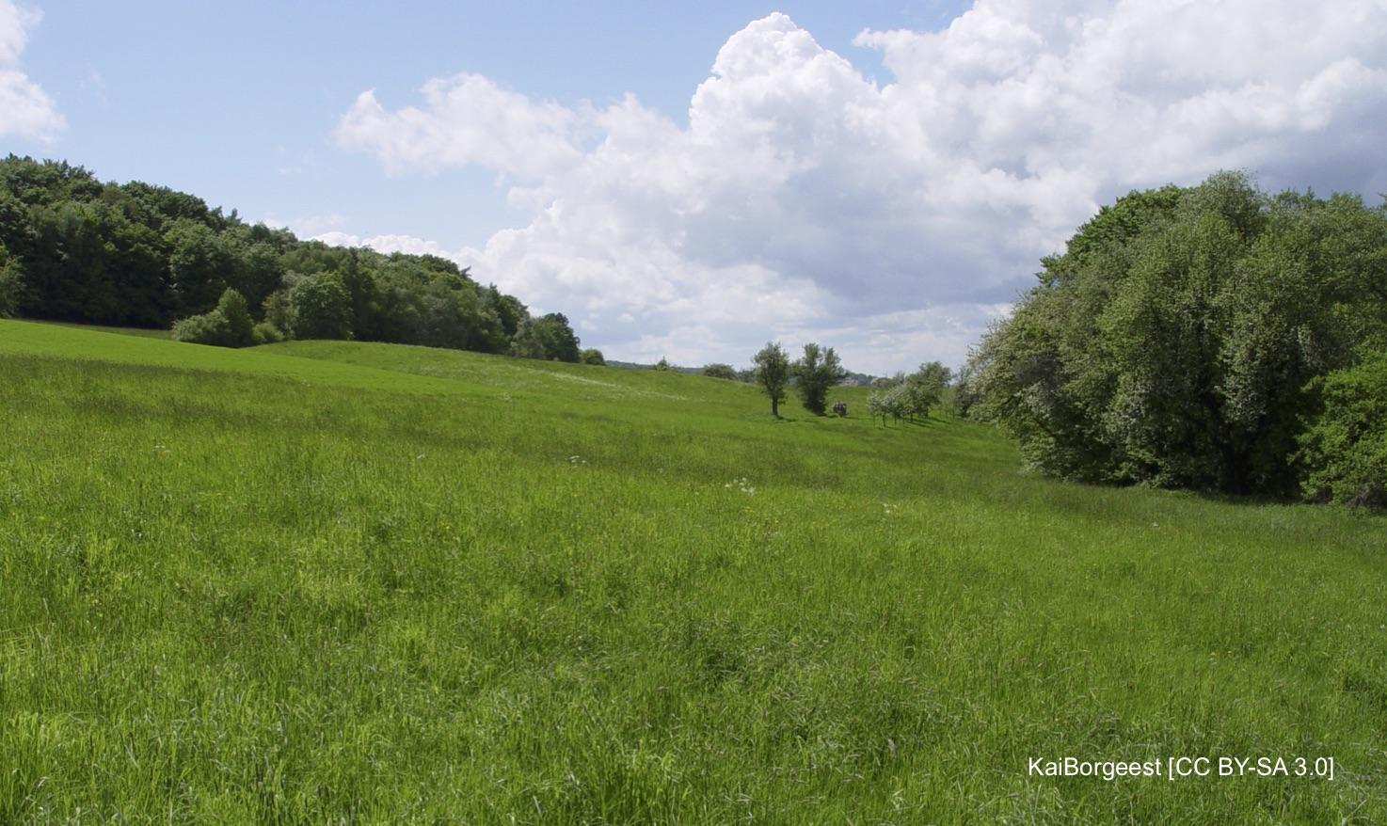
Germany
Notes:
Photograph By KaiBorgeest [CC BY-SA 3.0 (https://creativecommons.org/licenses/by-sa/3.0)], from Wikimedia Commons
https://upload.wikimedia.org/wikipedia/commons/4/44/LSG-00561-01_NSG-00339-01_Wuestenei.JPG
Pasture at the north side of the Elterberg hill, land parcel "Wüstenei" (still belonging to Aschaffenburg) in the protected landscape area Spessart (LSG-00561-01), the natural reserve Dörngraben (NSG-00339-01) begins at the trees on the right side

Slide 15
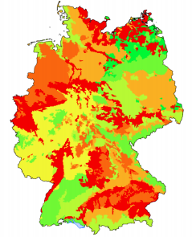
Extent of HNV Farmland
13-16% of the total farmland
Proportion HNV farmland
7,0% – 8,4%
8,5% – 10,7%
10,8% – 13,4%
14,5% – 14,4%
14,5% – 16,0%
16,1% – 20,3%
20,4% – 23,7%
Keenleyside et al. 2014. High Nature Value farming throughout EU-27: Annex 1 (maps)
Notes:
Agricultural statistics: 52.4% land area is agricultural, 30.1% forest, 13.3% settlements and infrastructure, 4.2 other uses. Total agricultural area is 18.4 million ha and 28% of that is permanent grassland. Permanent crops cover 1% of the agricultural area. (Oppermann in Oppermann et al. 2012).
Just over half of Germany’s land area is used for agriculture. Crop production accounts for 70% of farmland, and the remaining 30% are grassland and permanent crops including vineyards and orchards. The average farm size for farms with main income from farming is 57 ha, while the holdings with mainly non-farm income average 14 ha. Farming is mainly intensive. There are almost no regions in Germany used predominantly for extensive agriculture. (Oppermann in Oppermann et al. 2012)
HNV farmland in Germany is predominantly are grasslands. The most important types in terms of area are lowland and mountain hay meadows, which account for about 37% of all semi-natural habitats (Oppermann in Oppermann et al. 2012).
The map presents a graded representation of the proportion of land that is HNV farmland in Germany, where red indicates areas with the least amount of HNV farmland, and bright green indicates the areas with the most HNV farmland. The values of the shades are determined from data in Table 9 of the report (BfN, 2011)
SOURCE: Oppermann, R. 2012. Germany. In Oppermann, R., Beaufoy, G., Jones, G. (Eds) 2012. High Nature Value Farming in Europe: 35 European countries – experiences and perspectives. c. Verlag gegionalkultur, Germany. 544pp. ISBN: 978-89735-657-3
MAP: Keenleyside, C, Beaufoy, G, Tucker, G and Jones, G (2014) High Nature Value farming throughout EU-27 and its financial support under the CAP. Report prepared for DG Environment, contract ENV B.1/ETU/2012/0035. Institute for European Environmental Policy: London. http://www.efncp.org/download/HNV_and_CAP_Annex_1_maps_.pdf

Slide 16
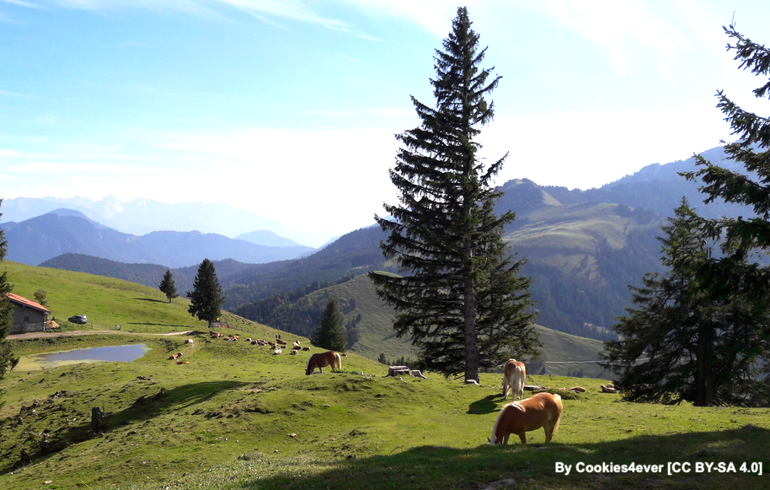
HNV Farming systems
Traditional HNV farming systems
Transhumant shepherds (Schwäbische Alb, the Rhön, north German coast)
Dairy & sheep in higher Alp regions
Sedentary extensive-grazing sheep systems
Extensive suckler farms
Hay producers
Permanent crop farms (orchards, mainly part-time farming)
Some organic farms
By Murmelkaktus [CC BY-SA 4.0]
Notes:
Although intensive farming dominates, almost all regions of Germany have some areas that are used extensively and can be regarded as HNV farmland.
HNV farmland consists mostly of patches within predominantly non-HNV farmland.
However, there are some farms where the farmland is predominantly HNV farmland these are:
Transhuman shepherds (Schwäbische Alb, the Rhön, north German coast)
Sedentary extensive-grazing sheep systems
Dairy & sheep in higher Alp regions
Extensive suckler farms
Hay producers
Permanent crop farms (orchards, mainly part-time farming)
Some organic farms
These HNV farming systems are farmed by an estimated 1-5% of the farmers in Germany but account for roughly ⅕ of all the HNV farmland in Germany.
SOURCE: Oppermann, R. 2012. Germany. In Oppermann, R., Beaufoy, G., Jones, G. (Eds) 2012. High Nature Value Farming in Europe: 35 European countries – experiences and perspectives. c. Verlag gegionalkultur, Germany. 544pp. ISBN: 978-89735-657-3 p. 223
Photo: By Cookies4ever [CC BY-SA 4.0 (https://creativecommons.org/licenses/by-sa/4.0 )], from Wikimedia Commons https://upload.wikimedia.org/wikipedia/commons/7/7a/Farrenpoint3.jpg
Photo description: Bavarian Mountain Pastures: Horses and cows next to the Huberalm on top of the Farrenpoint.

Slide 17
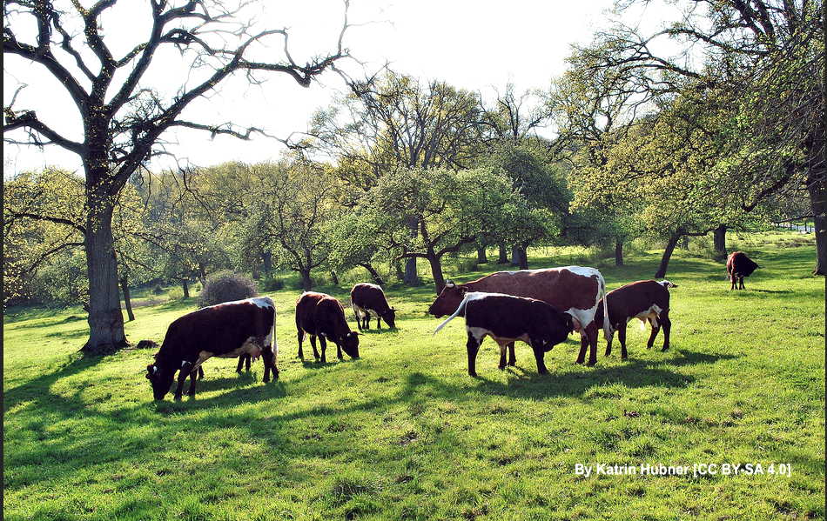
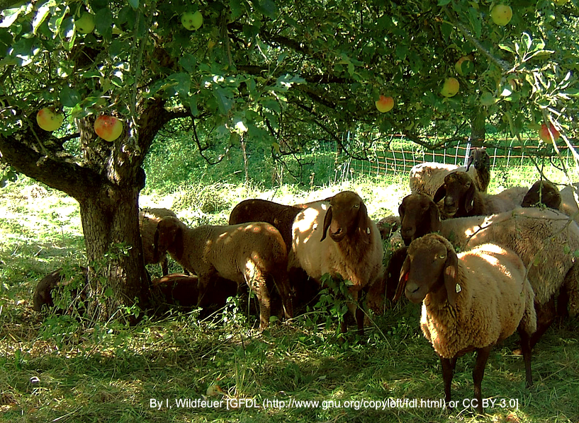
HNV Farming systems
2. Farms with HNV farmland areas:
Maintain patches of extensively used grassland, Natura sites, landscape elements, traditional orchards
Organic farms with species-rich arable land or vineyards
Less biodiverse farmland matrix than the full HNVf system
Includes both full & part-time farmers, hobby farmers with horses or sheep
Notes:
So-called “normal” or regular farmers maintain patches of extensively used grassland and Natura 2000 sites, landscape elements and traditional orchards with a less biodiverse farmland matrix than those with traditional HNV farming systems. Collectively, these full and part-time farmers, both conventional and organic, maintain about 80% of the HNV farmland in Germany.
Thus, maintaining Germany’s HNV farmland is in the hands of many farmers in Germany through their everyday farm work.
Of note in wine-growing areas is the presence of species rich vineyards through the practice of contour viticulture carried out on narrow terraces along rivers. The dry stone walls and dry grassland banks used in this production are important HNV habitats.
The understory of traditional apple and pear orchards is mostly used for grazing and hay-making. Regionally, they are a significant part of the HNV farmland.
SOURCE: Oppermann, R. 2012. Germany. In Oppermann, R., Beaufoy, G., Jones, G. (Eds) 2012. High Nature Value Farming in Europe: 35 European countries – experiences and perspectives. c. Verlag gegionalkultur, Germany. 544pp. ISBN: 978-89735-657-3 p. 223-224.
Photos
COWS
By Katrin Hubner [CC BY-SA 4.0 (https://creativecommons.org/licenses/by-sa/4.0 ], from Wikimedia Commons
https://upload.wikimedia.org/wikipedia/commons/5/5f/Altensittenbacher_Anger07.jpg
Photo description: The Altensittenbacher Anger near Hersbruck is still used as pasture for cattle
SHEEP under the APPLE TREE By I, Wildfeuer [GFDL (http://www.gnu.org/copyleft/fdl.html ) or CC BY 3.0 (https://creativecommons.org/licenses/by/3.0 Creative Commons Attribution 3.0 Unported)], from Wikimedia Commons. https://upload.wikimedia.org/wikipedia/commons/f/fc/2006-09-12Braunes_Bergschaf01.jpg
Photo description: “Braunes Bergschaf” breed of sheep beneath an apple tree in the Rems valley in Baden- Württemberg, Germany.

Slide 18
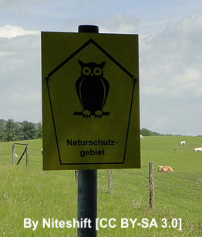
HNV Farming systems
3. “Nature conservation” farmers
Work with specific nature conservation aim in mind
Paid via agri-environment contracts and/or nature conservation orgs.
Includes both individual farmers and conservation orgs.
1-5% of Germany’s farmers.
Photo: Cattle grazing in a nature reserve Upahler and Lenzener
Notes:
SOURCE: Oppermann, R. 2012. Germany. In Oppermann, R., Beaufoy, G., Jones, G. (Eds) 2012. High Nature Value Farming in Europe: 35 European countries – experiences and perspectives. c. Verlag gegionalkultur, Germany. 544pp. ISBN: 978-89735-657-3 p. 224
Photo
By Niteshift (talk), driver and motive selection: Klostermönch [CC BY-SA 3.0 (https://creativecommons.org/licenses/by-sa/3.0 )], from Wikimedia Commons
https://upload.wikimedia.org/wikipedia/commons/0/09/Lenzen_%28Mustin%29_Naturschutzgebiet_Upahler_und_Lenzener_See_2011-05-24_201.JPG
Photo description: Nature reserve Upahler und Lenzener See in Lenzen, district Parchim, Mecklenburg-Vorpommern, Germany

Slide 19
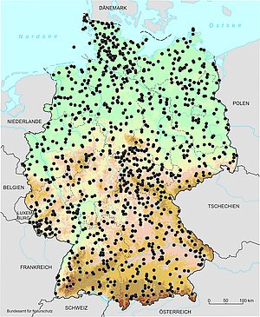
In Focus: A unique monitoring system for HNV farmlands
Data from field surveys on some 900 1-sq.km. sample plots throughout Germany
Assigned values for HNV farmland structures:
  HNV I: Exceptionally high nature value
  HNV II: Very high nature value
  HNV III: Moderately high nature value
Evaluates quality and potential quality and monitors quality changes
Sample plots of the HNV farmland indicator
(Source: BfN 2013, © GeoBasis-DE/BKG)
Notes:
“HNVF in Germany Germany is the first (and so far the only) Member State to have devised a new data system to gather qualitative and quantitative on HNV farmland, which provides quite a robust CMEF monitoring tool. Type 1 HNV farmland is mainly extensive semi-natural grasslands in upland areas, mountains and on poorer lowland soils. In these areas farm diversification, direct marketing and part-time farming are common, although there are some large sheep farms in some regions. Type 2 HNV land is mainly on more intensively managed conventional farms. It is estimated that HNV farmland in Germany benefited from about 16 % of the public expenditure under Pillar 2 and less than 3 % of the combined Pillar 1 and 2 (2007-9 period). Regional agri-environment programmes have measures designed for HNV semi-natural grasslands, and these include some results-based payments, with simple self-assessment by farmers of the floristic diversity of their meadows.” (SOURCE: IEEP 2014, p. 122)
(BELOW & map is from: Benzler https://www.bfn.de/en/activities/monitoring/hnv-farmland-indicator.html)
“Data for the HNV farmland indicator are gathered in field surveys, using some 900 sample plots throughout Germany each covering one kilometre square.”
“The identified HNV farmland structures were assigned nature values on a scale:
HNV I: Exceptionally high nature value
HNV II: Very high nature value
HNV III: Moderately high nature value”
“To ensure homogenous conditions for the nationwide field mapping, various measures for a quality management are undertaken. BfN arranges training courses on a regular basis to educate the field ecologists.”
“the conceptual design offers an additional potential for analysis, as the data allows a more differentiated view. Qualitative changes in the HNV farmland setting can be assessed in time by addressing the different quality levels separately in their temporal dynamics as well as trends for qualitative development of HNV types as e.g. grassland, fallow land or arable land. Merely in cases of rare HNV types that cannot be assessed in sufficient numbers to guarantee statistical soundness this potential reaches its limit.”
MAP: Distribution of sample plots for compilation of the HNV farmland indicator in Germany (Source: BfN 2013, © GeoBasis-DE/BKG) (SOURCE: Benzler https://www.bfn.de/en/activities/monitoring/hnv-farmland-indicator.html)
Sources:
BFN Federal Agency for Nature Conservation. The High Nature Value farmland indicator in Germany https://www.bfn.de/en/activities/monitoring/hnv-farmland-indicator.html
IEEP & EFNCP. 2014. High Nature Value farming throughout EU-27 and its financial support under the CAP – Final Report, March 2014. EU. https://lbst.dk/fileadmin/user_upload/NaturErhverv/Filer/Landbrug/Natur_og_miljoe/Natura2000_og_HNV-kort/HNV_rapport_2014_-_27_EU_lande.pdf
Klimek et al 2015 High Nature Value farming: From Indication to Conservation http://www.efncp.org/download/S24.3_Klimek.pdf
https://lbst.dk/fileadmin/user_upload/NaturErhverv/Filer/Landbrug/Natur_og_miljoe/Natura2000_og_HNV-kort/HNV_rapport_2014_-_27_EU_lande.pdf page 122

Slide 20
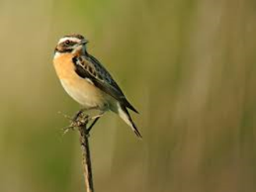
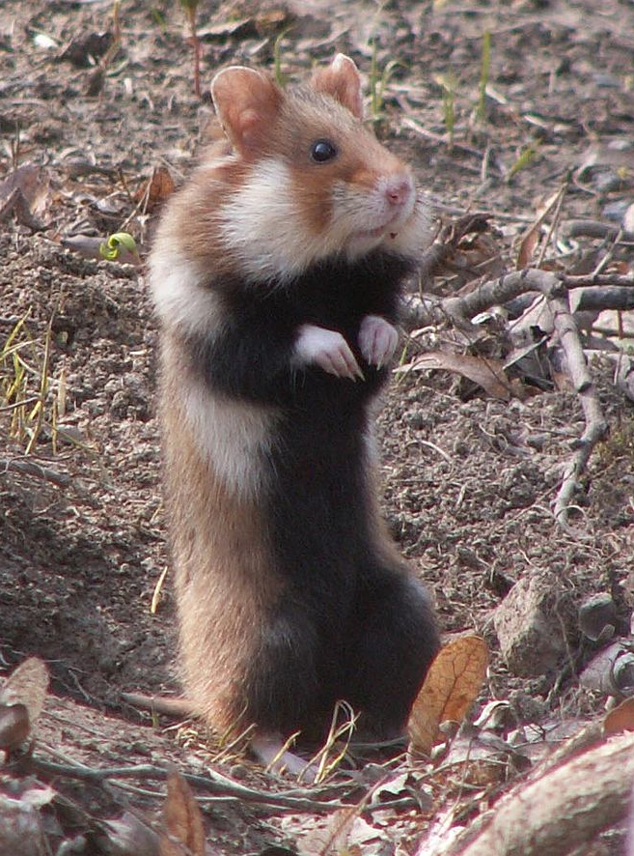
Biodiversity
Of 870 species of vascular plants on the red data list, 500 species are characteristic of semi-natural grasslands (Briemle 2003).
F Vassen CC BY-SA 2.0
Whinchat (Cricetus cricetus) - a formally common species of grasslands
European hamster (Cricetus cricetus), associated with extensive farming, has become rare
katanski CC BY-SA 3.0
Notes:
Bird data show decline in farmland birds, including of formally common species like skylark (Alauda arvensis) and whinchat (Saxicola rubetra). The European hamster (Cricetus cricetus) is considered characteristic of extensive farming in Germany but has become very rare. Butterflies (e.g. Phengaris) and crickets (e.g. Stethophyma grossum and Polysarcus denticauda) are typical of extensively managed damp meadows. (Oppermann in Oppermann et al. 2012).
SOURCE: Oppermann, R., Beaufoy, G., Jones, G. (Eds) 2012. High Nature Value Farming in Europe: 35 European countries – experiences and perspectives. c. Verlag gegionalkultur, Germany. 544pp. ISBN: 978-89735-657-3
Briemle, G. (2003): Artenreiches Grüland in Artenreiches Grüland (Hrsg.: Oppermann, R. & Gujer, H-U.) Ulmer, Stuttgart, 15-16
Photos:
European hamster: By katanski [GFDL (http://www.gnu.org/copyleft/fdl.html ) or CC BY 3.0 (https://creativecommons.org/licenses/by/3.0 )], from Wikimedia Commons
Whinchat: Frank Vassen [CC BY-SA 2.0 de (https://creativecommons.org/licenses/by-sa/2.0/de/deed.en )], from Wikimedia Commons https://commons.wikimedia.org/wiki/File:Saxicola_rubetra_-Belgium_-male-8.jpg

Slide 21
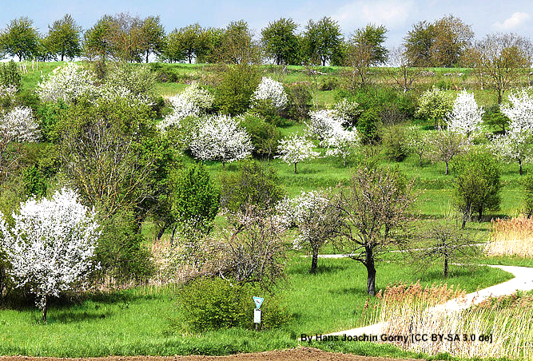
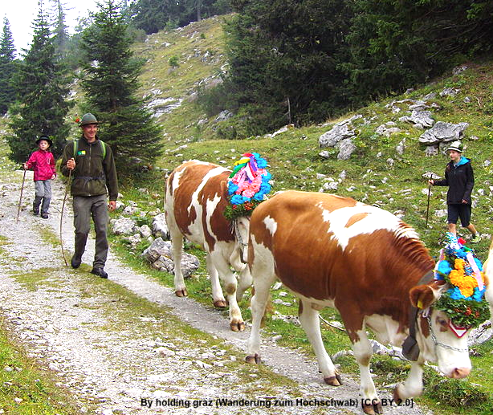
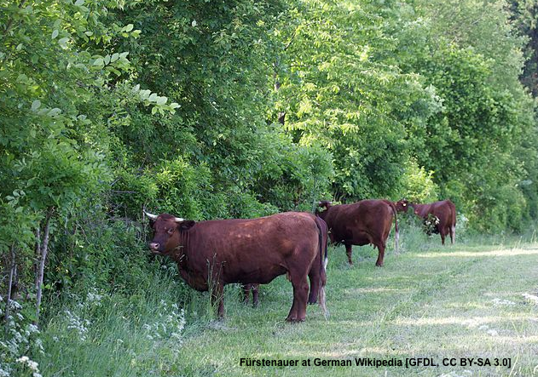
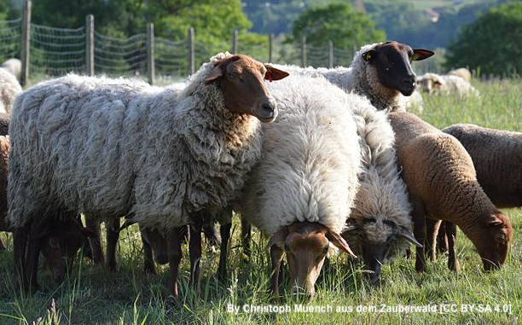
Other values
Plant diversity:
+2000 varieties of apple & pear
Alpine culture:
The cattle drive
Heritage breeds
54 of the 65 indigenous livestock breeds are endangered
Coburger Fuchsschaf
Rotes Höhenvieh
Notes:
Alpine culture: the cattle drive
Taking cattle up to the summer mountain pasture and bringing them down again is an integral part of the culture around the Alps. In Bavaria, the cattle are brought down from the mountain pastures in September during the Almabtrieb. The cattle drive is an annual event with a long tradition. The cattle themselves are colorfully decorated and have elaborate bells. The leader is sometimes crowned. The festival includes e.g. a brass band, beer tents, display of regional traditional outfits, dancing, music, and food. In some areas, the cattle are transported over the water. (SOURCES: Bavaria.by https://www.bavaria.by/experiences/city-country-culture/traditions-customs/almabtrieb-viehscheid-in-bavaria/ ;
Fischunkelalm, Bavaria https://commons.wikimedia.org/wiki/Category:Fischunkelalm https://de.wikipedia.org/wiki/Fischunkelalm ;
Cattle drive on Königssee Lake http://www.joergnitzsche.de/mobile/en/cattle-drive-koenigssee.html)
Photo: By holding graz (Wanderung zum Hochschwab) [CC BY 2.0 (https://creativecommons.org/licenses/by/2.0 )], via Wikimedia Commonshttps://upload.wikimedia.org/wikipedia/commons/d/d7/Wanderung_zum_Hochschwab_%2810926289523%29.jpg
Orchards: The traditional orchards are important sources of genetic material for fruit trees: there are approximately 2000 traditional varieties of pear and apple in Baden-Württemburg alone (Oppermann in Oppermann et al. 2012). Horizon2020 PEGASUS Project has defined environmental and social benefits which interrelate with traditional orchards. These include social trends such as “hobbies with a purpose”, contribution to public recreation, and environmental services such as improved water quality and climate adaptation. (SOURCE: Horizon2020 PEGASUS Project. Case study on Traditional orchard meadows in Hessen/Baden-Württemberg https://oppla.eu/casestudy/18390)
Photo: By Hans Joachin Gorny (see author) [CC BY-SA 3.0 de (https://creativecommons.org/licenses/by-sa/3.0/de/deed.en )], via Wikimedia Commons https://upload.wikimedia.org/wikipedia/commons/c/c0/Biotop_Streuobst_NSG-Saure-Matten_Oberrhein_Ettenheim.JPG
Caption: “Saure Matten” , nature reserve at the eastern scarp of the Rhine graben (Upper Rhine Plain), Southwest Germany. Ecologically very valuable orchards, meadows, seasonally wetlands, dry slopes. habitat for rare and even highly endangered flora and fauna.
Indigenous livestock
HNV farming, particularly in the mountains, includes the use of traditional landraces not found in intensive farming. This is particularly important because 54 of the 65 indigenous livestock breeds of horse, cattle, pig, sheep, and goat are endangered. (Oppermann in Oppermann et al. 2012).
Examples
Rotes Höhenvieh, or red upland cattle in English, is a mixed stock breed of red cattle from the Central Uplands of Germany. The breed was created in 1985 by merging the few remaining closely similar regional breeds of upland red cattle and pure-bred semen found in a sperm bank. The Rotes Höhenvieh was the first variety of German Red cattle for whom a recovery plan was made to save it from extinction. (SOURCE: https://en.wikipedia.org/wiki/Rotes_H%C3%B6henvieh ).
Photo: German Red Cattle. Fürstenauer at German Wikipedia [GFDL (http://www.gnu.org/copyleft/fdl.html ), CC BY-SA 3.0 (https://creativecommons.org/licenses/by-sa/3.0 ) or CC BY-SA 3.0 de (https://creativecommons.org/licenses/by-sa/3.0/de/deed.en )], from Wikimedia Commons https://upload.wikimedia.org/wikipedia/commons/5/50/Landschaftspfleger.jpg
Coburger Fuchsschaf, or Coburg Fox Sheep in English, was abundant in the 19th to early 20th century, but nearly went extinct after WWII. Today, the flocks are mainly used for landscape preservation. They are robust animals well suited to rough grazing. They can have multiple litters per year and average 2 lambs per litter. (SOURCE: https://en.wikipedia.org/wiki/Coburger_Fuchsschaf; Association for German Fox Sheep Breeders Arbeitsgemeinschaft der deutschen Fuchsschafzüchter e.V. https://www.agfuchsschaf.de/)
German Fox Sheep By Christoph Muench aus dem Zauberwald [CC BY-SA 4.0 (https://creativecommons.org/licenses/by-sa/4.0 )], from Wikimedia Commons. https://upload.wikimedia.org/wikipedia/commons/e/e3/Schafe_im_Sinngrund.jpg
SOURCE:
Oppermann, R. 2012. Germany. In Oppermann, R., Beaufoy, G., Jones, G. (Eds) 2012. High Nature Value Farming in Europe: 35 European countries – experiences and perspectives. c. Verlag gegionalkultur, Germany. 544pp. ISBN: 978-89735-657-3

Slide 22
Sources & experts
European Forum on Nature Conservation and Pastoralism (EFNCP)
http://www.efncp.org/hnv-showcases/south-west-germany/
http://www.high-nature-value-farming.eu/member-state-activity/germany/
http://www.high-nature-value-farming.eu/panorama/saargau-wolferskopf/
Benzler, A. 2016. Mapping HNV Farmland in Germany 2009 to 2015 http://enrd.ec.europa.eu/sites/enrd/files/gpw-02_4-1_germany_benzler.pdf
Aue, B., Diekötter, T., Gottschalk, T.K., Wolters, V. & Hotes, S. (2014) How High Nature Value ( HNV ) farmland is related to bird diversity in agro-ecosystems - Towards a versatile tool for biodiversity monitoring and conservation planning. Agriculture, Ecosystems and Environment, 194, 58-64

Slide 23
Sources & experts
Luick, R. 2008. Transhumance in Germany. www.efncp.org/download/Swabian_Alb_F_F_Download.pdf
Oppermann, R. 2012. Germany. In Oppermann, R., Beaufoy, G., Jones, G. (Eds) 2012. High Nature Value Farming in Europe: 35 European countries – experiences and perspectives. c. Verlag gegionalkultur, Germany. 544pp. ISBN: 978-89735-657-3
Oppermann, R. 2010. posters:
HNV-farmland in Germany https://www.bfn.de/fileadmin/MDB/documents/ina/vortraege/2010-Farmland-Poster-Germany1-HNV%20farmland.pdf
German farms with HNV farmland https://www.bfn.de/fileadmin/MDB/documents/ina/vortraege/2010-Farmland-Poster-Germany2-Farms-HNV.pdf
Expert: Rainer Opperman, Institut für Agrarökologie und Biodiversität (IFAB), oppermann@ifab-mannheim.de

Slide 24
High Nature Value Farming: Learning, Innovation and Knowledge HNV-Link
Disclaimer: This presentation reflects the author's view and the Research Executive Agency is not responsible for any use that may be made of the information it contains.
Working together for a sustainable future
www.hnvlink.eu

