Slide 1
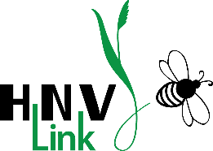
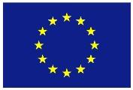
High Nature Value farmland
Examples across Europe: part 3 of 3
Irina Herzon, Traci Birge, Riina Koivuranta, Milka Keinänen
This presentation is an output of HNV-Link project - www.hnvlink-eu
THIS PROJECT HAS RECEIVED FUNDING FROM THE EUROPEAN UNION HORIZON 2020
RESEARCH AND INNOVATION PROGRAMME UNDER GRANT AGREEMENT NO. 696391

Slide 2
Notes for instructors and users
This presentation is part of the package of Education Materials on the topic of High Nature Farmland. It is an output of the Horizon 2020-funded project HNV-Link and is an Open Source material under CC BY-NC-SA. You may freely use, for non-commercial purposes only, any elements of it or as a whole, also modifying as fit, as long as you cite the project and its funding. Observe copyrights for images: all images are by HNV-Link unless otherwise specified.
The presentation contains minimum or no animation/special effects. Instructors may wish to add such effects according to their preferences.
Notes:
Attribution-NonCommercial-ShareAlike CC BY-NC-SA https://creativecommons.org/licenses/
"This license lets others remix, tweak, and build upon your work non-commercially, and although their new works must also acknowledge you and be non-commercial, they don’t have to license their derivative works on the same terms."
This presentation contains minimum or no animation/special effects. Instructors may wish to add such effects according to their audience and teaching style.

Slide 3
Learning objectives
To appreciate a diversity of High Nature Value farmland types across Europe and outside
To learn of the general characteristics of HNV farmland and farming systems
To familiarise oneself with various public values of HNV farmland

Slide 4
Content
Concept of High Nature Value (HNV) farmland
Examples from Europe
Spain and Portugal
Croatia
Romania
France
Germany
Ireland
Finland
Examples outside Europe
Notes:
There are many more examples that can be accommodated in one lecture. The instructor can decide which ones to choose: contrasting parts of Europe or for representing a specific region.
IMPORTANT: High nature value farming is a European concept, but this does not mean that HNV-farming systems or farmlands are exclusive to Europe, as non-European HNV-farming examples show.

Slide 5
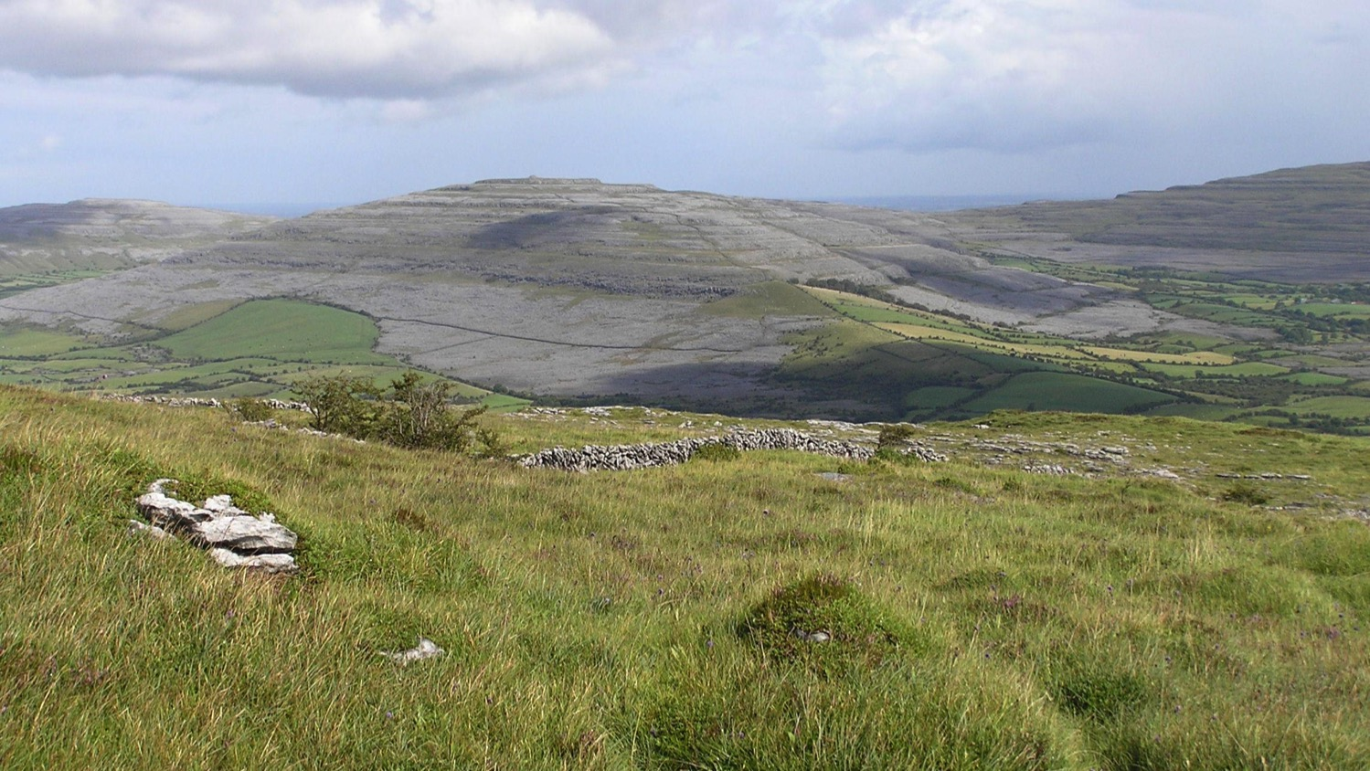
Ireland

Slide 6
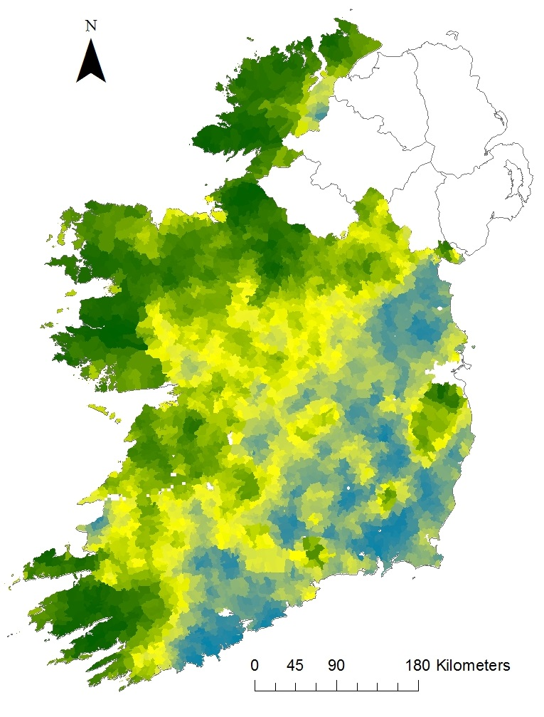

Extent of HNV farmland
5 classes
Darkest green = greatest likelihood of HNV farmland
High HNV potential in classes 4-5
IDEAL HNV Project http://www.high-nature-value-farmland.ie/hnv-distribution/
Notes:
Agricultural statistics: 62% land area is agricultural, 8% forest, 28% other uses (including 2% semi-natural land and 15.8% as wetland- both of these likely include agricultural use.). Total agricultural area is 4.35 million ha and 91% of that is grassland- 75% of which is declared as permanent pastures including rough grazing and commonage (Jones et al. in Oppermann et al. 2012).
Livestock-based farming is the dominant agricultural production- 95% of farm holdings have livestock. Dairy industry has become more concentrated- only 17% of holdings have dairy production. Permanent pasture covers the whole range of possible agricultural production intensities: the country can be divided into areas of extensive livestock mostly in the uplands and north-west, intensive grass/arable livestock in the east and south-east, and intensive based livestock elsewhere. Approximately 25% of the agricultural area of the Republic has a high likelihood of being HNV farmland. (Jones et al. in Oppermann et al. 2012).
Reference: Jones, G., Dunford, B. McGurn, P., Boyle, P., Hayes, M., Gormally, M., Moran, J. 2010. Ireland. In Oppermann, R., Beaufoy, G., Jones, G. (Eds) 2012. High Nature Value Farming in Europe: 35 European countries – experiences and perspectives. c. Verlag gegionalkultur, Germany. 544pp. ISBN: 978-89735-657-3
National Map of High Nature Value farmland in Ireland: The map shows the likelihood of finding HNV farmland in an electoral division (ED), with 5 being almost certain to find HNV and 1 being almost certain not to find HNV. The 1 through 5 classification is based on 5 variables available at the national scale: Corine land cover, land use, stocking densities, stream and river density, and soil diversity.
Map is from: http://www.high-nature-value-farmland.ie/hnv-distribution/
Technical aspects of the mapping process are described here http://www.high-nature-value-farmland.ie/hnv-distribution/
Identifying High Nature Value farmland in Ireland: https://idealhnv.wordpress.com/
HNV farmland likelihood of occurrence: https://www.youtube.com/watch?v=aEFc8rhhPYI
S. Matin, C. A. Sullivan, D. Ó hUallacháin, D. Meredith, J. Moran, J. A. Finn & S. Green (2016) Predicted distribution of High Nature Value farmland in the Republic of Ireland, Journal of Maps, 12:sup1, 373-376, DOI: 10.1080/17445647.2016.1223761

Slide 7
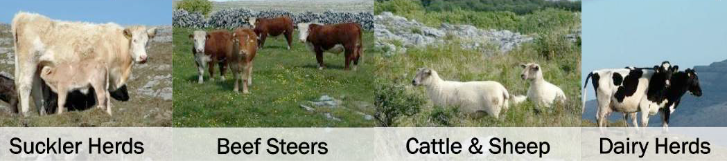
HNV farming systems
Pastoral systems
“Mountain” and “inbye” (enclosed) pastures
Carrying capacity highly variable and
Stocking rates lower on HNV farms
Whole farm, partial & landscape HNVf
Suckler herds Beef steers Cattle & sheep Dairy herds
Photos: HNV-Link Baseline Assessment
Notes:
About 50% of Ireland’s farmers are economically full-time farmers, and 15% are statistically “subsistence” (aka “very small”) farmers.
Pastoral farming can be divided into so-called “mountain” pastures and “inbye” (enclosed) pastures.
Soil cover is highly variable and stocking rates are an important issue. Large areas have been subject to compulsory destocking to reduce overgrazing.
Recent assessments place undergrazing as a bigger cause for concern than over-grazing in the uplands.
Commonage at the foothills of mountain areas and lowlands – usually more intensively managed.
Reference: Jones, G., Dunford, B. McGurn, P., Boyle, P., Hayes, M., Gormally, M., Moran, J. 2010. Ireland. In: Oppermann, R., Beaufoy, G., Jones, G. (Eds) 2012. High Nature Value Farming in Europe: 35 European countries – experiences and perspectives. c. Verlag gegionalkultur, Germany. 544pp. ISBN: 978-89735-657-3
IDEAL-HNV project identified Ireland as having several types of HNVf. http://www.high-nature-value-farmland.ie/types-of-hnv-farmland/ These are whole farm HNV, partial farmland HNV farmland, and farms associated with landscape level HNV.
Whole HNV farms with no commonage. These are typically lowland farms with low proportions of peatland and often high proportions of semi-natural grassland and are found mainly in an area called the Burren.
Small whole HNV farms are under 40 ha. About 45% have commonage, and semi-natural habitat coverage is about 81%. They occur throughout the Ireland.
Large whole HNV farms average 208 ha and have high proportions (91%) of semi-natural habitat cover which is mainly peatland. About 45% have commonage. Occur in upland areas.
Commonage farms with improved grassland have about 68% semi-natural vegetation coverage and they occur at a range of elevations. 62% have commonage and the highest stocking densities of the whole HNV-types. They occur in Comeragh and Wicklow uplands.
Partial HNV farmland have high proportions of semi-natural habitat (55%), low commonage (8%) and lower proportion of peatlands compared to other groups.
Farms associated with landscape level HNV are lowland farms occuring along the Shannon River and contribute to larger landscape-level features such as nationally important species-rich wet grasslands. They have relatively low proportions of semi-natural habitats (28%) and the highest stocking rate of the HNV types.

Slide 8
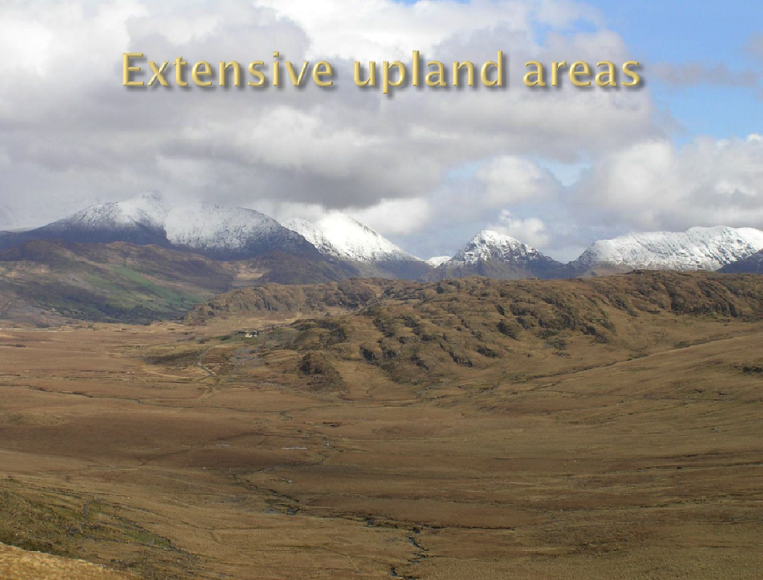
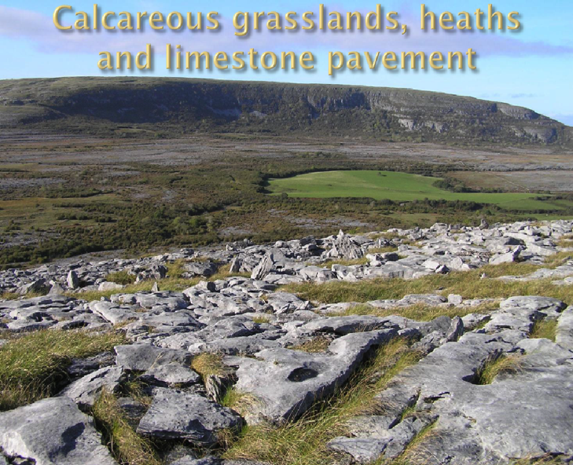
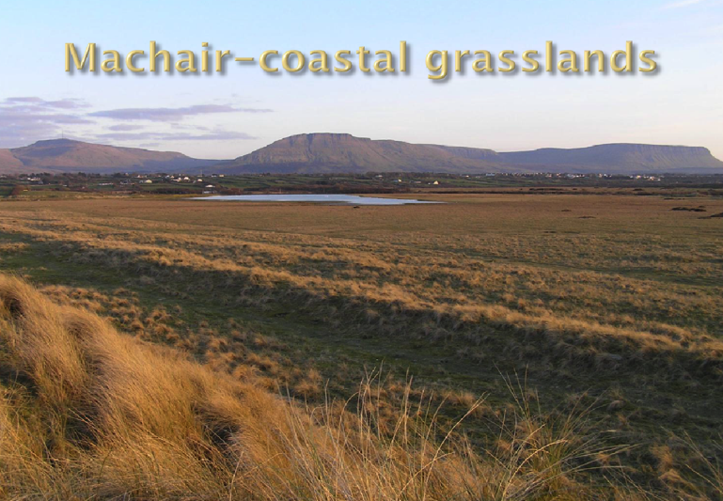
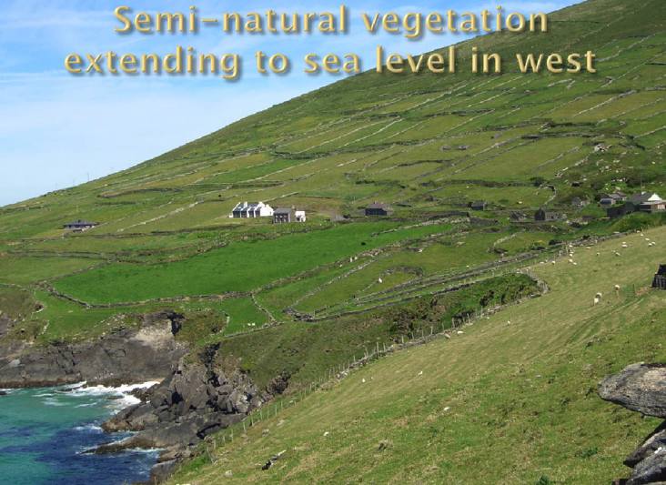
HNV farmland
Extensive upland areas
Calcareous grasslands, heaths and limestone pavement
HNV-Link Baseline Assessment
Machair-coastal grasslands
Semi-natural vegetation extending to sea level in west
EFNCP video on Achill Island http://dai.ly/x3hqlvc
Notes:
The “upland” areas are dominated by semi-natural vegetation and extend down to the coast in the extreme west, where the Atlantic climate creates conditions for blanket bog at sea level. Typical communities are dry heaths, Atlantic wet heaths, blanket bogs and species Molinia caerulea, Nardus stricta and Festuca/Agrostis grasslands. (Jones et al. in Oppermann et al. 2012).
Machair is a rare biodiverse coastal grassland unique to the north-western fringes. There is just 19,000 ha of it globally, with 70% in western Scotland, mostly on offshore islands, and the remainder in western Ireland. Formation of machair is caused by sedimentation of sand with high content of shells by the prevailing western winds onto low-lying coasts. For hundreds of years, it has been used for low intensity production resulting in a mosaic of habitats: pastures, hay meadows, traditional crops. It hosts many rare plant species and invertebrates, and is famous for its important bird areas (Oppermann et al. 2012, p. 45). “Machair” comes from a Gaelic word meaning “fertile plain” -see EFNCP video http://dai.ly/x3hqlvc
Inbye grasslands have seen shifts from natural to semi-natural to improved permanent pasture, and the nature value of semi-natural areas in particular should be assessed. Field boundaries are very important parts of lowland agriculture nature values. These include dry stone walls, hedges and earth banks.
EFNCP produced a film on Achill Island that highlights the Natura 2000 habitats Machair Grassland and Upland Heath. The key messages: “Supporting the type of traditional extensive farming that is practiced here is essential for maintaining these habitats. Taking a more targeted approach to agri-environment schemes can help achieve this as can supporting local food production methods that add value to the farming system and local community.” - https://www.dailymotion.com/video/x3hqlvc
References: Jones, G., Dunford, B. McGurn, P., Boyle, P., Hayes, M., Gormally, M., Moran, J. 2010. Ireland. In: Oppermann, R., Beaufoy, G., Jones, G. (Eds) 2012. High Nature Value Farming in Europe: 35 European countries – experiences and perspectives. c. Verlag gegionalkultur, Germany. 544pp. ISBN: 978-89735-657-3
Oppermann, R., Beaufoy, G., Jones, G. (Eds) 2012. Chapter 3: Types of high nature value farming in Europe. In: High Nature Value Farming in Europe: 35 European countries – experiences and perspectives. c. Verlag gegionalkultur, Germany. 544pp. ISBN: 978-89735-657-3

Slide 9
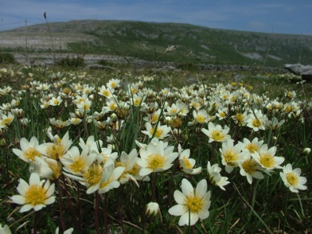
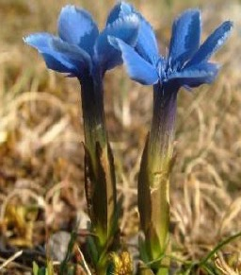
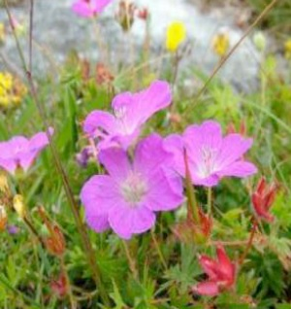
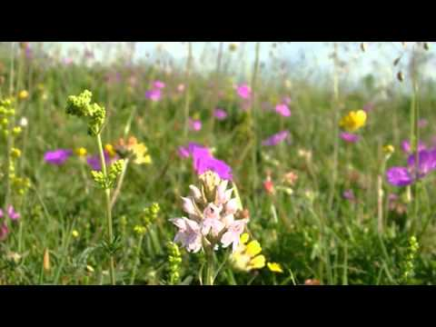
Biodiversity
Mountain avens
(Dryas octopetala)
Spring gentian (Gentiana verna)
Grasslands support insects incl. beetles, flies, butterflies, moths, dragonflies
Stone walls: habitat, corridors, connectivity
Fauna: e.g. pine martin, badgers, bats, birds
Bloody crane's-bill
(Geranium sanguineum)
In focus: The Burren
A special limestone habitat
Over 70% of Ireland’s species of flowers and 30 of Ireland’s 34 butterfly species recorded in the Burren
102 species of breeding birds recorded
Photos: HNV-Link Baseline Assessment; Caroline Sullivan (HNV Ideal)
Notes:
Grasslands provide important habitats for many insects such as beetles, flies, butterflies, moths and dragonflies. These insects are, in turn, essential sources of food for birds and other animals. The Burren, for example, is a highly important breeding area for the European pine marten. Stone walls are important habitat for mosses, lichens and insects. They also connect landscapes and provide corridors for safe passage of small mammals.
The Burren is a special habitat of biodiversity importance. On limestone biotopes of The Burren, over 70% of Ireland’s 900 native plant species have been found in the uplands, which represent less than 0.5% of the national area. In the Burren 23 of Ireland’s 27 orchid species, 30 of Ireland’s 34 butterfly species, at least half of the 570 macro-moths recorded in Ireland are found, as well most of Ireland’s native bat species. Stocking rates in the Burren remain relatively low compared the national rates: an average of 0.65LU/ha (Dunford, 2001).
There is a wealth of good visual materials on the many aspects of the Burren, its history, geology, ecology, agriculture and culture. Check on BurrenBeo Trust website or YouTube (for example, "Wild Ireland": The Burren in Spring, County Clare, Ireland - https://www.youtube.com/watch?v=KUFky2as5hI)
Embedded video here - https://youtu.be/j1IjSrfWE60
References:
Dunford, B. 2001. The Impact of Agricultural Practices on the Natural Heritage of the Burren Uplands, Co. Clare. PhD Thesis submitted to the National University of Ireland, Dublin, November 2001.
Dunford, B. 2016. The Burren Life Programme: An overview. NESC Research Series Paper no. 9. 26pp. files.nesc.ie/nesc_research_series/Research_Series_Paper_9_BDunford_Burren.pdf
Sullivan, C., Moran, J., Dunford, B. 2017. Ireland Baseline Assessment. HNV-Link. 66pp. http://www.hnvlink.eu/download/BurrenBaselineAssessment.pdf

Slide 10
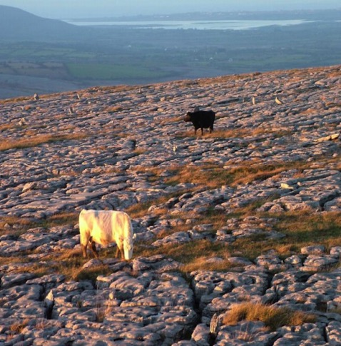
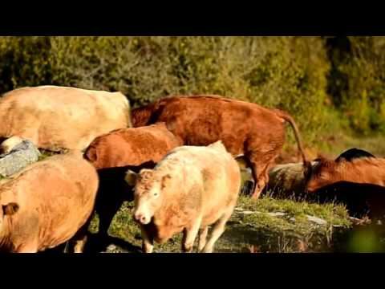
In focus: Winterage in the Burren
Winterage: a unique and ancient “reverse transhumance” practiced in the Burren
Livestock are moved from the lowlands to the highlands for the winter
Made possible by the limestone bedrock, which acts as a “heated floor”
Maintains plant biodiversity by keeping scrub down and grazing when wildflower species are dormant
https://youtu.be/WHaP3mbJaMY
https://youtu.be/WHaP3mbJaMY
Notes:
Winterage is a unique agrarian practice, thousands of years old, which occurs in the Burren. Winterage is a form of reverse transhumance whereby cattle are put up on the rough grazing of the Burren uplands in October. They remain there until the following spring, at which point they are brought back down to the more fertile or improve lowland pastures.
Winterage is made possible by the warmth of the limestone, which acts as “underfloor heating”. The winter grazing creates a unique habitat because most flowering species are dormant during the winterage period. Thus, the species can thrive without grazing pressure in the summer.
The winterage grazing suppresses such plants as blue moor-grass (Sesleria caerulea) , purple moor grass (Molinia caerulea) and heather (Erica sp. and Calluna sp.) that would otherwise out-competing smaller herbs for which the Burren is famous. Winterage also controls shrubs such as hazel (Corylus avellana) and blackthorn (Prunus spinosa), which would otherwise smother the grasslands and any monuments they might contain.
As Dr. Brendan Dunford of Burrenbeo Trust explains:
“The practice of Winterage is not only unique and intriguing, it's a big part of the reason why we have so many monuments, flowers and stories here in the Burren today. Witnessing the cattle browsing on the herb-rich winterage pastures, drinking from the calcium-rich springs or enjoying the 'dry-lie' of the limestone captures the very essence of this 'fertile rock'.” https://www.burrenwinterage.com/about-winterage or Burren Winterage Weekend - https://www.youtube.com/watch?v=KUFky2as5hI
Video on slide: https://youtu.be/WHaP3mbJaMY also: https://youtu.be/G9-sNVqKZAw
References:
Burrenbeo Trust: https://www.burrenwinterage.com/about-winterage
HNVLink: http://www.hnvlink.eu/download/BurrenBaselineAssessment.pdf

Slide 11
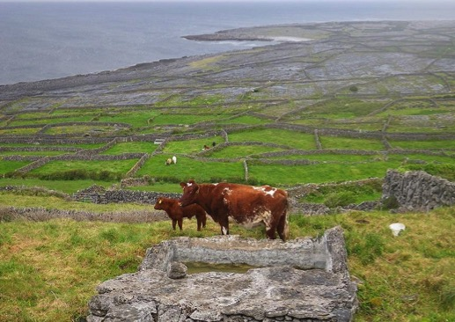
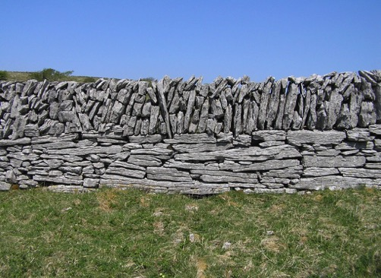
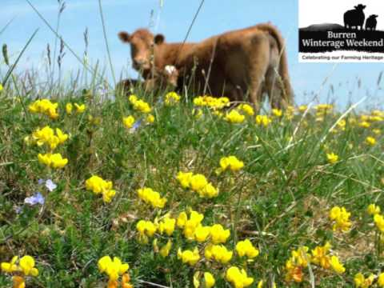
Other values: Culture
Unique cultural landscapes, incl. many archaeological sites
Profitability is low; farmers’ practices shifting, incl. to part-time
Landscape-based tourism and celebration of farming traditions
Connemara ponies, rye thatching, stone walls, winterage are some of the farming heritage and skills visible in the landscape.
The Burren winterage weekend- (start 1:14) https://youtu.be/KUFky2as5hI
https://www.aranlife.ie/farming-on-the-islands
http://www.high-nature-value-farmland.ie/whole-hnv/
Notes:
There are many elements of the farming heritage across HNV farmlands in Ireland: Connemara ponies, rye thatching, stone walls, and winterage are some of the farming heritage and skills visible in the landscape. Cultural heritage is a major draw for Irish tourism, so all of these elements support tourism.
Landscape-based tourism and cultural celebrations: An example of a modern revival of an old tradition is The Burren Winterage weekend: Community-led events of workshops, demonstrations, local foods, music, exhibitions, and the culmination- a wintering drove. https://www.burrenwinterage.com/slideshow
Video in slide: https://youtu.be/KUFky2as5hI
Island and coastal tourism: example: Aran Islands has about 160,000-200,000 visitors/year. Cultural heritage (ancient monuments, landscape, way of life), of which HNV farming a part, is an important draw.
Extensive grazing keeps the landscape open, making such monuments and ancient structures visible and accessible.
HNV farming and farm products are not listed as a specific Opportunity in the tourism strategy. However, farming experiences and local food are described as important experiences and are also integrated into the overall island experience, including:
“Support existing and create new innovative food festivals” is listed as a Catalyst Project.
“The food story” and its link to how flora and fauna have adapted to the islands is one of the “Experience Development Priorities” (p. 22)
“Hero Products”: e.g. goat farm visit to buy goat cheese, seafood and farming traditions, sheep shearing, sheepdogs at work
Reference: “Wild Atlantic Way” tourism strategy: http://www.failteireland.ie/FailteIreland/media/WebsiteStructure/Documents/2_Develop_Your_Business/Key%20Projects/The-Connemara-Coast-Aran-Islands-Visitor-Experience-Development-Plan.pdf
There is potential for HNV farming to better access and benefit from tourism. Currently, some farmers in Aran Islands feel that they are not sufficiently rewarded for the public goods they provide
“Pro-active marketing of produce from High Nature Value farmland is needed to make farming in these areas financially viable.”
“Types of tourism that have the potential to support High Nature Value farmland should be encouraged. There is a need to explore ways in which the farmers who maintain the landscape can benefit directly from the tourists and tour operators who enjoy that landscape.”
*Aran Islands farmer quote: ‘Farmers on the island are not in it to make money, but for the love of farming and to keep going what has been done on the island for years.’
Reference: From the report on HNV farming in Connemara and Aran Islands https://www.heritagecouncil.ie/content/files/high_nature_value_farming_north_connemara_aran_summary_2010_890kb.pdf

Slide 12
Sources & experts
https://idealhnv.wordpress.com/ & http://www.high-nature-value-farmland.ie/
http://efncp.org/projects/hnv-farmland-irish-uplands/
http://www.hnvlink.eu/learning-areas/the-burren-ireland/
https://whc.unesco.org/en/tentativelists/5522/
http://burrenprogramme.com/category/high-nature-value-farming/
https://www.aranlife.ie/
https://www.burrenwinterage.com/about-winterage
S. Matin, C. A. Sullivan, D. Ó hUallacháin, D. Meredith, J. Moran, J. A. Finn & S. Green (2016) Predicted distribution of High Nature Value farmland in the Republic of Ireland, Journal of Maps, 12:sup1, 373-376, DOI: 10.1080/17445647.2016.1223761
Experts: James Moran, GMIT James.Moran@gmit.ie
Notes:
Sources for HNV farmland in Ireland: the HNV-Link Baseline Assessment, Ideal HNV project, European Forum on Nature Conservation and Pastoralism Ireland page, UNESCO’s page on the Burren, Burren Programme’s webpage, Aran LIFE project.

Slide 13
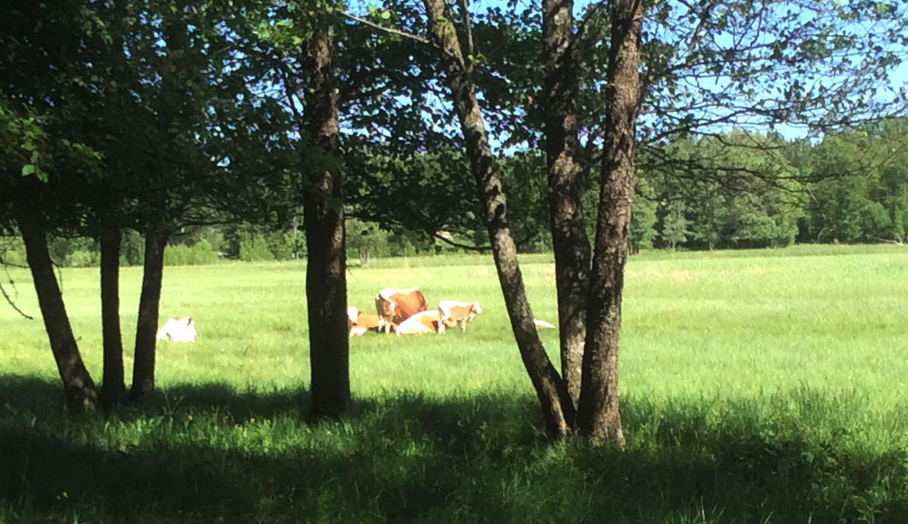
Finland
Notes:
Photo: Eastern Finnish Cattle in Espoo, Finland 2018, by T. Birge CC BY–NC-SA

Slide 14
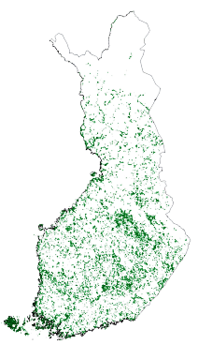
HNV farming indicator at farm level
Farms with highest scores have:
Large areas of semi-natural grasslands and permanent pastures
Large areas under agri-environment contracts for managing semi-natural grasslands, but also
Small field parcels
Animal husbandry
Large areas under extensive land use, such as grassland, fallow
Source: Heliölä et al. 2009
Notes:
Statistics: Land Use: 75% forest, 8% agricultural area, 17% other. Of the agricultural land, only 1.6% are permanent pastures and 0.2% are permanent crops; the rest is arable (mainly, cultivated grassland, cereals, oilseed rape. Organic farming =7%.
Half of Finland lies above the Arctic Circle. It is a land of forests and lakes and has the lowest population density in Europe. It is a country of family farms, although farm size has increased since accession to EU in 1995. Farms normally have large forests in addition to their arable lands. Agriculture is highly concentrated in the south. Finnish farmland is a mosaic of fields and forests. Large open farmland landscapes are typical only in the southern and western coastal regions. About half of all farmland is in arable crops and a further ⅓ in rotational grasslands. (SOURCE: Herzon and Helliölä, 2012 Finland. In Oppermann et al. 2012. High Nature Value Farming in Europe).
Finland and Sweden are highly similar, with similar percentage of land area in agriculture. Typical farm enterprises in both countries have both agriculture and forest production, and cropping farms dominate in the south. In both countries, the areas most valuable for biodiversity are the traditional semi-natural meadows and grazed forests and woodland pastures. Sweden has retained about ten times more of these valuable semi-natural farmlands compared to Finland. (SOURCE: relevant chapters In Oppermann et al. 2012. High Nature Value Farming in Europe)
The national HNV farmland indicator is calculated based on annual field-level information, collected as part of farm-level agricultural reporting. The indicator sums up scores from three so-called strong sub-indicators (areas of semi-natural grasslands, permanent pastures and those under relevant Agri-Climate-Environment Measure (AECM) contracts), and three weak sub-indicators (edge density, extensive cultivation and livestock farming). Farms that score above 20 points are classified as HNVf (Heliölä et al., 2009) - on the map.
According to the indicator, the HNVf has declined from 10.2 to 8.7% of agricultural area in 2006–2014 (Luonnontila 2017, MA8 Luontoarvoiltaan rikas maatalousmaa 22.4.2015).
Map adapted from: Heliölä, J., Lehtomäki, J., Kuussaari, M., Tiainen, J., Piha, M., Schulman, A., Lehtonen, H., Miettinen, A. & Koikkalainen, K. Luonnoltaan arvokkaat maatalousalueet Suomessa – määrittely, seuranta ja hoidon taloudelliset edellytykset. Maa- ja metsätalousministeriö 1/2009
http://mmm.fi/documents/1410837/1721034/MMMjulkaisu2009_1.pdf/aac60174-df79-4423-8a0f-5bd59cd8ac61/MMMjulkaisu2009_1.pdf.pdf
SOURCE: Oppermann, R., Beaufoy, G., Jones, G. (Eds) 2012. High Nature Value Farming in Europe: 35 European countries – experiences and perspectives. c. Verlag gegionalkultur, Germany. 544pp. ISBN: 978-89735-657-3

Slide 15
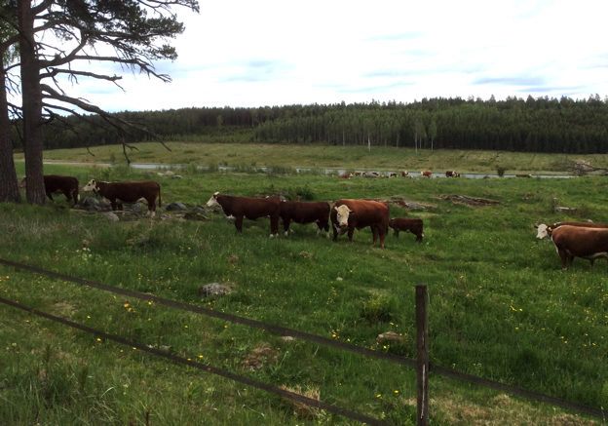
HNV farming systems
Include extensive grazing:
Suckler cow producers
Sheep, horse farms
Seldom dairy farms
All farms also have intensively
cultivated grasslands.
T. Birge CC BY–NC-SA
Common:
Management of semi-natural grasslands by grazing or mowing that does not relate to farm production
Management by conservation authorities, NGOs, volunteers
Entrepreneurship- grazing as a service.
Notes:
Semi-natural grasslands such as grazed woodlands and wooded pastures, moist freshwater and coastal meadows, as well as dry rocky outcrops (bedrock) are the main HNV habitat types. In Finland, these are collectively referred to as “traditional rural (or farmland) biotopes” (Finnish: perinnebiotooppi, Swedish: vårdbiotoper).
The level of integration or importance of HNV farmland to the whole farm system varies tremendously, from small sites managed for non-economic purposes (e.g. aesthetics, keeping landscape open) to livestock production substantially based around grazing of semi-natural grasslands. Regardless, winter fodder is generally from intensively cultivated grasslands (along with any concentrated feed). (SOURCE: Birge, T. & Herzon, I. 2014. Farmer and landowner motivations and experiences in managing rare semi-natural biotopes: A case from Finland. Land Use Policy 41:128–137. https://doi.org/10.1016/j.landusepol.2014.05.004)
Photo: Hereford cattle on riparian meadow, Salo, Finland 2018, by T. Birge CC BY–NC-SA

Slide 16
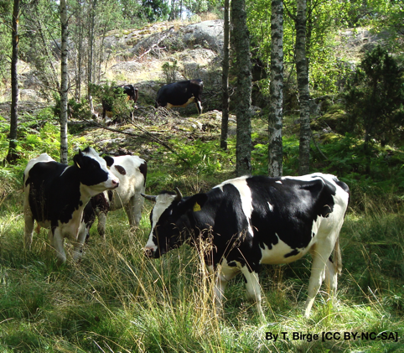
HNV farmland: Traditional biotopes
Different types of meadowland, moorland and wooded pastures
c. 40,000 ha remaining (< 1% from beg. 20th century), highly fragmented, mostly small areas
App. ⅓ are woodland pastures
In Focus: wooded pastures & grazed forest
Forest pastures common till 1960s
Nowadays, forest and agricultural land separated through policy and subsidies -> grazing in forest is rare
Notes:
Traditional rural biotopes include heaths, mineral soil meadows, seashore meadows, flood meadows, fen meadows, woodland pastures, forest pasture and wooded meadows.
Traditional rural biotopes correspond to HNVf type 1: farmland with semi-natural characteristics.
During the period of traditional agriculture, there was more meadow than arable field, and the primary purpose of cattle was to provide manure for the arable fields. Fodder was collected from meadows, seashore reedbeds, and from coppiced trees, and cattle also grazed in forests. Traditional agriculture lasted until the end of the 19th century. Meadow use peaked and then declined in the 1800s, and crashed again in the 1950s. (SOURCE: Birge 2017 Dissertation http://urn.fi/URN:ISBN:1798-744X )
The area of all semi-natural (traditional) rural biotopes decreased by more than 99 % in Finland during the 20th century. In Finland there exists approximately 20 000 hectares of inventoried meadows and pasturages (Vainio et al. 2001). This is ten time less than in Sweden. They have been lost due to abandonment of extensive grazing – especially simplification where farms got rid of their livestock and concentrated on crop production only – and due to land use change like afforestation of former grazing areas.
Wooded pastures and grazed forests
Cattle traditionally grazed in non-arable areas- including forests. Further, “leaf hay” - coppiced branches, were traditionally fed to livestock, but that practice only exists in rare cases (mainly for sheep) as supplementary feed.
Nowadays, forest & ag. land are distinctly divided due to both policy and effects of subsidies on land use planning
CAP is not adequate at recognizing pastures with high tree density. In Finland, these areas are not regarded agricultural and are not entitled to direct support. Many grazed woodlands are managed by the National Forest Board as cultural heritage sites.
Photo: Milking cattle breed in grazed woodland Raasepori, Finland. T. Birge CC BY–NC-SA

Slide 17
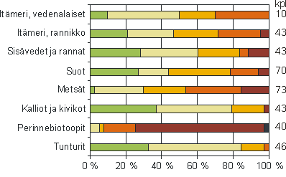
Biodiversity
28% (421 sp) of the endangered species - foremost on traditional biotopes
22% (338 sp) of species of traditional biotopes threatened
Baltic Sea, marine
Baltic Sea, coastal
Inland waters and coasts
Bogs
Forests
Rocky biotopes
Traditional biotopes
Tundra
Numbers of biotope types by IUCN classes: from favourable in green to extinct in black
Notes:
The remaining traditional rural biotopes are nowadays often reduced to small-sized parcels, but nonetheless they are essential for the country’s biodiversity. Numerous endangered species of plants, insects and fungi are dependent on them. Traditional rural biotopes also belong to the most endangered habitat types in Finland. Preserving the remaining traditional rural biotopes has become one of Finland’s most difficult conservation issues.
The dire situation of Finland’s traditional rural biotopes is evidenced by this figure showing the habitat types by IUCN classes. Green indicates a good status, increasingly red to dark red and black the increasingly poor status. Looking at traditional biotopes, there is very little green, and quite a lot of shades of red – indicating poor status, and even black – indicating that some habitat types have gone extinct.
SOURCES
Heliölä, J., Lehtomäki, J., Kuussaari, M., Tiainen, J., Piha, M., Schulman, A., Lehtonen, H., Miettinen, A. & Koikkalainen, K. Luonnoltaan arvokkaat maatalousalueet Suomessa – määrittely, seuranta ja hoidon taloudelliset edellytykset. Maa- ja metsätalousministeriö 1/2009
Finnish, with English summaries:
Schulman, A., Alanen, A., Hæggström, C.-A., Huhta, A.-P., Jantunen, J., Kekäläinen, H., Lehtomaa, L., Pykälä, J., & Vainio, M. 2008. Perinnebiotoopit. Julk.: Raunio, A. Schulman, A. & Kontula, T. (toim.). 2008. Suomen luontotyyppien uhanalaisuus − Osa I: Tulokset ja arvioinnin perusteet. Suomen ympäristökeskus, Helsinki. Suomen ympäristö 8/2008. S. 149−174.
SY 8/2008 Suomen luontotyyppien uhanalaisuus
Schulman, A., Alanen, A., Hæggström, C.-A., Huhta, A.-P., Jantunen, J., Kekäläinen, H., Lehtomaa, L., Pykälä, J., & Vainio, M. 2008. Perinnebiotoopit. Julk.: Raunio, A. Schulman, A. & Kontula, T. (toim.). 2008. Suomen luontotyyppien uhanalaisuus − Osa II: Luontotyyppien kuvaukset. Suomen ympäristökeskus, Helsinki. Suomen ympäristö 8/2008. S. 397−466. SY8/2008 LuTu, Osa 2, 7 Perinnebiotoopit.pdf

Slide 18
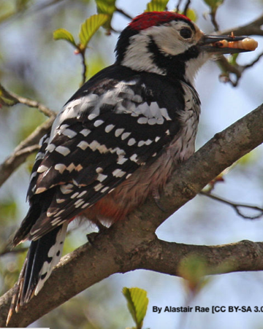
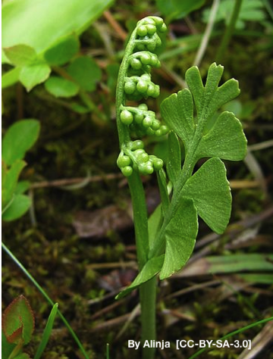
Biodiversity
Management of habitat types most valuable to biodiversity is crucial, e.g.:
44% of endangered species of the permanent grasslands are found in dry meadows (ca 10 000- 13 000 ha);
Seashore meadows (ca 57 000 ha) are a designated Habitat of National Responsibility (Finnish Environment Center).
White-backed woodpecker (Dendrocopos leucotos)
Common moonwort
Botrychium lunaria
Notes:
The previous slide showed us the dire straits for the main HNV farmland type in Finland. Management of the most valuable habitat types/sites is essential for farmland biodiversity. Here we present some of the species associated with the traditional rural biotopes, as well as highlight two important traditional biotope types: dry meadows and seashore meadows.
Biodiversity examples:
Plant species: Typical examples of HNV-farmland plant species in Finland: Rumex acetosella, Antennaria dioica, Deschampsia flexuosa, Leucanthemum vulgare, Dianthus deltoides and Festuca ovina.
White-backed woodpecker (Dendrocopos leucotos) and dunlin (Calidris alpina schinzii) live in traditional rural biotopes and they are both endangered in Finland (Vainio et al. 2001).
Dry meadows: 44% of endangered species of traditional biotopes are found in dry meadows, mostly insects, vascular plants, and fungi. Dry meadows are critically endangered (CR), with c. 10 000- 13 000 ha - less than 10% of 1950s levels (Schulman et al. 2008).
Seashore meadows and postglacial land uplift: In Finland and Sweden, the seashore meadows are affected by a unique postglacial land uplift (isostatic rebound), which results in a land rise of as much as 7-8 cm/10 years in some areas. Finland, for example, has an obligation to protect seashore meadows affected by land uplift because they are designated as one of Finland’s Areas of National Responsibility (http://www.ymparisto.fi/fi-FI/Luonto/Luontotyypit/Luontotyyppien_uhanalaisuus/Kansainvaliset_vastuuluontotyypit_2008). Land uplift is responsible for a dynamic coastline that creates unique temporary habitat. Bays in land uplift areas experience stages of temporary brackish-water lagoons, called flads (Finnish: flada) and gloe lakes (Finnish: kluuvi). Eventually, it turns into a freshwater lake. Flads function as as refugia for species of the of the order Charales that are endangered in more open waters. https://en.wikipedia.org/wiki/Gloe_lake
The low-growth seashore meadows are important habitats for waterbirds for their nesting period because the optimal nesting spot for such birds is some distance from the forest but also sufficiently above the waterline. Birds that nest in Finnish seashore meadows include (Calidris alpina schinzii),(Tringa totanus), (Philomachus pugnax), (Numenius arquata), (Vanellus vanellus), (Limosa limosa),(Phalaropus lobatus), (Anas acuta), (Anas clypeata), (Aythya fuligula). Seashore meadows are estimated to be under 10% of the amount compared to the 1950s, at about 57 000 ha. They have a status of CR critically endangered. (REFERENCE: Schulman, A., Alanen, A., Hæggström, C.A., Huhta, A.P., Jantunen, J., Kekäläinen, H., Lehtomaa, L., Pykälä, J., Vainio, M. 2008. Perinnebiotoopit. In: Raunio, A., Schulman, A., Kontula, T. (Eds). Suomen luontotyyppien uhanalaisuus – Osa 2: Luontotyyppien kuvaukset (Finnish only). Vammala, Kirjapaino OY. pp. 402-465.)
SOURCES
Heliölä, J., Lehtomäki, J., Kuussaari, M., Tiainen, J., Piha, M., Schulman, A., Lehtonen, H., Miettinen, A. & Koikkalainen, K. Luonnoltaan arvokkaat maatalousalueet Suomessa – määrittely, seuranta ja hoidon taloudelliset edellytykset. Maa- ja metsätalousministeriö 1/2009
Finnish, with English summaries
Schulman, A., Alanen, A., Hæggström, C.-A., Huhta, A.-P., Jantunen, J., Kekäläinen, H., Lehtomaa, L., Pykälä, J., & Vainio, M. 2008. Perinnebiotoopit. Julk.: Raunio, A. Schulman, A. & Kontula, T. (toim.). 2008. Suomen luontotyyppien uhanalaisuus − Osa I: Tulokset ja arvioinnin perusteet. Suomen ympäristökeskus, Helsinki. Suomen ympäristö 8/2008. S. 149−174.
SY 8/2008 Suomen luontotyyppien uhanalaisuus
Schulman, A., Alanen, A., Hæggström, C.-A., Huhta, A.-P., Jantunen, J., Kekäläinen, H., Lehtomaa, L., Pykälä, J., & Vainio, M. 2008. Perinnebiotoopit. Julk.: Raunio, A. Schulman, A. & Kontula, T. (toim.). 2008. Suomen luontotyyppien uhanalaisuus − Osa II: Luontotyyppien kuvaukset. Suomen ympäristökeskus, Helsinki. Suomen ympäristö 8/2008. S. 397−466. SY8/2008 LuTu, Osa 2, 7 Perinnebiotoopit.pdf
Photos:
White-backed woodpecker: By Alastair Rae [CC BY-SA 3.0 (https://creativecommons.org/licenses/by-sa/3.0) or GFDL (http://www.gnu.org/copyleft/fdl.html)], from Wikimedia Commons https://upload.wikimedia.org/wikipedia/commons/b/b6/Dendrocopos_leucotos_2.jpg
Common moonwort: By Alinja [GFDL (http://www.gnu.org/copyleft/fdl.html), CC-BY-SA-3.0 (http://creativecommons.org/licenses/by-sa/3.0/) or CC BY-SA 2.5 (https://creativecommons.org/licenses/by-sa/2.5)], from Wikimedia Commons https://upload.wikimedia.org/wikipedia/commons/6/6c/Noidanlukko_Botrychium_lunaria.jpg

Slide 19
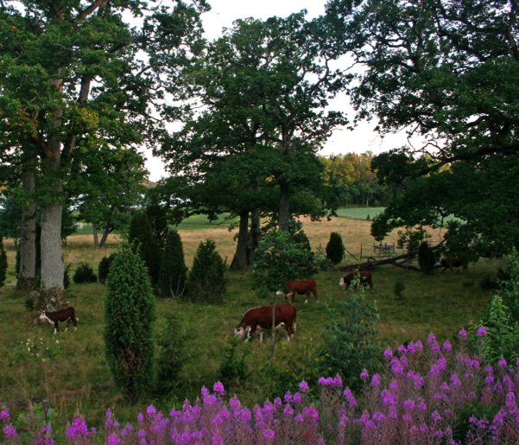
Other values
Cultural value: Often considered the most beautiful part of the Finnish countryside.
Direct sales of “meadow meat” is important for marketing and farm image of some farmers.
Coastal grazing prevents nutrient inflow and removes nutrients.
by Eija Hagelberg CC BY-NC-SA
T. Birge CC BY–NC-SA
Notes:
Direct sales of “meadow meat” is important for marketing and farm image of some farmers (SOURCE: Birge, T. & Herzon, I. 2014. Farmer and landowner motivations and experiences in managing rare semi-natural biotopes: A case from Finland. Land Use Policy 41:128–137. https://doi.org/10.1016/j.landusepol.2014.05.004). However, the certification with such a label is not used in Finland, unlike in Sweden.
Coastal grazing prevents nutrient flow to waterways. Grazing of reedbeds also removes nutrients from the waterways .
Photo: Hereford cattle in Lenholm, SW Finland. Copyright Eija Hagelberg CC BY–NC-SA Attribution-NonCommercial-ShareAlike "This license lets others remix, tweak, and build upon your work non-commercially, as long as they credit you and license their new creations under the identical terms" https://creativecommons.org/licenses/by-nc-sa/3.0/

Slide 20
Sources & experts
Heliölä, J. & Herzon, I. 2012. Finland. In: Oppermann, R., Beaufoy, G., Jones, G. (Eds) 2012. High Nature Value Farming in Europe: 35 European countries – experiences and perspectives. c. Verlag gegionalkultur, Germany. 544pp. ISBN: 978-89735-657-3
Heliölä, J., Lehtomäki, J., Kuussaari, M., Tiainen, J., et al. 2009. High Nature Value farmland in Finland – definition, monitoring and economic conditions for management. Publications of the Ministry of Agriculture and Forestry 1/2009. Vammalan Kirjapaino Oy, Sastamala. (in Finnish with English summary)

Slide 21
Sources & experts
SW Finland Cultural Landscapes Association http://perinnemaisemat.fi/in-english/
Doctoral dissertations of Raatikainen, K. (2018) and Birge, T. (2017): https://jyx.jyu.fi/handle/123456789/56692 and http://urn.fi/URN:ISBN:1798-744X
Birge, T. 2018. Could results-based payments help Finland’s most endangered farmlands? http://www.arc2020.eu/could-results-based-payments-help-finlands-most-endangered-farmlands/
Experts:
Irina Herzon, University of Helsinki; Kaisa Raatikainen, University of Turku

Slide 22
Outside Europe
Notes:
Though the concept of HNV farmland is used only in the European context, such types of production landscapes with high nature values are found throughout the world.

Slide 23
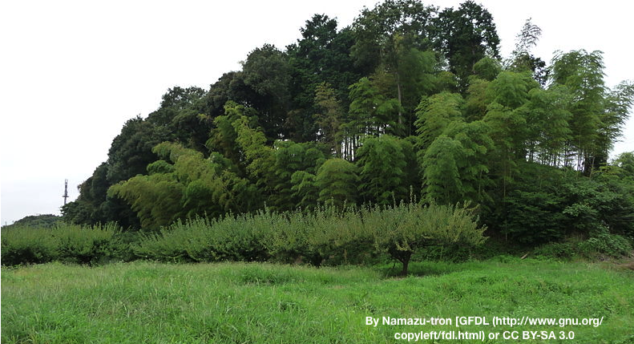
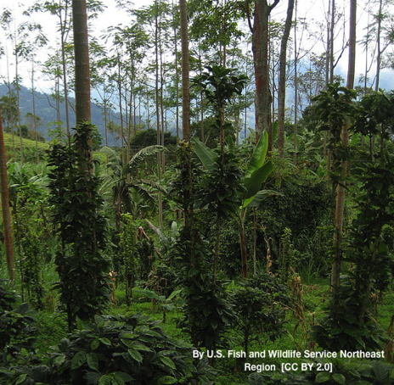

HNV farming outside of Europe
Shade grown coffee, Columbia
Satoyama, Japan
A European concept, but not exclusive to Europe!
http://www.fao.org/giahs/en/
Notes:
They comes under various local names, such as muyong in the Philippines and chitemene in Malawi. In Japan, such landscapes are termed satoyama, a combination of two words which denote mountains, woodlands and grasslands (yama) and surrounding villages (sato).
FAO has a database listing designated Globally Important Agricultural Heritage Systems (http://www.fao.org/giahs/en/ ). Many HNV-systems still in use today all over the world are described here.
In the next few slides, we present some examples of HNV farming systems found in different parts of the world.
Columbia photo: By U.S. Fish and Wildlife Service Northeast Region (Flickr: Coffee farm in Colombia) [CC BY 2.0 (https://creativecommons.org/licenses/by/2.0)], via Wikimedia Commons https://upload.wikimedia.org/wikipedia/commons/5/5d/Coffee_farm_in_Colombia.jpg
Japan photo: By Namazu-tron [GFDL (http://www.gnu.org/copyleft/fdl.html) or CC BY-SA 3.0 (https://creativecommons.org/licenses/by-sa/3.0)], from Wikimedia Commons https://upload.wikimedia.org/wikipedia/commons/d/df/Satoyama%2C_utilize_plant_layer.jpg

Slide 24
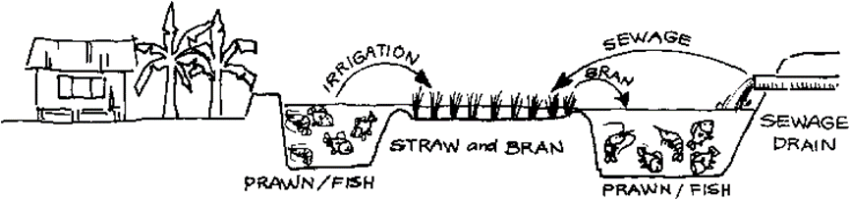
China: Rice-Fish System
Listed as Globally Important Agriculture Heritage System by FAO and UNESCO;
average reduction of 30000 ha annual since 2002
https://www.youtube.com/watch?v=2vhpsM5uriM
Notes:
“In Asia fish farming in wet rice fields has a long history. A Chinese clay plate dating to the Han Dynasty 2000 years ago shows a fish swimming from its pond into a rice field.
Ecological symbiosis exists in the traditional rice-fish agricultural system: fish provides fertilizer to rice, regulates micro-climatic conditions, softens the soil, disturbs the water, and eats larvae and weeds in the flooded fields; rice provides shade and food for fish.
Furthermore, multiple products and ecological services from the co-ecosystems are beneficial to local farmers and the environment. The high quality food of fish and rice are helpful to maintain farmers’ nutrient and living standard: the reduced cost and labor increases the productive efficiency, and, especially by reducing the use of chemical fertilizers, pesticides and herbicides for insect and weed control, helps in agro-biological conservation and field environmental protection. The rice-fish system in Longxian village of Zhejiang province demonstrates an ingenious approach to generating ecological, economic and social benefits through encouraging essential ecological functions.”
(SOURCE: FAO Globally Important Agriculture Heritage System: Rice-fish culture http://www.fao.org/giahs/giahsaroundtheworld/designated-sites/asia-and-the-pacific/rice-fish-culture/en/)
RESOURCES
FAO Globally Important Agriculture Heritage System: Rice-fish culture http://www.fao.org/giahs/giahsaroundtheworld/designated-sites/asia-and-the-pacific/rice-fish-culture/en/
FAO. Growing rice and fish together https://www.youtube.com/watch?v=2vhpsM5uriM
Video description: An ancient Chinese farming system has been designated a Globally Important Agricultural Heritage System (GIAHS) by FAO, making Qingtian County and Longxian village famous for something other than emigration. The entire village is benefitting from the conservation of its agricultural heritage and has become a popular destination for tourists coming from the cities of Wenzhou and Shanghai. FAO's Director-General, José Graziano da Silva, visited the site in June 2016.
Li Kang min. 1986. A review of rice-fish culture in China http://www.fao.org/docrep/field/003/ac221e/ac221e00.htm
Mackay, K.T. (ed.) 1995. Rice-Fish farming in China https://www.idrc.ca/sites/default/files/openebooks/313-5/index.html

Slide 25
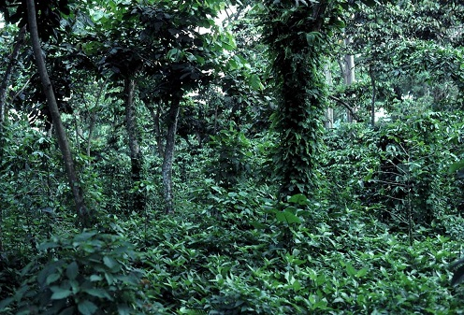
Latin America & Africa:
Shade-grown coffee
Agroforestry with coffee, fruit and timber trees
Many ecological benefits over sun-grown production:
high species diversity, including pollinators and migratory birds
soil protection, water retention, carbon storage
"Bird Friendly coffee” - most stringent coffee production standards.
By John Blake. Public Domain, ttps://commons.wikimedia.org/w/index.php?curid=34486787
Declining system
One of the most biodiverse tropical cash crop systems
Notes:
One of the most biodiverse tropical cash crop systems, when grown as an agroforestry systems, as opposed to more recent sun-grown systems of pure coffee plants. It is one of the most researched tropical systems in terms of biodiversity support, pollination and other ecological functioning. Ecological benefits are summarised in https://nationalzoo.si.edu/scbi/migratorybirds/coffee/bird_friendly/ecological-benefits-of-shade-grown-coffee.cfm
Other recent studies:
Bhagwat, S. A., Willis, K. J., Birks, H. J. B. & Whittaker, R. J. 2008. Agroforestry: A Refuge for Tropical Biodiversity? Trends Ecol. Evol. 23, 261–67 .
Perfecto, I., A. Mas, T. Dietsch, and J. Vandermeer. 2003. Conservation of biodiversity in coffee agroecosystems: a tri-taxa comparison in southern Mexico. Biodiversity and Conservation 12:1239-1252.
Shade grown coffee has declined precipitously in the past twenty years, largely due to greater production of robusta variety, more tolerant of sun growing, particularly in Asia (Jha, S. et al. 2014. Shade Coffee: Update on a Disappearing Refuge for Biodiversity. BioScience 64, 416–28).
Similar shade-grown agroforestry systems exist for growing cocoa and vanilla plants in Madagascar.
RESOURCES:
Foundjem-Tita, D., Donovan, J., Stoian, D., Degrande, A. 2016. Baseline for Assessing the Impact of Fairtrade Certification on Cocoa Farmers and Cooperatives in Ghana. World Agroforestry Centre.
https://www.fairtrade.net/fileadmin/user_upload/content/2009/resources/1704_ICRAF_Ghana_cocoa_baseline-final.pdf
Rice, R.A. and Greenberg, R., 2000. Cacao cultivation and the conservation of biological diversity. AMBIO: A Journal of the Human Environment 29 (3): 167-173.
Richard, A. & Ræbild, A. 2016. Tree diversity and canopy cover in cocoa systems in Ghana. New Forests 47(2): 287–302
https://link.springer.com/article/10.1007/s11056-015-9515-3
Ruf, F.O. 2011. The Myth of Complex Cocoa Agroforests: The Case of Ghana. Human Ecology 39(3): 373–388. https://www.ncbi.nlm.nih.gov/pmc/articles/PMC3109247/
Stoian, D. 2017, 19 July. Moving towards a sustainable cocoa sector in Ghana. Biodiversity International.
https://www.bioversityinternational.org/news/detail/moving-towards-a-sustainable-cocoa-sector-in-ghana/

Slide 26
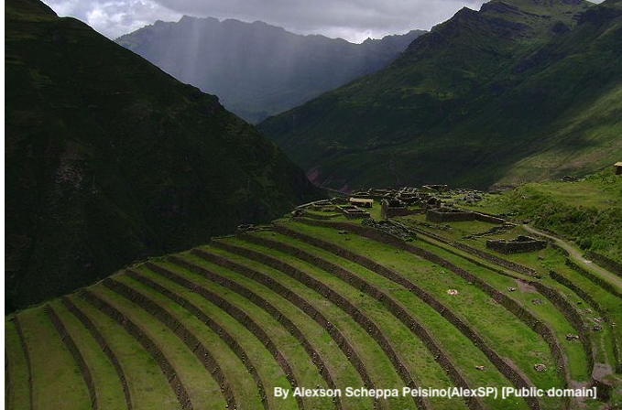
South America:
Andean terrace farming
Spanish for “platform”, Andenes refers to pre-Columbian terraces that enable crop cultivation at high altitudes on steep slopes.
Highly engineered with fertile soil, sophisticated water management, warmth from stone walls.
High cultural & aesthetic value.
Highly adapted for local resources.
Notes:
The Andes is a challenging environment for agriculture particularly due to shallow soils and low water availability on steep slopes (Fonte et al. 2012). Andenes are an ancient technological response to these challenges.
An anden is a step terrace in the Andes region of South America. They were already being built by at least 2000 BCE, and some have been in use for 500 years or more. The andenes are about 3 m. wide. They are complicated engineering structures dug into the mountain or hillside. They have retaining walls of stone, foundations for stability, and systems for managing water (movement, retention, and drainage). The engineering creates a microclimate enabling crop production in extreme conditions. For example, they dramatically extend the elevation at which maize can be grown. https://en.wikipedia.org/wiki/And%C3%A9n,
Andean farming systems are designated by FAO as a Globally Important Agricultural Heritage Systems and are famous for being sustainable for soils and earth (FAO no date). Mountain farmlands are remote, and farmers tend to be resource poor which limits use of external agri-chemical inputs (Fonte, et al. 2012). Low level of external inputs is supportive of associated natural values. Management of the terraces supports genetic value related to native seeds (see video), including and especially to native and wild potato, of which many are in danger of extinction (Taboada& Dolorier 2004). Andenes are an example of maintaining the ancient traditional agricultural technologies and knowledge. High pressure from the youth leaving to the forest or the towns has lead to a severe loss of knowledge and biodiversity (see video; FAO no date). However, several institutions in the Andes work to restore abandoned terraces and build new ones (Altieri & Nicholls 2008). Reclaiming of andenes is considered one of the ways to sustainably increase agricultural production in the Andes and to increase resilience to climate change (Graber 2011). The main challenges to terrace farming in the Andes nowadays are the high labour input needed, as well as a loss of traditional knowledge.
EXAMPLE country situation: “Peru has approximately one million hectares of agricultural terraces called andenes on highland mountain slopes, a tradition of the Andean culture which, in the past, enabled Peruvians to expand their agricultural frontier and use land in a sustainable manner. Today, barely 20% of these andenes are being used properly, the rest are deteriorated due to inappropriate farming practices”. (SOURCE: Biodiversity in Peru, national report for CBD. 1997 https://www.cbd.int/doc/world/pe/pe-nr-01-en.pdf )
RESOURCES
Altieri, M. A. & Nicholls, C.A. 2008. Scaling up Agroecological Approaches for Food Sovereignty in Latin America. Development Supplement: The Future of Agriculture 51:472-480.
Alvarado, F. Siura, S., & Manrique, A. (2017) Peru: agroecological movement history 1980–2015, Agroecology and Sustainable Food Systems, 41:3-4, 366-379. https://doi-org.libproxy.helsinki.fi/10.1080/21683565.2017.1287148
Beltran, R. Blogspot with collection of resources https://lahoradelachalina.blogspot.com/2014/11/presented-to-cop20-andenes-or-inca.html?view=mosaic
FAO (no date). Globally Important Agriculture Heritage System: Andean agriculture http://www.fao.org/giahs/giahsaroundtheworld/designated-sites/latin-america-and-the-caribbean/andean-agriculture/en/
Fonte, S.J., Vanek, S.J., Oyarzun, P. Parsa, S., Quintero, D. C. Rao, I.M., Lavelle, P. 2012. Chapter 4. Pathways to agroecological intensification of soil fertility management by smallholder farmers in the Andean highlands. Advances in Agronomy 116: 125-184.
Graber, C. 2011. Farming Like the Incas https://www.smithsonianmag.com/history/farming-like-the-incas-70263217/
Dunlap, A.S. Video (4:58 min) with Dr. Ann Kendall (founder of Cusichaca Trust) on Cusichaca in Peru https://vimeo.com/53141717
In Spanish
Llerena, C.A., Inbar, M. Benavides, M.A. (Eds.) 2004. Conservación Y Abandono De Andenes
http://www.lamolina.edu.pe/facultad/forestales/web2007/PublicacionesYRevistas/pdf/contenido.pdf
Taboada, L. & Dolorier, R. 2004. Caracterización de andenes en Experiencia de campo en el río santa eulalia p. 158-166 In: Llerena, C.A., Inbar, M. Benavides, M.A. (Eds.) 2004. Conservación Y Abandono De Andenes
http://www.lamolina.edu.pe/facultad/forestales/web2007/PublicacionesYRevistas/pdf/contenido.pdf
Photo: https://upload.wikimedia.org/wikipedia/commons/7/71/Pisac006.jpg By Alexson Scheppa Peisino(AlexSP) [Public domain], from Wikimedia Commons

Slide 27
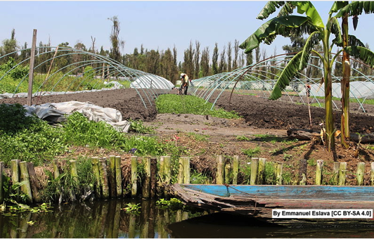
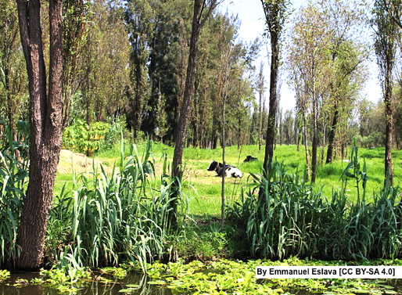
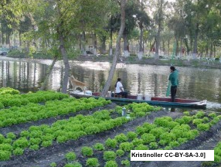
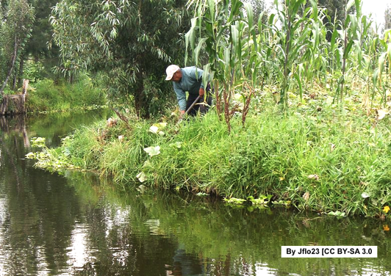
South America: Chinampa island gardens
Constructed floating islands of high agricultural productivity.
Native willows, an integral part, provide important habitat for birds.
Diverse agricultural production.
Notes:
Chinampa island garden agricultural system is a historical Mesoamerican farming system based on creation of small, fertile artificial island plots. The chinampas are created by weaving reeds with stakes (visible in the top right-hand photo) to create underwater fences. Rock, soil and plant material is piled on top until the island forms above the surface of the water. The system has agroforesty elements. Still today, they are built in a traditional way, surrounded by canals and ditches and rows of native willows. Some of the chinampas are mobile islands. Beyond food production, they also provide other services. In the Xochimilco Lake area, they provide multifunctional activities complementary to the urban dynamics of Mexico City, for example they recycle nutrients, help control flooding, and their microclimates of greater vegetation positively affect the humidity of the region and reduce wind erosion. They are an example of sustainable farming that can be particularly compatible with urban development and revitalization of heritage. Chinampas are designated by FAO as a Globally Important Agricultural Heritage System. (SOURCES: FAO; Onofre 2005)
In the photographs, you can see the diverse agricultural production practiced on the chinampas, including greenhouse, and vegetable production, mixed maize-based cropping, and cattle grazing. floriculture is also practiced on the chinampas (Onofre 2005).
RESOURCES
FAO. Chinampa Agriculture in the World Natural and Cultural Heritage Zone in Xochimilco, Tláhuac and Milpa Alta.
http://www.fao.org/giahs/giahsaroundtheworld/designated-sites/latin-america-and-the-caribbean/chinampa-agriculture-in-the-world-natural-and-cultural-heritage-zone-in-xochimilco-tlahuac-and-milpa-alta/en/
Onofre, S.A. 2005. The floating gardens in Mexico Xochimilco, world heritage risk site. City & Time 1 (3): 5. [online] URL:
http://www.ct.ceci-br.org
Also
https://www.smithsonianmag.com/travel/mexicos-floating-gardens-return-their-agricultural-roots-180961899/
https://sidewalksprouts.wordpress.com/history/international-history-of-urban-ag/tenochtitlan/
https://www.upworthy.com/chinampas
Videos: “Modern-day Chinampas "Floating Gardens" - Ancient Mesoamerican Agriculture Re-conceived” https://www.youtube.com/watch?v=zANQy_gjC0I
Fighting to Keep Mexico’s Floating Farms Alive https://www.youtube.com/watch?v=HJiTRh4EeTs
Videos in Spanish
https://www.youtube.com/watch?v=QbApUUEubKA; https://www.youtube.com/watch?v=tV5O595amPg; https://www.youtube.com/watch?v=FEiapcmbRhU
Photos:
Cow on a chinampa. By Emmanuel Eslava [CC BY-SA 4.0 (https://creativecommons.org/licenses/by-sa/4.0 )], from Wikimedia Commons https://upload.wikimedia.org/wikipedia/commons/a/a2/Vaca_en_chinampa.JPG
Vegetable farming on Camas chinampa. By The original uploader was Kristinoller at English Wikipedia. (Transferred from en.wikipedia to Commons.) [GFDL (http://www.gnu.org/copyleft/fdl.html ) or CC-BY-SA-3.0 (http://creativecommons.org/licenses/by-sa/3.0/ )], via Wikimedia Commons https://upload.wikimedia.org/wikipedia/commons/7/7e/Camas_chinampas.jpg
Greenhouse production on chinampa. By Emmanuel Eslava [CC BY-SA 4.0 (https://creativecommons.org/licenses/by-sa/4.0 )], from Wikimedia Commons https://upload.wikimedia.org/wikipedia/commons/8/88/Sembrad%C3%ADo_en_chinampa.JPG
Man working one of the remaining chinampas in Xochimilco. By Jflo23 [CC BY-SA 3.0 (https://creativecommons.org/licenses/by-sa/3.0 ) or GFDL (http://www.gnu.org/copyleft/fdl.html )], from Wikimedia Commons https://upload.wikimedia.org/wikipedia/commons/d/dd/Chinampa.JPG

Slide 28
High Nature Value Farming: Learning, Innovation and Knowledge HNV-Link
Disclaimer: This presentation reflects the author's view and the Research Executive Agency is not responsible for any use that may be made of the information it contains.
Working together for a sustainable future
www.hnvlink.eu

